Slide 1
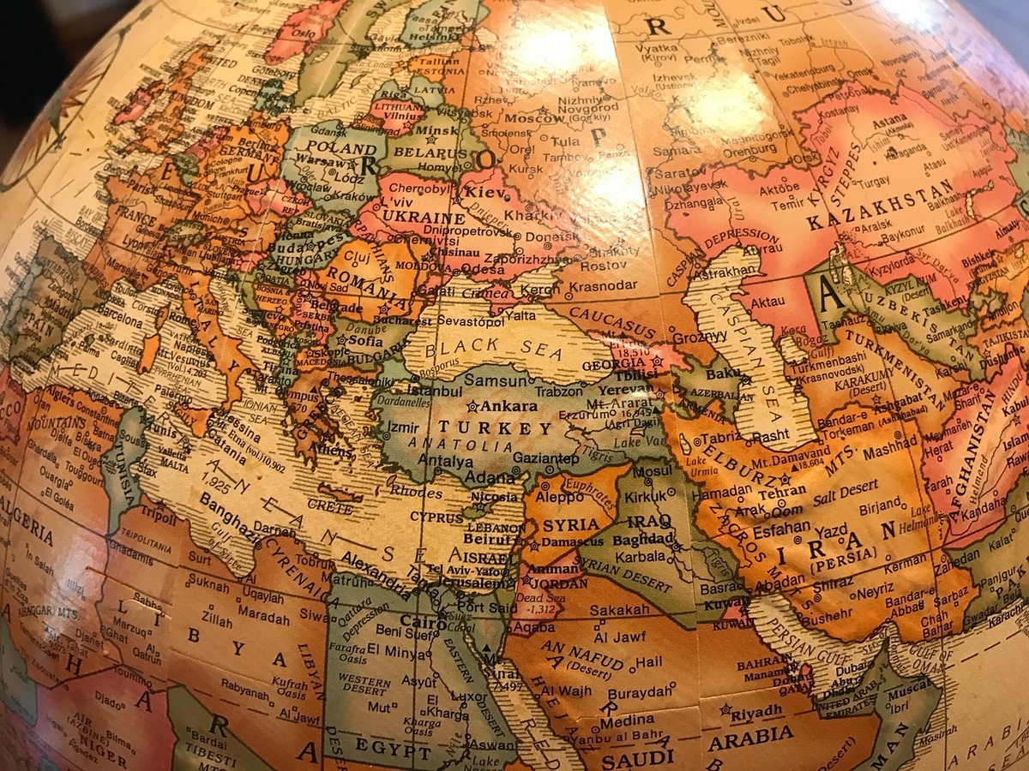
Bless the LORD O My Soul -Psalm 103
Part of Book 4’s (90-106) response to the questions of Psalm 89:46-49:
Where is God’s steadfast love?

Slide 2
Bless the LORD O My Soul - Psalm 103
Inviting Self to Worship [v1-5]
God’s blessings touched David’s inner man, emotions.
YHWH’s OT patterns have continued down to today. He forgives & heals, He rescues from the pit.
We must join David in Blessing the LORD!
Inviting Israel to Worship (v6-9)
Inviting Both of Us to Worship (v10-14)
Inviting ALL Humanity to Worship (v15-18)
Inviting Heavenly Hosts to Worship (v19-22)

Slide 3
Bless the LORD O My Soul - Psalm 103
Inviting Self to Worship (v1-5)
Inviting Israel to Worship [v6-9]
YHWH did righteous acts for Israel & revealed His ways. David reminds them of God’s Name & [Ex 34:5-9].
Our sin is not so bad that God holds a grudge against us.
Inviting Both of Us to Worship (v10-14)
Inviting ALL Humanity to Worship (v15-18)
Inviting Heavenly Hosts to Worship (v19-22)

Slide 4
Bless the LORD O My Soul - Psalm 103
Inviting Self to Worship (v1-5)
Inviting Israel to Worship (v6-9)
Inviting Both of Us to Worship [v10-14]
YHWH is more patient than ANY human has been. Note the distance He puts between us & our guilt. Why? He is a perfect Father, the model for The Prodigal.
He knows we are but dust. We aren’t perfect.
Inviting ALL Humanity to Worship (v15-18)
Inviting Heavenly Hosts to Worship (v19-22)

Slide 5
Bless the LORD O My Soul - Psalm 103
Inviting Self to Worship (v1-5)
Inviting Israel to Worship (v6-9)
Inviting Both of Us to Worship [v10-14]
Inviting ALL Humanity to Worship (v15-18)
The frailty of man is contrasted with God’s longevity. He is faithful to generations that revere & obey Him. Magnifying God’s grace should NEVER cause more sin.
Inviting Heavenly Hosts to Worship (v19-22)

Slide 6
Bless the LORD O My Soul - Psalm 103
Inviting Self to Worship (v1-5)
Inviting Israel to Worship (v6-9)
Inviting Both of Us to Worship [v10-14]
Inviting ALL Humanity to Worship (v15-18)
Inviting Heavenly Hosts to Worship (v19-22)
His Throne is surrounded by angels who also worship. Even they are described as obeying ministers. They should join in praising YHWH’s forgiveness.
This Psalm could be behind Jesus’ actions in Mark 2
Psalms of Forgiveness: One writer counted 37!
Mark them, read them, remember HOW God’s name. He is forgiveness. He declares us forgiven.
“If we don’t know God as He revealed himself, we’ll never properly understand our place in His world. We must never allow our own hangups & insecurities to blur God’s self-description of His love for us, …it is more vast than the cosmos!” -Tucker & Grant NIVAC p 490

Slide 7
Bless the LORD O My Soul - Psalm 103
Inviting Self to Worship (v1-5)
Inviting Israel to Worship (v6-9)
Inviting Both of Us to Worship [v10-14]
Inviting ALL Humanity to Worship (v15-18)
Inviting Heavenly Hosts to Worship (v19-22)
They should join in praising YHWH’s forgiveness.
Psalm 103 could be behind Jesus’ actions in Mark 2: Where He daringly forgave & healed the paralytic.
Psalms of Forgiveness: One writer counted 37!
Mark them, read them, remember HOW God’s name. He is forgiveness. He declares us forgiven.

