Slide 1
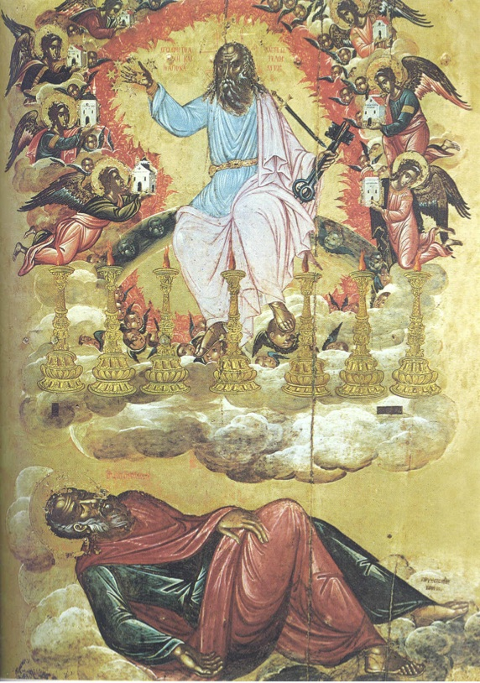
Worship In The Revelation
Rev 1:3 Blessed are those who obey.
These words are trustworthy. 22:6-7
Things in heaven MAY not always transfer to things on earth.

Slide 2
Worship In The Revelation
A) What Does It Say About Worship?
1) Worship For God (~10x): Twice in 19:10; 22:9
[4:8-11; 5:13-14] The swelling chorus at God’s Throne. The Great International Choir in 7:9-17. 11:6 Describes worship & measures the worshippers. 11:1 An angel commands worshipping The Creator in 14:6-7. Ch15 describes Throne Scene again. “Song of Moses 15:4.
One of my favorite hymns comes from [19:1-5].

Slide 3
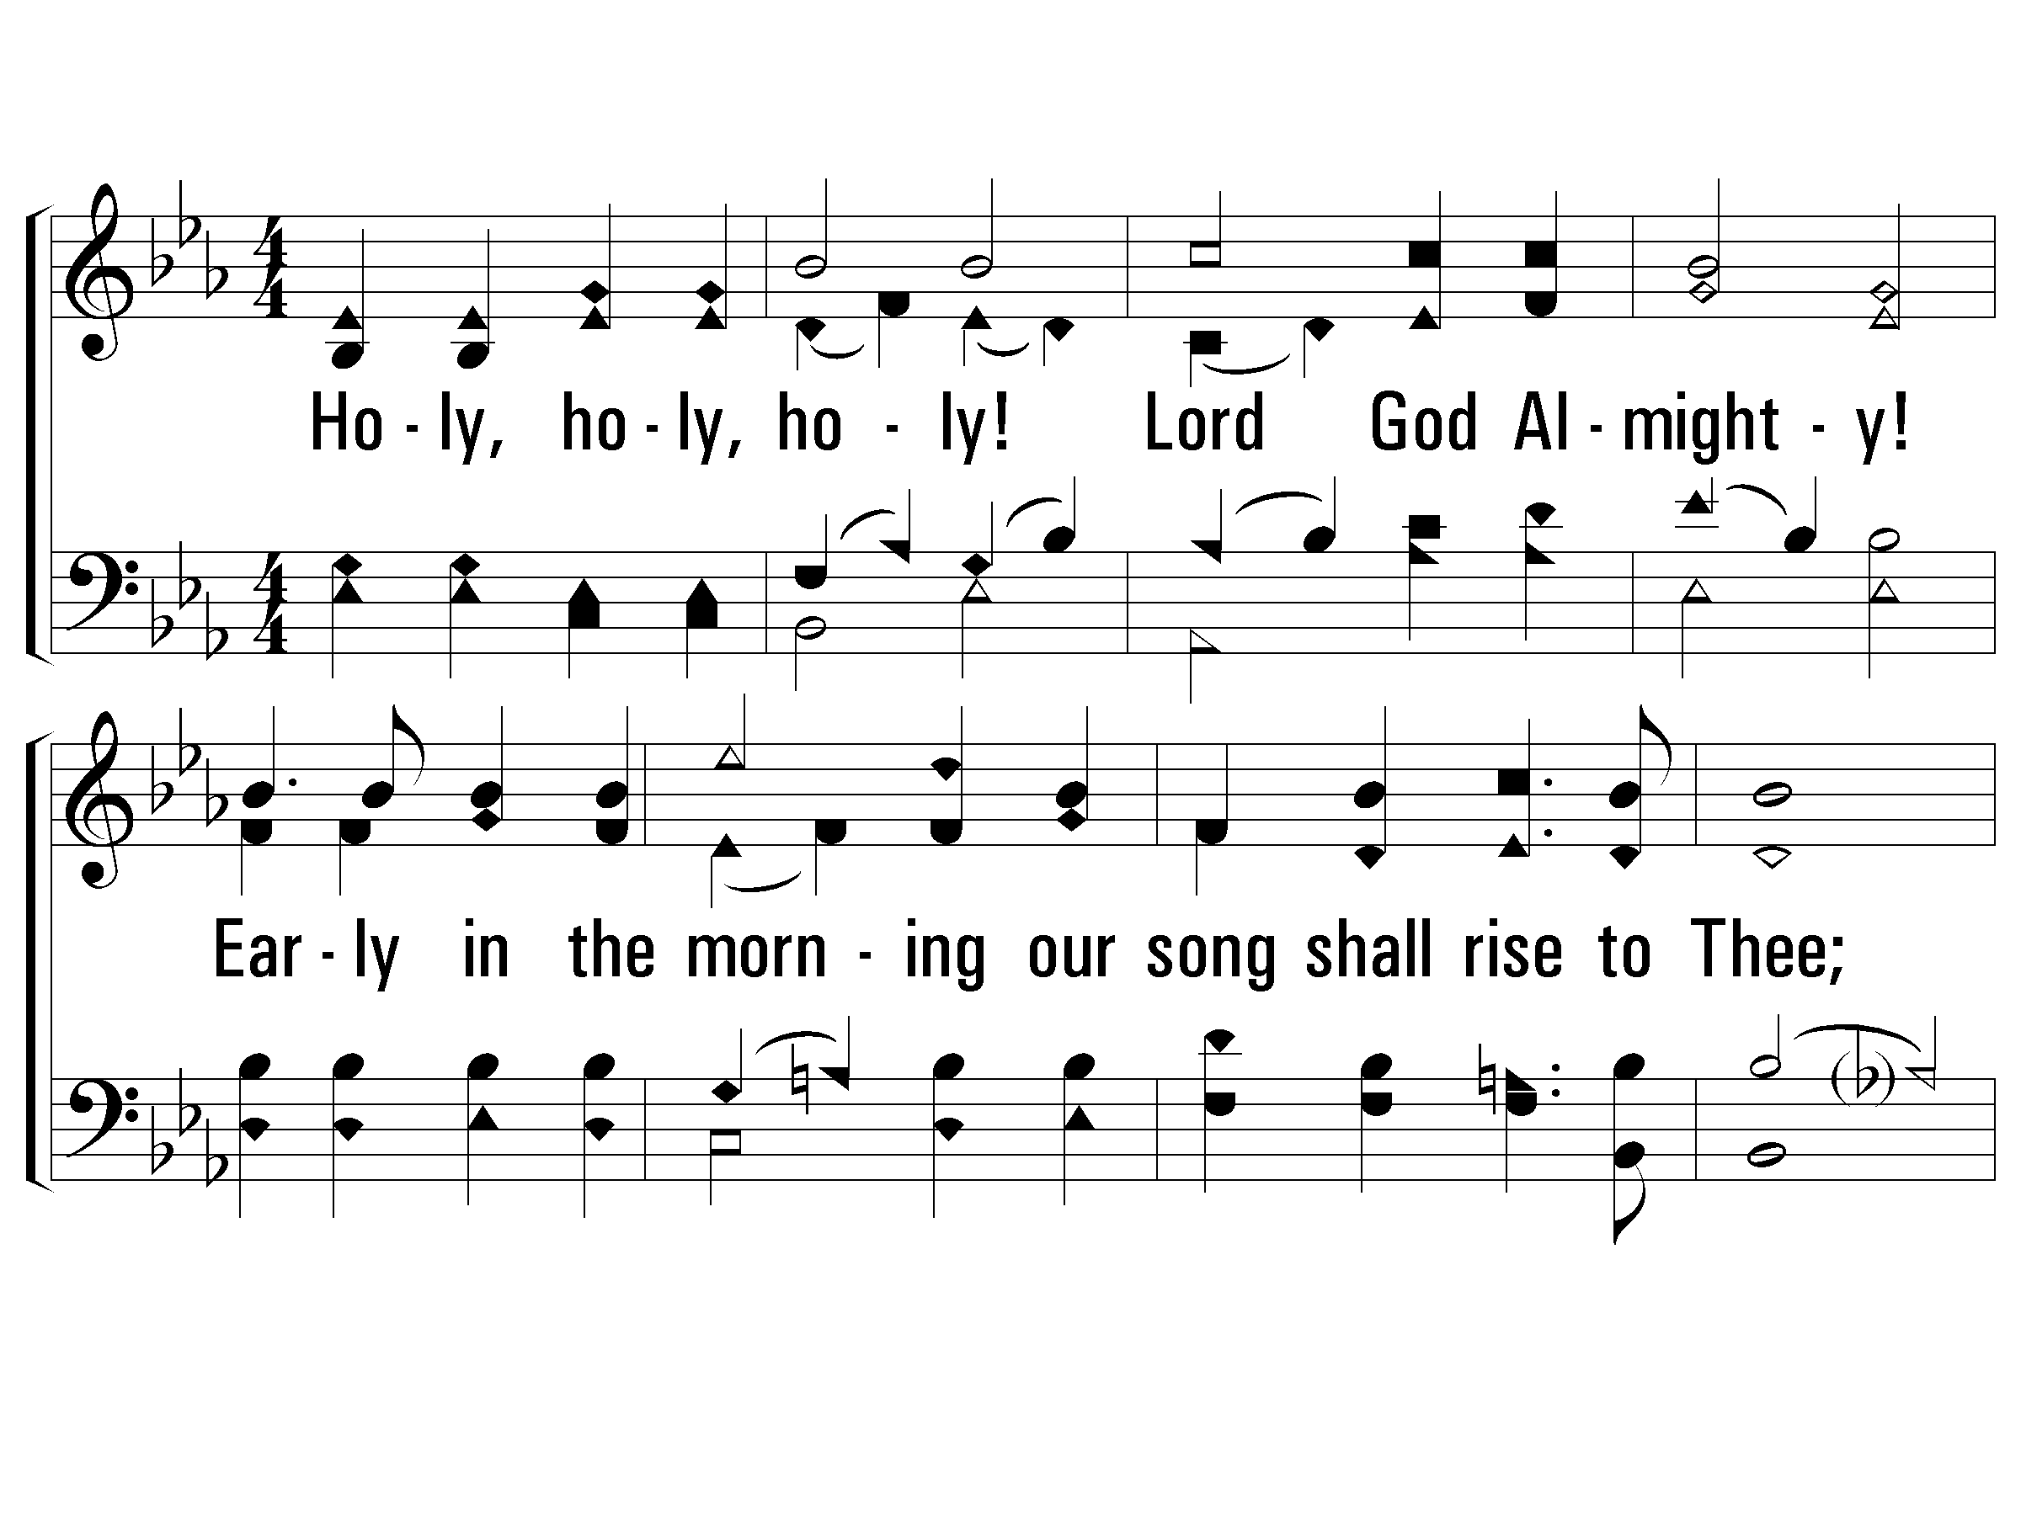
1 - Holy, Holy Holy!
v1 Women, v2 Men, v4 ALL
238
1.
Holy, holy, holy! Lord God Almighty!
Early in the morning our song shall rise to Thee;
Holy, holy, holy! merciful and mighty!
God over all, and blest eternally.
Words by: Reginald Heber
Music by: John B. Dykes
Praise Press

Slide 4
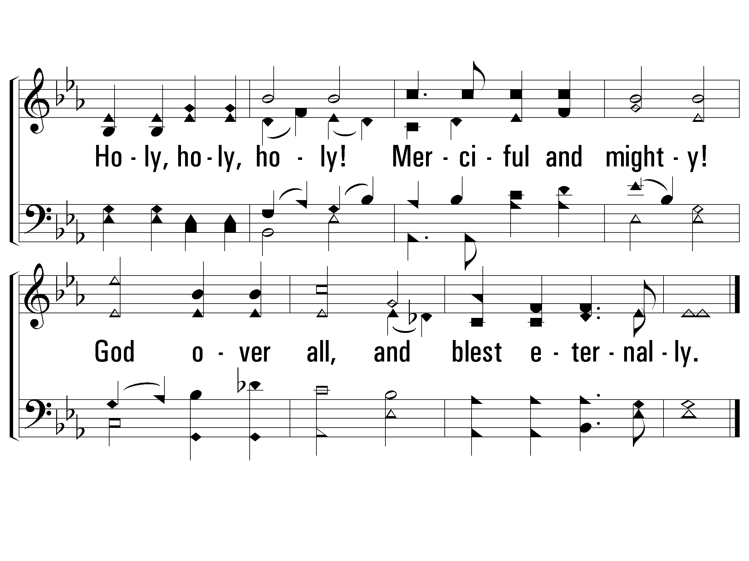
1 - Holy, Holy Holy!
v1 Women, v2 Men, v4 ALL
238
Praise Press

Slide 5
2 - Holy, Holy Holy!
v1 Women, v2 Men, v4 ALL
238
2.
Holy, holy, holy! all the saints adore Thee,
Casting down their golden crowns around the crystal sea;
Cherubim and seraphim falling down before Thee,
Who wast, and art, and evermore shalt be.
Words by: Reginald Heber
Music by: John B. Dykes
Praise Press

Slide 6
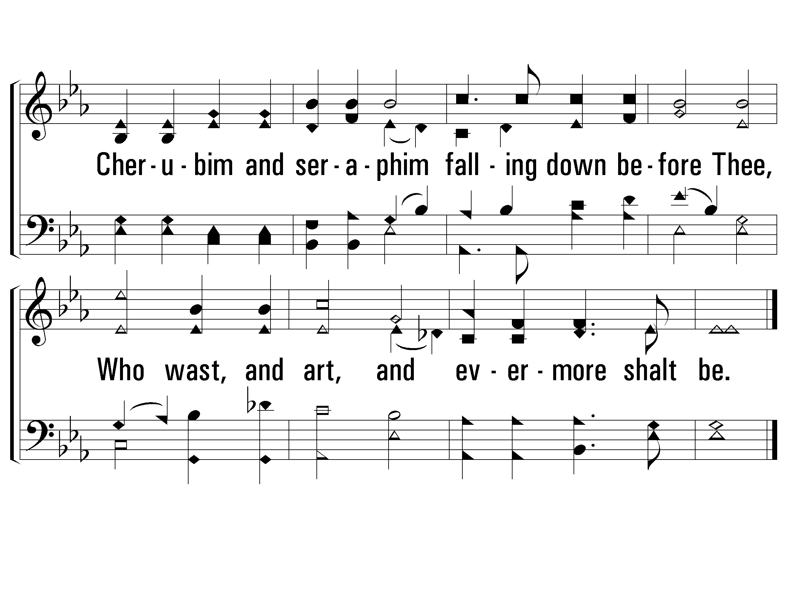
2 - Holy, Holy Holy!
v1 Women, v2 Men, v4 ALL
238
Praise Press

Slide 7
4 - Holy, Holy Holy!
v1 Women, v2 Men, v4 ALL
238
4.
Holy, holy, holy! Lord God A-mighty!
All Thy works shall praise Thy name, in earth, and sky, and sea;
Holy, holy, holy! merciful and mighty!
God over all, and blest eternally.
Words by: Reginald Heber
Music by: John B. Dykes
Praise Press

Slide 8
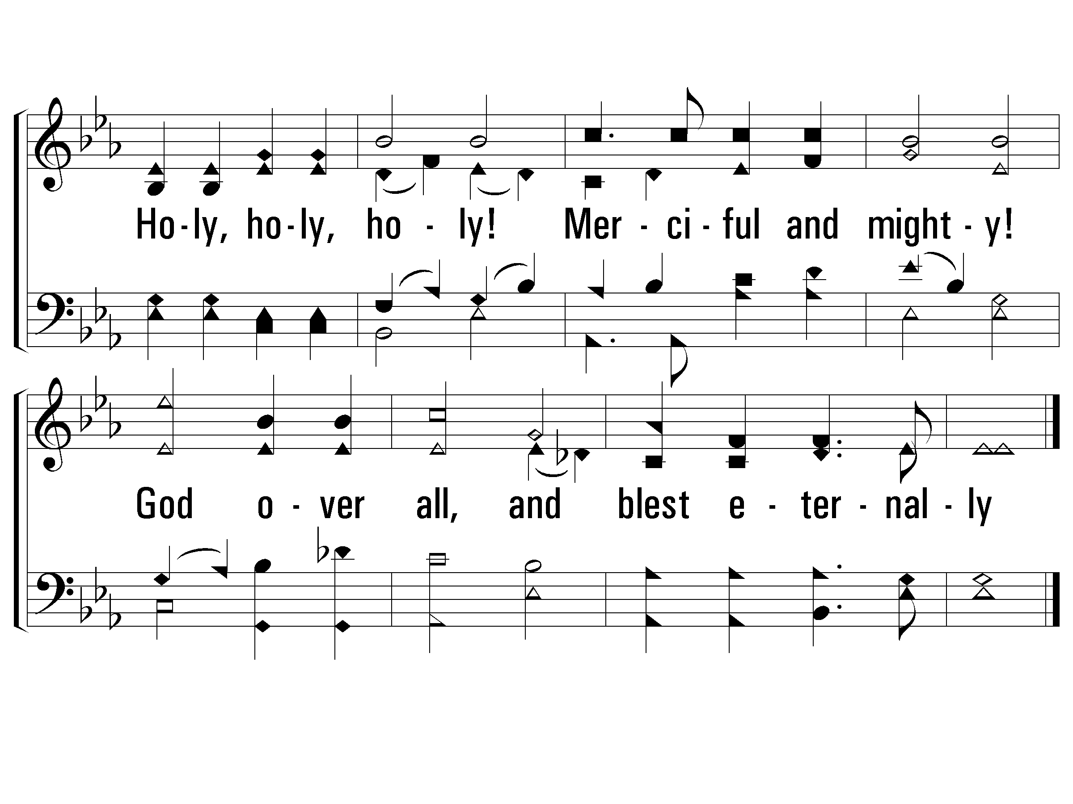
4 - Holy, Holy Holy!
v1 Women, v2 Men, v4 ALL
238
The End
Praise Press

Slide 9
Worship In The Revelation
A) What Does It Say About Worship?
1) Worship For God (~10x): Twice in 19:10; 22:9
[4:8-11; 5:13-14] The swelling chorus at God’s Throne. The Great International Choir in 7:9-17. 11:6 Describes worship & measures the worshippers. 11:1 An angel commands worshipping The Creator in 14:6-7. Ch15 describes Throne Scene again. “Song of Moses 15:4.
One of my favorite hymns comes from [19:1-5].

Slide 10
1-1 He Is Wonderful
He Is Wonderful
1. Alto 2. Add Soprano 3. Add Tenor 4. Add Bass 5. Remove Bass 6. Remove Tenor 7. Remove Soprano 8. Altos 9. ALL together.

Slide 11
2-1 He Is Wonderful
He Is Wonderful
1. Alto 2. Add Soprano 3. Add Tenor 4. Add Bass 5. Remove Bass 6. Remove Tenor 7. Remove Soprano 8. Altos 9. ALL together.

Slide 12
2-2 He Is Wonderful
He Is Wonderful
1. Alto 2. Add Soprano 3. Add Tenor 4. Add Bass 5. Remove Bass 6. Remove Tenor 7. Remove Soprano 8. Altos 9. ALL together.

Slide 13
3-1 He Is Wonderful
He Is Wonderful
1. Alto 2. Add Soprano 3. Add Tenor 4. Add Bass 5. Remove Bass 6. Remove Tenor 7. Remove Soprano 8. Altos 9. ALL together.

Slide 14
3-2 He Is Wonderful
1. Alto 2. Add Soprano 3. Add Tenor 4. Add Bass 5. Remove Bass 6. Remove Tenor 7. Remove Soprano 8. Altos 9. ALL together.

Slide 15
3-3 He Is Wonderful
1. Alto 2. Add Soprano 3. Add Tenor 4. Add Bass 5. Remove Bass 6. Remove Tenor 7. Remove Soprano 8. Altos 9. ALL together.

Slide 16
4-1 He Is Wonderful
He Is Wonderful
1. Alto 2. Add Soprano 3. Add Tenor 4. Add Bass 5. Remove Bass 6. Remove Tenor 7. Remove Soprano 8. Altos 9. ALL together.

Slide 17
4-2 He Is Wonderful
He Is Wonderful
1. Alto 2. Add Soprano 3. Add Tenor 4. Add Bass 5. Remove Bass 6. Remove Tenor 7. Remove Soprano 8. Altos 9. ALL together.

Slide 18
4-3 He Is Wonderful
He Is Wonderful
1. Alto 2. Add Soprano 3. Add Tenor 4. Add Bass 5. Remove Bass 6. Remove Tenor 7. Remove Soprano 8. Altos 9. ALL together.

Slide 19
3-1 He Is Wonderful
1. Alto 2. Add Soprano 3. Add Tenor 4. Add Bass 5. Remove Bass 6. Remove Tenor 7. Remove Soprano 8. Altos 9. ALL together.

Slide 20
3-2 He Is Wonderful
1. Alto 2. Add Soprano 3. Add Tenor 4. Add Bass 5. Remove Bass 6. Remove Tenor 7. Remove Soprano 8. Altos 9. ALL together.

Slide 21
3-3 He Is Wonderful
1. Alto 2. Add Soprano 3. Add Tenor 4. Add Bass 5. Remove Bass 6. Remove Tenor 7. Remove Soprano 8. Altos 9. ALL together.

Slide 22
2-1 He Is Wonderful
1. Alto 2. Add Soprano 3. Add Tenor 4. Add Bass 5. Remove Bass 6. Remove Tenor 7. Remove Soprano 8. Altos 9. ALL together.

Slide 23
2-2 He Is Wonderful
1. Alto 2. Add Soprano 3. Add Tenor 4. Add Bass 5. Remove Bass 6. Remove Tenor 7. Remove Soprano 8. Altos 9. ALL together.

Slide 24
1-1 He Is Wonderful
1. Alto 2. Add Soprano 3. Add Tenor 4. Add Bass 5. Remove Bass 6. Remove Tenor 7. Remove Soprano 8. Altos 9. ALL together.

Slide 25
4-1 He Is Wonderful
He Is Wonderful
1. Alto 2. Add Soprano 3. Add Tenor 4. Add Bass 5. Remove Bass 6. Remove Tenor 7. Remove Soprano 8. Altos 9. ALL together.

Slide 26
4-2 He Is Wonderful
He Is Wonderful
1. Alto 2. Add Soprano 3. Add Tenor 4. Add Bass 5. Remove Bass 6. Remove Tenor 7. Remove Soprano 8. Altos 9. ALL together.

Slide 27
4-3 He Is Wonderful
He Is Wonderful
1. Alto 2. Add Soprano 3. Add Tenor 4. Add Bass 5. Remove Bass 6. Remove Tenor 7. Remove Soprano 8. Altos 9. ALL together.
The End

Slide 28
Worship In The Revelation
“The pressing issue for John’s readers was how Christians, who gave their highest loyalty to Jesus, should conduct themselves in a world where economic & political structures assumed that everyone would worship the emperor.”
-J.N. Kraybill Apocalypse & Allegiance: Worship, Politics & Devotion in Revelation, p 15
A) What Does It Say About Worship?
2) Worshipping Counterfeits (False Gods) ~10x
Some evil & unrepentant won’t suffer. [9:20-21]
Awestruck, some worship The Beast! [13:1-10]
This is clearly condemned in [14:9-12].
They are judged/condemned in 16:2, 19:20.
Thus, Jesus didn’t hold back strong words [3:7-10]!

Slide 29
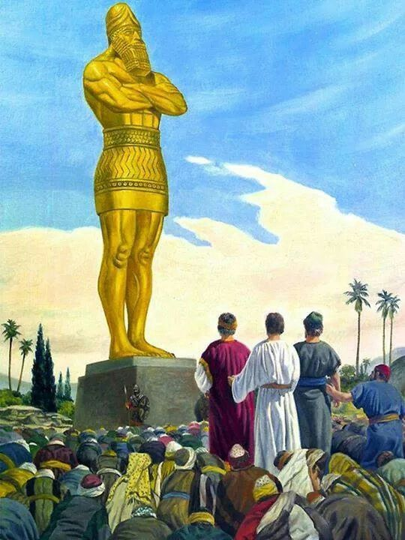
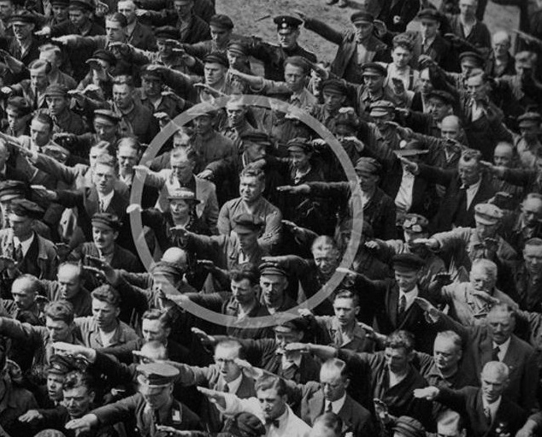
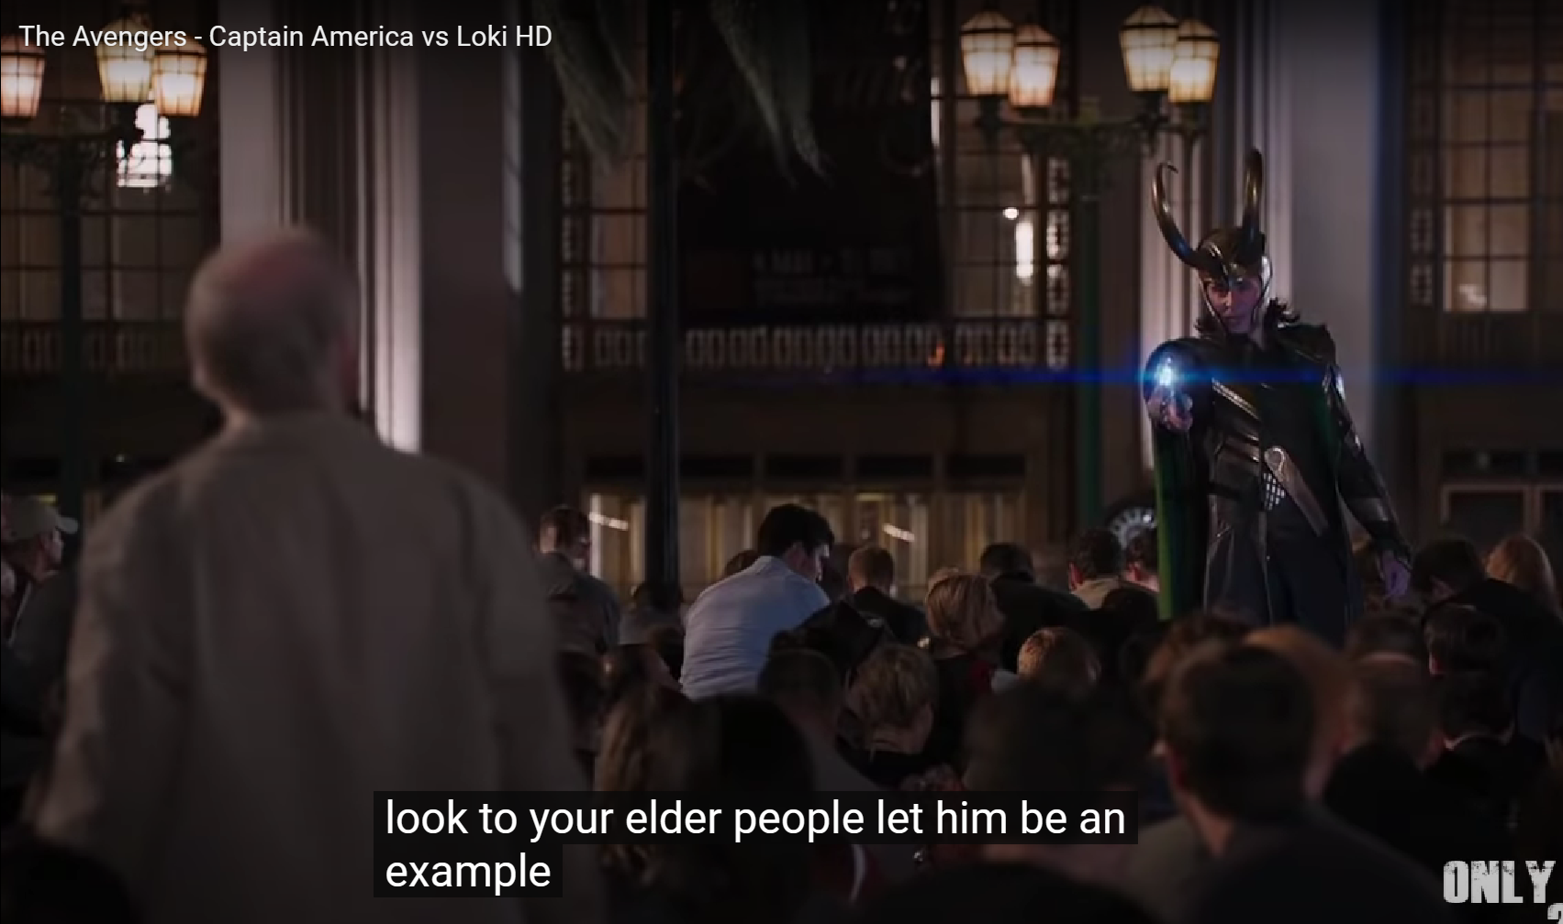
Worship In The Revelation
B) What is learned & how do we obey?
1) Heavenly worship includes ALL nations singing praise.
2) Even in heaven, a posture of humility matters.
3) Service is rightly connected to the concept of worship.
4) The Lamb is rightfully worthy of worship! [5:1-12]
5) Prayer powerfully triggers the reaction of God! [8:1-5]
6) Man is easily lured to worship man-made powers.
7) Worship MUST be paired with lives of humility & holiness.

Slide 30
Worship In The Revelation
C) A Word to “Shut-Ins” & Everyone…
“In the city of the redeemed, life will be very different from what we now experience. All earthly limitations will disappear: physical limitations of sickness & weakness; social hindrances with all the difficulties of human relationships; mental limitations that cause errors, mistakes, & misconceptions; &, of course, spiritual problems, the influence of sin—gone, forever. And we will see His face!” -A. Ross, Recalling the Hope of Glory, p 498
If the world seems dark & chaotic, cling to His vision of true worship!

