Slide 1
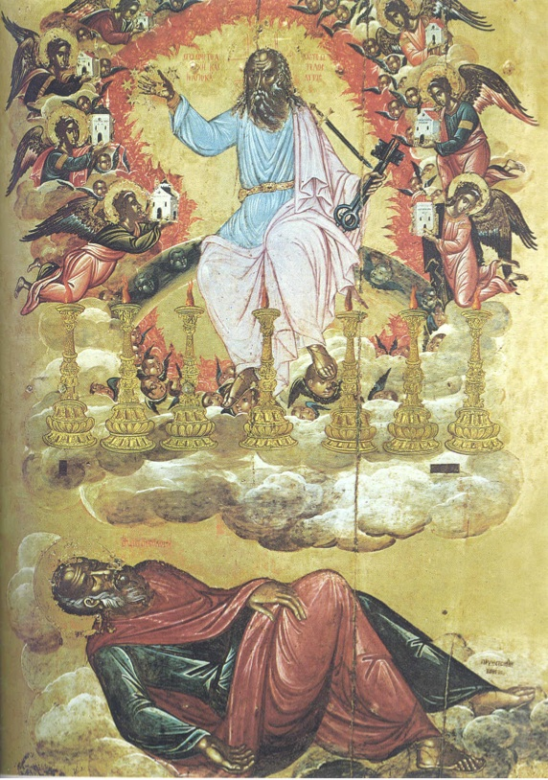
The 2 Witnesses of Rev 11
Rev 1:3 Blessed are those who obey.
These words are trustworthy. 22:6-7
John uses OT words/images and applies them to NT concepts.
Here: Ezk 40-48; Zech 2-4; Dan 7-9
God’s People=Holy Priesthood/Temple
“The most difficult passage to interpret in the entire book.”
-Keener, 287, NIVAC

Slide 2
The Sevens of Revelation
The 2 Witnesses are between:
The 6th & 7th Trumpet Judgments
And is the 2nd of 3 Woes. 8:3, 9:12
[4:5]
There will be lots of repetition…
Seven Seals
[8:5]
Seven Trumpets
[11:19]
Seven Bowls
[16:18]

Slide 3
The 2 Witnesses of Ch 11
“The difficulty of Revelation surfaces when so many views compete for attention.”
(Schriener, 375)
1) What happens in The 2 Witnesses?
It’s a Temple Scene: [11:1-2] So consider [21:22, 3:12].
Like John, they’re authorized to prophesy [Rev 11:3-4].
They’re further described with Zech 4 & [Rev 1:20].
Described in prophetic images [v5-6]. Moses/Elijah/Jeremiah
Their hard words lead to persecution. [11:7-10]
God resurrects them & brings them to heaven. [11:11-14]

Slide 4
The 2 Witnesses of Ch 11
Symbolic & Parallel Numbers:
3½ years=42 months=1260 days=“3x & ½time.”
1) What happens in The 2 Witnesses?
A Temple Scene of authorized prophesy Rev 10:10-11:4.
Wide array of prophetic images… ending in martyr victory.
Keep in mind: Be humble. Variety of approaches.
John’s use of symbolism elsewhere:
Why specific people? What about The Harlot?
Numbers are often parallel, contrasts are often present.

Slide 5
The 2 Witnesses of Ch 11
Who are the Witnesses: (1) OT & NT
(2) Law & Prophets (3) Peter & Paul (4) Christian Jews & Gentiles
(5) Out of 7 churches, 2 will be persecuted. (6) Figures t/o history
(7) Unknown early prophets (8) Enoch/Moses & Elijah
(9) Most common: symbolic for God’s church. But, how did it lay in the street for 3 days? Or what about prophecy? Not always prediction [19:10].

Slide 6
The 2 Witnesses of Ch 11
2) How Are The Witnesses A BLESSING?
It is GOOD to know that some Repent. Give glory to God!
Pray, we never know who or why they’ll turn.
It is GOOD to know God Rewards His saints. [11:15-18]
He sees the injustices & hears the slander.
It is GOOD to know God will Resurrect His people/prophets.
The world can kill the body, but it’ll NEVER kill the soul!

Slide 7
The 2 Witnesses of Ch 11
3) How Do We OBEY The Witnesses Story?
Join the Mighty Army of God, blow the trumpet warning.
Note the battle strategy: Victory by suffering. [12:11]
Are we proclaiming The Words of God?
Jer 5:14 Behold I am making My words in your mouth a fire, And this people wood, & the fire should consume them.
Our task: Speak the fire of God’s Word [Jer 23:23-32].

