Slide 1
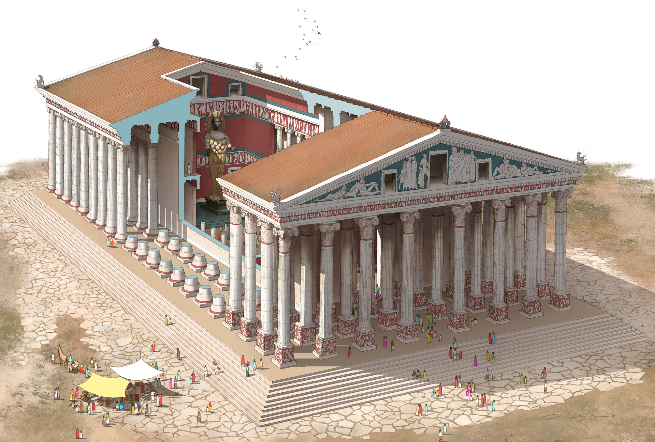
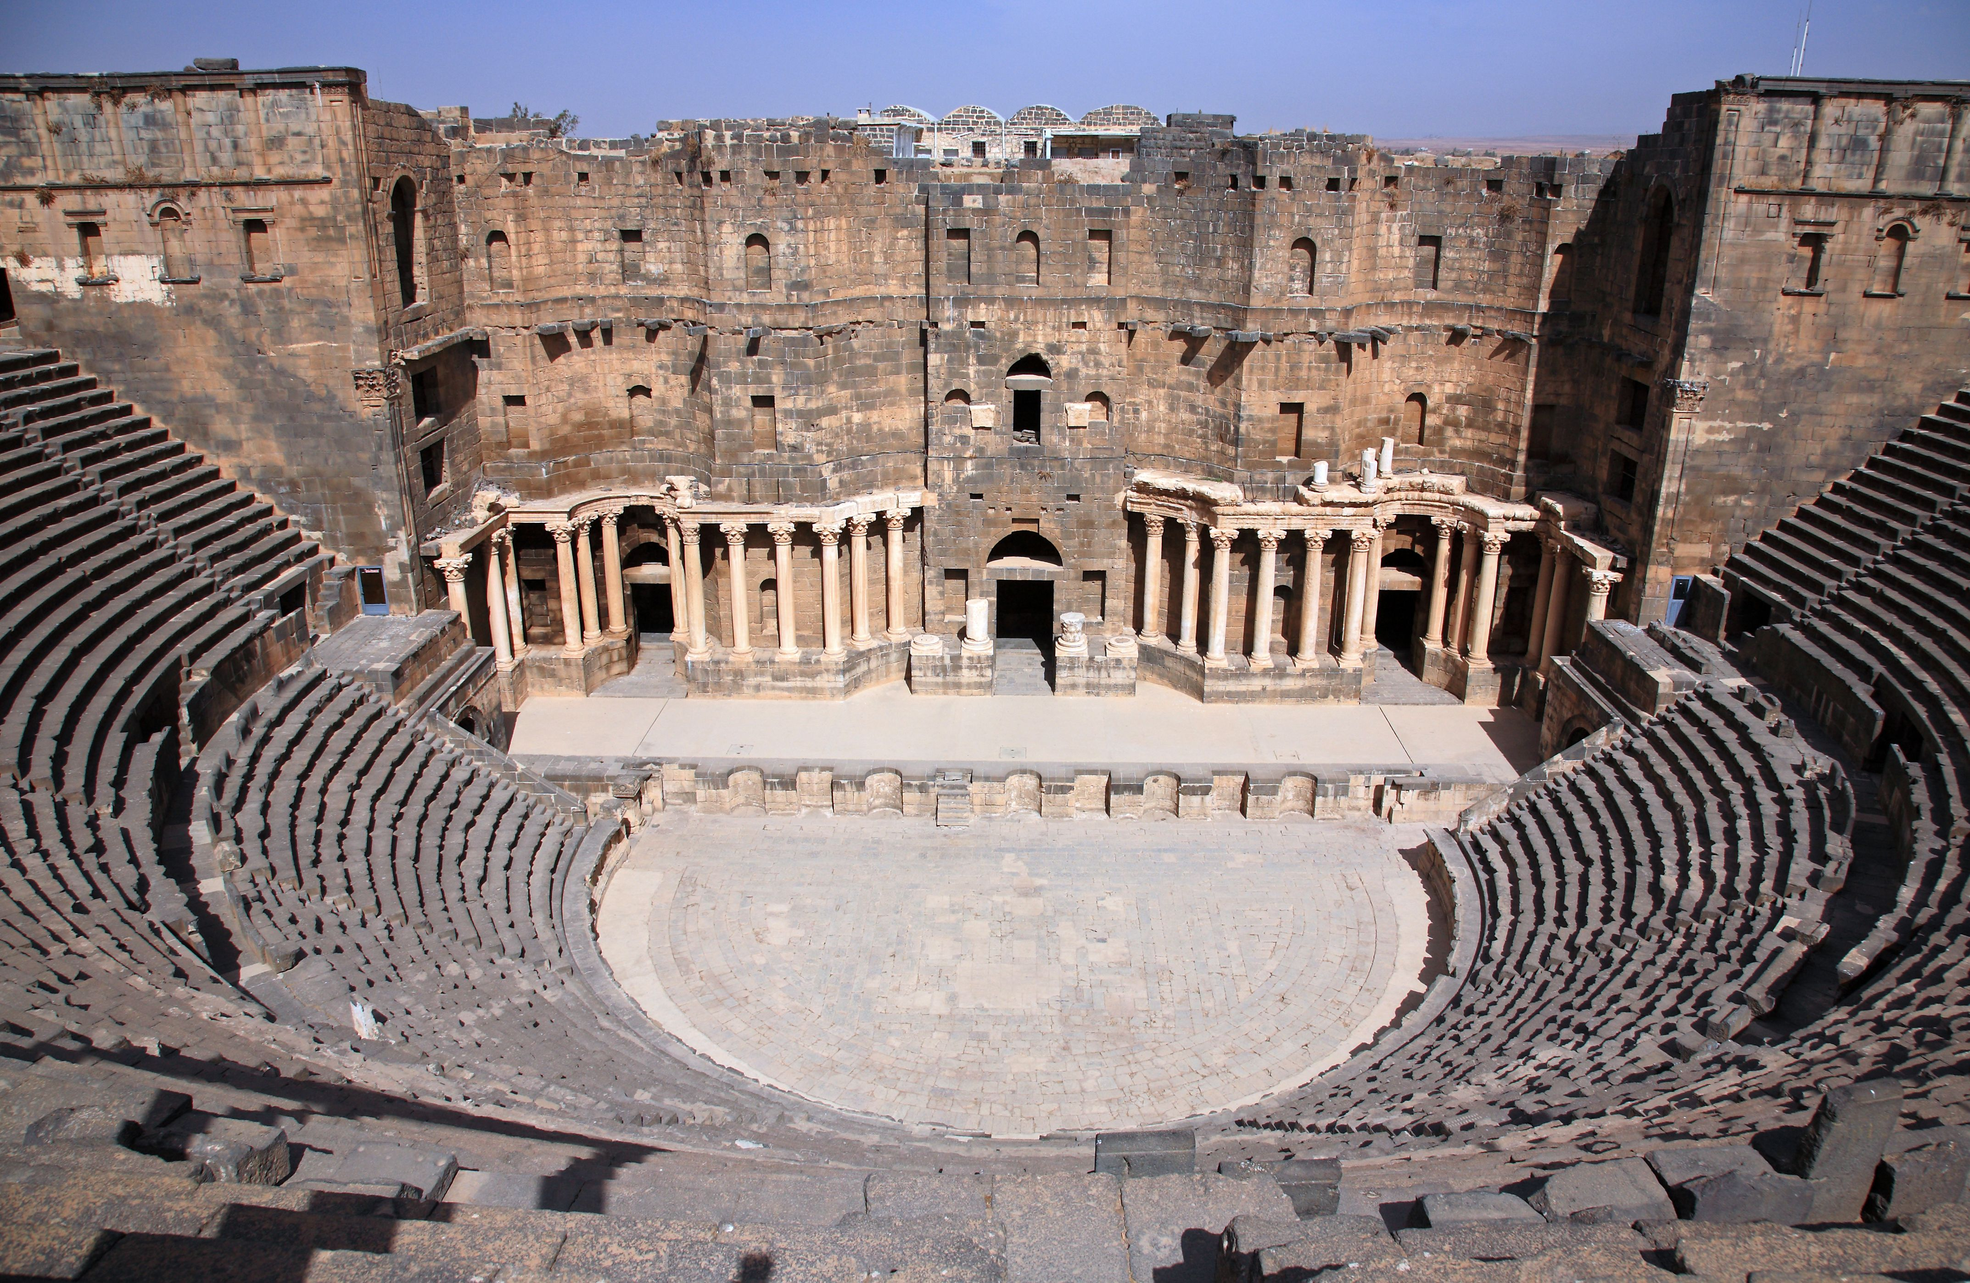
Acts 19:17-20
A Union riot in Ephesus
Acts 19:23-20:1
Union: An association formed by people with a common interest.

Slide 2
Christians & Political Powers
Maintain a biblical, faith-filled, outlook:
Government should never be our Faith. (Ezekiel 1-32) God’s Kingdom is Eternal. Recall [Matt 16:18]
Government should never be our Fear. (Prov, Psm, Job) The beginning of Wisdom=Fear God. [Matt 10:28]
Government can be our Friend. (Daniel 1:9, 6:14) Be prayerful for these moments [Neh 2:1-10]
Government can also be our Foe. (Daniel 6:4) Daniel’s virtue, punished. Nehemiah was opposed.
Political Parties
Political Parties
Political Parties
Political Parties

Slide 3
Christians & Political Powers
Don’t let government divide God’s people. By love & humility, bridge the divide.
Libertarians: ONLY Liberty
Democrats: ADD Care & Fairness
Republicans: ADD three more… Authority, Loyalty, Sanctity.
Different experiences, constant growth. Disciples CAN rise above the chaos!

Slide 4
Christians & Political Powers
Don’t let government divide God’s people. By love & humility, bridge the divide, pray.
Disciples of Christ CAN rise above the chaos!
Our citizenship is in heaven [Eph 2:11-22].
Instead of policies, convince people to join the Commonwealth of Christ Jesus!
[1 Timothy 2:1-6]

