Slide 1
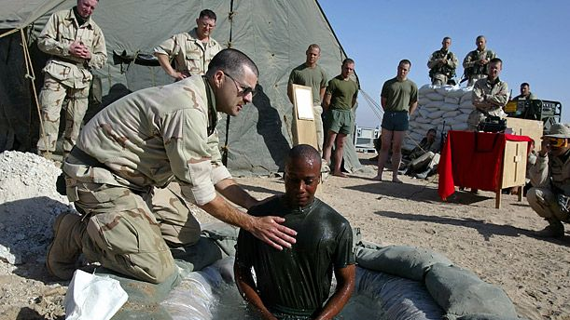

Slide 3
Make Every Effort to maintain unity
A Study of Ephesians 4:1-6

Slide 4
Make Every Effort To Maintain unity
A Study of Ephesians 4:1-6
What Makes For A Worthy Life? [4:1-3]
A worthy life will invest energy into God’s unity plan.
What We Must Be United On [4:4-6]
“Unity in essentials, liberty in incidentals, & in all things love.”
What We Will NOT Be United On:
We can’t be united on telling lies (untruths). We can’t be united on walking in darkness.
We won’t be united on the 100s of Christian opinions.
In Revelation, Ephesus was praised for testing true apostles. In Eph 4 church leadership immediately follows the unity list.
In 1 Timothy, Paul wants elders appointed at Ephesus.

Slide 5
Leadership In The New Testament
1) Leaders were EARLY, even among GENTILES.
Consider the context of [Acts 14:11-16, 23, 27]
For Titus 1, remember Cretans were lazy liars. v12
Notice this early NT letter [1 Th 5:12-14; 1:9-10, 2:13-16].
Do churches today approach leadership this way? Is it a foundational issue treated with urgency?

Slide 6
Leadership In The New Testament
1) Leaders were EARLY, even among GENTILES.
Ac14:11-16, 23, 27; Titus 1:3-12; 1Th 5:12-14; 1:9-10, 2:13-16
2) Leadership was NEVER just ONE.
Philippians 1:1 To overseers & deacons. Acts 14:23 Elders
In 1 Timothy 3 & Titus 1 the evangelists appoint overseers.
1 Peter 5 has a fellow-elder, Peter, writing to elders.
Plurality is in [Hebrews 13:17-21] & James 5:14.
The single leader in [3 John 9-10] didn’t turn out so well.

Slide 7
Leadership In The New Testament
1) Leaders were EARLY, even among GENTILES.
Ac14:11-16, 23, 27; Titus 1:3-12; 1Th 5:12-14; 1:9-10, 2:13-16
2) Leadership was NEVER just ONE. Cf. [3 John 9-10]
Php 1:1; Acts 14:23; 1 Tim 3; Titus 1; 1 Pet 5; Heb 13:17-21; James 5:14
3) Church Leaders had VARIOUS TITLES. (synonyms)
Notice where the word is interchangeable: [Acts 20:17, 28]
Elders (presbuteros); Overseers (episkopi); Shepherd (poimen). Sometimes overseer=bishop & shepherd=pastor.
This interchange happens in [Titus 1:5,7 & 1 Pet 5:1-5].

Slide 8
Leadership In The New Testament
1) Leaders were EARLY, even among GENTILES.
Ac14:11-16, 23, 27; Titus 1:3-12; 1Th 5:12-14; 1:9-10, 2:13-16
2) Leadership was NEVER just ONE. Cf. [3 John 9-10]
Php 1:1; Acts 14:23; 1 Tim 3; Titus 1; 1 Pet 5; Heb 13:17-21; James 5:14
3) Church Leaders had VARIOUS TITLES. (synonyms)
Notice where the word is interchangeable: [Acts 20:17, 28]
Elders (presbuteros); Overseers (episkopi); Shepherd (poimen). Sometimes overseer=bishop & shepherd=pastor.
This interchange happens in [Titus 1:5,7 & 1 Pet 5:1-5].
Being eager to obey, doesn’t mean we’re so desperate we’ll just pour or sprinkle, neither should we be so desperate we just appoint anyone. There will need to be grace-filled hard conversations about 1 Timothy 3 & Titus 1.

