Slide 1
Stand Firm Against The Devil
A Study of Ephesians 6:10-24

Slide 2
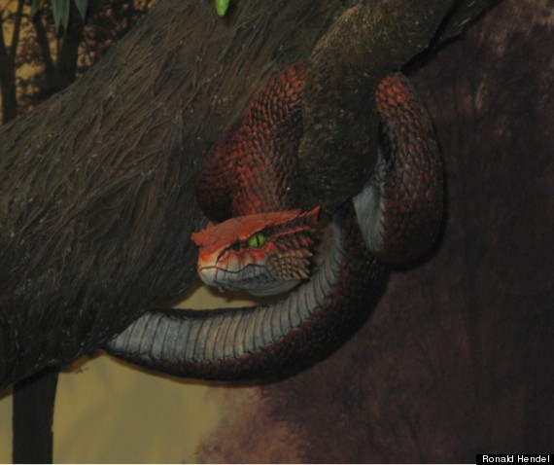
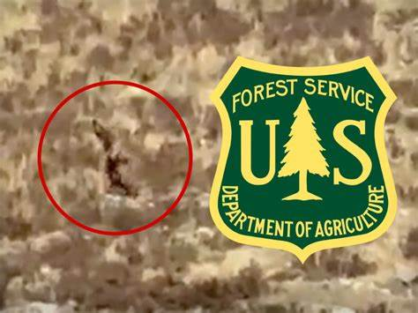

Slide 3
Stand Firm against The Devil
A Study of Ephesians 6:10-24
The New Humanity, A Divine Creation Ch 1-3
Ch 1 Paul’s Praise & Petition For God’s Blessings
Ch 2 God’s New Creation: His New Temple, His People
Ch 3 Paul’s Mission & His Prayer For God’s Power
The New Man’s Life On Earth Ch 4-6
Ch 4 Maintaining A New Unity By A New Life
Ch 5 Out Of The Darkness & Into The Light!
Ch 6 Strength In The Lord For the Daily Fight
The optimism of Ch 1-3 is balanced out by the battle of Ch 4-6
Doctrinal
Practical

Slide 4
Stand Firm against The Devil
A Study of Ephesians 6:10-24
The Forces of Evil [10-13]
Satan often looks attractive! [2 Cor 11:13-15]
He is not omnipotent, only Jehovah is!
We MUST put on God’s armor to win this battle.
The Whole Armor of God [14-17]
Paul is regularly & clearly on the attack.
Do we know the OT like early Gentile Christians?

Slide 5
Stand Firm against The Devil
A Study of Ephesians 6:10-24
The Forces of Evil [10-13]
Satan often looks attractive! [2 Cor 11:13-15]
The Whole Armor of God [14-17]
We must regularly & clearly be on the attack.
Our Prayer To God [18-20]
Paul was very open about his prayer requests.
Love of God & His People [21-24]
May we all love & encourage as he did.

