Slide 1
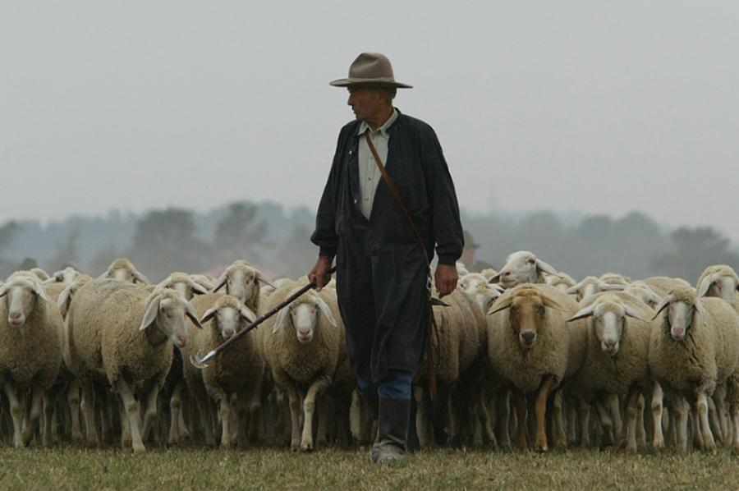
Common Qualification Questions
Did the Holy Spirit make overseers who fell away…?
Acts 20:28-30

Slide 2
Common Qualification Questions
How do we handle teaching on baptism?
Define the original Greek & compare other passages.
For unity sake, we beg a humble biblicism.
The same is desired for the biblical practice of elders.
Define the terms as used in ALL of scripture.
Don’t divide the church over these issues.
A key theme for tonight: Are we consistent?

Slide 3
Common Qualification Questions
Can a man serve if his wife has died?
This is not a new debate despite its new found popularity.
In 1 Tim 5:9 Paul calls the widow a one man woman.
What does biblical consistency require of this quality?
God’s desire is for men with a reputation for faithfulness.
What about a divorced man? Was it a biblical divorce?
Every situation must be judged carefully. This one is difficult.
Consistency in the domestic qualifications can raise some shocking questions about God. Did God have a right to “divorce” Israel? Was He unfaithful to her? Did God have only one child & therefore show inability to help other personalities? Was God too strict or too lenient with Israel? We all know she fell away…
We ought to seriously think about these parallels. Are we subconsciously looking for perfection? A friend of mine would remind, “Only one man was perfect, & look what happened.”

Slide 4
Common Qualification Questions
Can a man serve if his wife has died?
Can a man serve who has only one child?
How do you define children in other passages? At times it is used for a singular child. 1 Tim 5:3-4, 10
Is an only child not required to care for parents?
Why suggest he doesn’t know other personalities?
He does know how to work with others. His wife, co-workers, church members, etc.

Slide 5
Common Qualification Questions
Can a man serve if his wife has died?
Can a man serve who has only one child?
Where are his children presently? Home or Away?
It is harder to serve with kids still at home.
Once they’re long gone other influences have hit.
The real problem: they’ll struggle for group respect: “Wait until college years!” “Look how his turned out.”
Remember, even The Perfect Father tasted rebellion.

Slide 6
Common Qualification Questions
Can a man serve if his wife has died?
Can a man serve who has only one child?
Where are his children presently? Home or Away?
What does “children who believe” mean? [Tit 1:6]
It literally reads who are faithful. Faithful to who?
The emphasis is on character not status alone.
Consider: Would a late adoption disqualify him?

Slide 7
Common Qualification Questions
Can a man serve if his wife has died?
Can a man serve who has only one child?
Where are his children presently? Home or Away?
What does “children who believe” mean? [Tit 1:6]
Must a man’s wife be qualified?
I’m glad this was asked, [1 Tim 3:11] It is a difficult role.

Slide 8
Common Qualification Questions
Can a man serve if his wife has died?
Can a man serve who has only one child?
Where are his children presently? Home or Away?
What does “children who believe” mean? [Tit 1:6]
Must a man’s wife be qualified?
Above reproach…
This is the key quality of a qualified man: Good reputation.
So, someone asked, how long does a bad reputation last?
It seems to vary culturally & biblically. EG David & Saul

Slide 9
Common Qualification Questions
Can a man serve if his wife has died?
Can a man serve who has only one child?
Where are his children presently? Home or Away?
What does “children who believe” mean? [Tit 1:6]
Must a man’s wife be qualified?
Above reproach…
What if a man is “unapproachable”?
He’ll benefit from knowing why. Discern what he is doing wrong. Or, perhaps we need to do more to get to know him.
How to improve approachability:
-Give thought to how we answer in class. Are we too dogmatic on debatable issues?
-Support “There are no stupid questions.” Our body language may show we disagree.
-“You can hear a person’s heart.” Express emotion. We don’t all show it the same; say your feelings.

