Slide 1
Benaiah, son of Jehoida

Slide 2
Background
Benaiah means “Yahweh Builds” with roots in “bana” meaning build and “Yah” (not a derivation of the Tetragrammaton but a contraction)
Benaiah the son of Jehoiada, who was chief priest at some point (1st Chronicles 27:5) and is a Levite from a border town in Judah
Is mentioned in 2nd Samuel 8, 20, and 23 (David’s mighty men), 1st Kings 1-4, and 1st Chronicles 11 (David’s mighty men), (possibly as a priest/musician)15 & 16, 18, and 27.
He is mentioned as a “doer of great deeds”, including killing two “ariels” of Moab, killing a lion in a pit in the snow, and killing a large Egyptian man with his own spear (2nd Samuel 23:20-23)
Rabbinical tradition says he was chief of the Sanhedrin council (Berakhot 4a), as well as being the first person to meet the Queen of Sheba as it was thought she could “judging by Benaiah, ye may form for yourselves an idea of Solomon”(Munk pg 10)

Slide 3
Benaiah teaches us several things:
The value of violence
The Characteristics of a good soldier
The way God works in human affairs

Slide 4
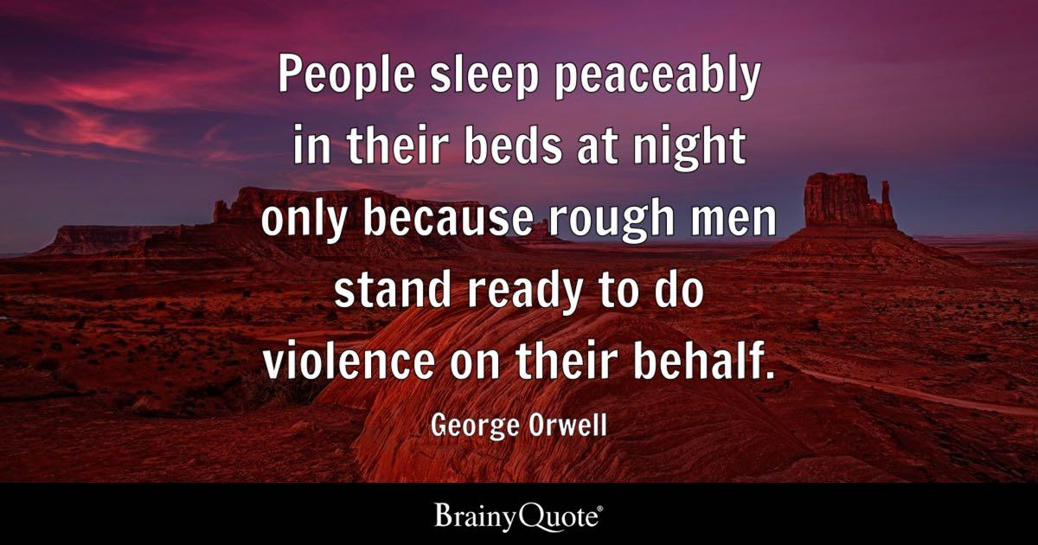
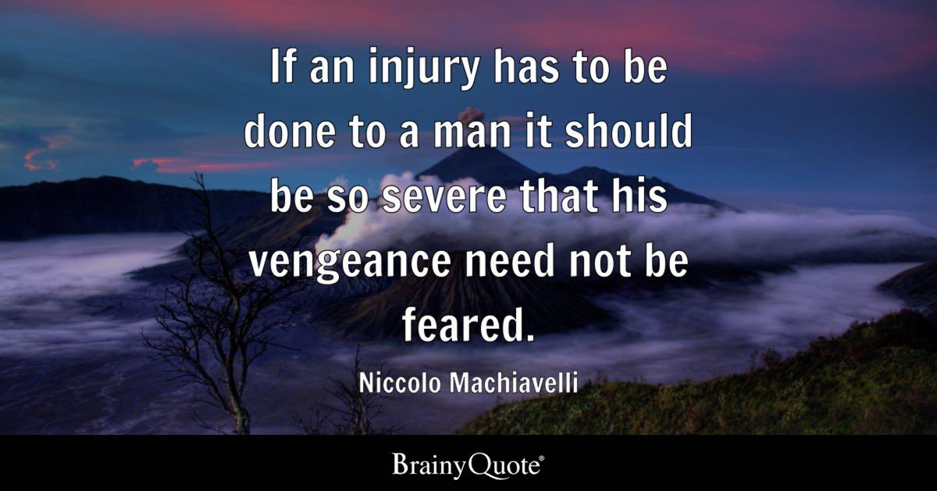
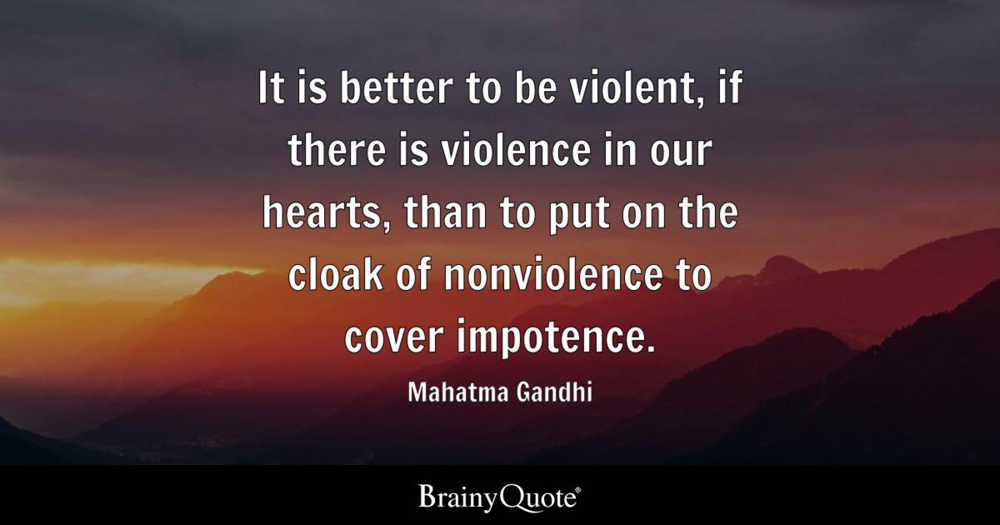
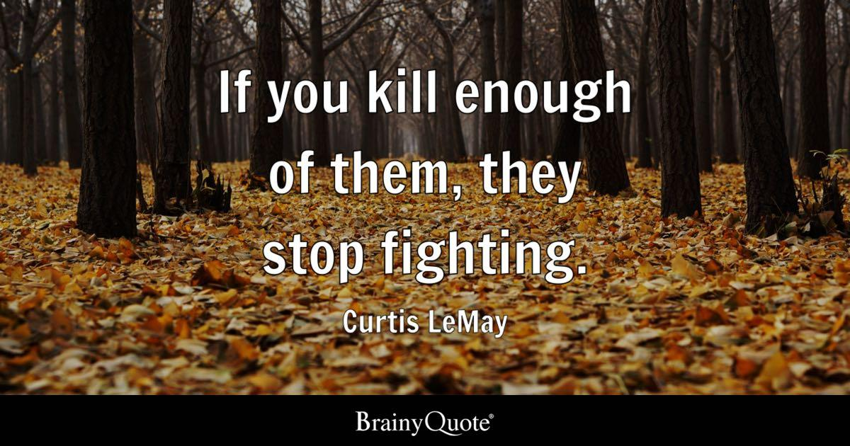

Slide 5
The Value of Violence
Psalm 11:5 “The Lord tests the righteous, but his soul hates the wicked and the one who loves violence.”
Proverbs 3:31 “Do not envy a man of violence and do not choose any of his ways”
Matthew 5:38-39 “You have heard that it was said, ‘An eye for an eye and a tooth for a tooth.’ But I say to you, Do not resist the one who is evil. But if anyone slaps you on the right cheek, turn to him the other also.”
Matthew 26:52 “Then Jesus said to him, “Put your sword back into its place. For all who take the sword will perish by the sword.”

Slide 6
The Value of Violence
Hebrews 11:32-34 “For time would fail me to tell of Gideon, Barak, Samson, Jephthah, of David and Samuel and the prophets— 33 who through faith conquered kingdoms, enforced justice, obtained promises, stopped the mouths of lions, 34 quenched the power of fire, escaped the edge of the sword, were made strong out of weakness, became mighty in war, put foreign armies to flight.”
Benaiah is mentioned as a “doer of great deeds”, including killing two “ariels” of Moab, killing a lion in a pit in the snow, and killing a large Egyptian man with his own spear (2nd Samuel 23:20-23)
He also spear-headed the transition of power from David to Solomon. (1Kings 1:4-10, 32-37/ 1 Kings 2:25, 28-35, 44-46)

Slide 7
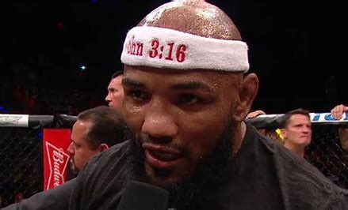
The Characteristics of a Good Soldier
Philippians 2:25 “I have thought it necessary to send to you Epaphroditus my brother and fellow worker and fellow soldier, and your messenger and minister to my need.”
2nd Timothy 2:3-4 “Share in suffering as a good soldier of Christ Jesus. No soldier gets entangled in civilian pursuits, since his aim is to please the one who enlisted him.

Slide 8
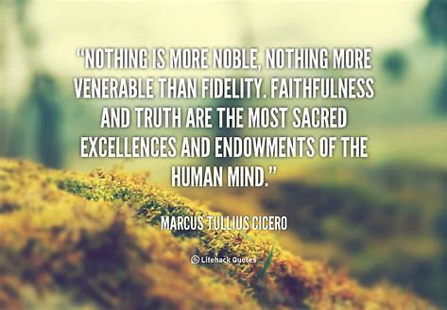
Loyalty
Proverbs 17:17 “A friend loves at all times and a brother is born for adversity.”
1st Samuel 8:18 “and Benaiah the son of Jehoida was over the Cherethites and the Pelethites…”
2nd Samuel 23:23 “He was renowned among the thirty, but he did not attain to the three. And David set him over his bodyguard.”
1st Kings 1:26 “But me, even me your servant, and Zadok the priest and Benaiah the son of Jehoiada and your servant Solomon, he has not invited.”

Slide 9
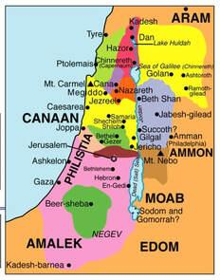
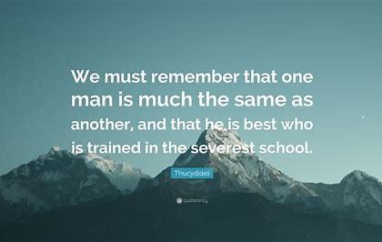
2) Understanding the Role of Suffering
2nd Samuel 23:20 “… the son of a valiant man of Kabzeel…”
Romans 5:3-5 “Not only that, but we rejoice in our sufferings, knowing that suffering produces endurance, and endurance produces character, and character produces hope, and hope does not put us to shame, because God's love has been poured into our hearts through the Holy Spirit who has been given to us.

Slide 10
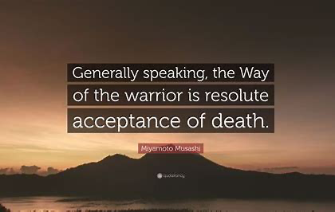
3) Conviction
Hebrews 11:1 “Now faith is the assurance of things hoped for, the conviction of things not seen.”
1st Kings 1:36-37 “And Benaiah the son of Jehoida answered the king, ‘Amen! May the LORD, God of my lord the king, say so. As the LORD has been with my lord the king, even so may he be with Solomon, and make his throne greater than the throne of my lord King David.’”

Slide 11
The Way God works in human affairs
Firmly- people died to establish Solomon as king (1st Kings 1-2)
Patiently- Benaiah was with David at the beginning of his reign (2nd Samuel 8) and possibly as early as his burning of Ziklag (1st Samuel 30:14)
With human actors- God has killed people miraculously (Numbers 16:35) (Acts 12:23) but as far as the Bible shows He most often uses human agents (1st Kings 1-2) (Assyria, Babylon, Persia, Romans, etc.)

Slide 12
Conclusion
Benaiah teaches us three things:
The Value of Violence
The Characteristics of a Good Soldier
The Way God works in human affairs
Hebrews 11:13-16 “All these died in faith, without receiving the promises, but having seen them and having welcomed them from a distance, and having confessed that they were strangers and exiles on the earth. For those who say such things make it clear that they are seeking a country of their own. And indeed if they had been thinking of that country from which they went out, they would have had opportunity to return. But as it is, they desire a better country, that is, a heavenly one. Therefore God is not ashamed to be called their God; for He has prepared a city for them.“

