Slide 1
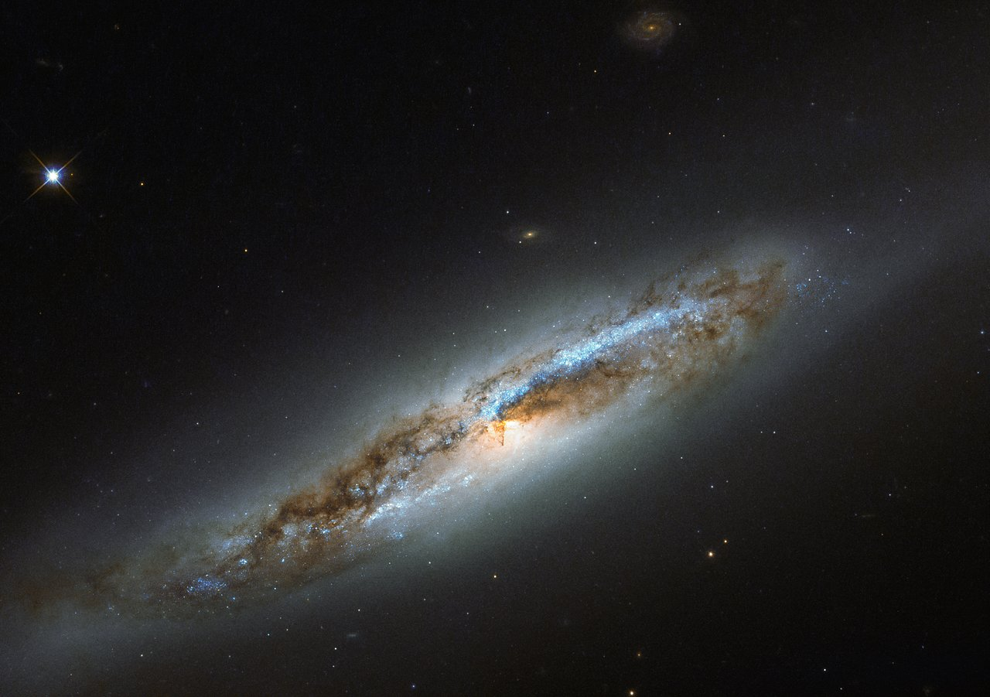

Slide 2
God is Creator
The Significance & Consequence

Slide 3
REVELATION 4.9-11
“Worthy are You, our Lord and our God, to receive glory and honor and power; for You created all things, and because of Your will they existed, and were created.”
NASB95

Slide 4
Contex of Rev. 4.11
3 Reasons
Created All Things – Worthy of Power
Your will, they “were” – Worthy of Honor
“were created” – Worthy of Glory

Slide 5
The Purposes of the Ceator

Slide 6
Why…Purpose?
1st Reason strongly connects to Holiness
2nd Reason inseparable from Almightiness
So 3rd Reason should connect to Eternality

Slide 7
Why…Purpose?
What did God need before creating?
A PURPOSE
Heb. 6.17,18

Slide 8
Hebrews 6.17,18
¹⁷ In the same way God, desiring even more to show to the heirs of the promise the unchangeableness of His purpose, interposed with an oath, ¹⁸ so that by two unchangeable things in which it is impossible for God to lie, we who have taken refuge would have strong encouragement to take hold of the hope set before us.
NASB95

Slide 9
Why…Purpose?
What did God need before creating?
A PURPOSE
Heb. 6.17,18
2 Things: 1) Oath 2) God’s nature (why God can’t lie)
Unchangeableness of the PROMISE to the heirs

Slide 10
Eph. 3.11
This was in accordance with the eternal purpose which He carried out in Christ Jesus our Lord,
NASB95

Slide 11
Why…Purpose?
What did God need before creating?
A PURPOSE
Heb. 6.17,18
Eph. 3.11
At least referring to God’s plan FROM eternity
Creator’s purpose comes from His eternal nature

Slide 12
Why…Purpose?
What did God need before creating?
A PURPOSE
Heb. 6.17,18
Eph. 3.11
“were created” connects to Creator’s purposes

Slide 13
What is glory?
Ex. 33.18-22

Slide 14
Exodus 33.18,19
¹⁸ Then Moses said, “I pray You, show me Your glory!” ¹⁹ And He said, “I Myself will make all My goodness pass before you, and will proclaim the name of the LORD before you;
NASB95

Slide 15
What is glory?
Ex. 33.18-22
Seems God’s goodness is a consolation prize

Slide 16
Exodus 33.22
and it will come about, while My glory is passing by, that I will put you in the cleft of the rock and cover you with My hand until I have passed by.
NASB95

Slide 17
What is glory?
Ex. 33.18-22
Seems God’s goodness is a consolation prize
1st says goodness will pass before you
Now says glory will pass by

Slide 18
Exodus 34.6,7
⁶ Then the LORD passed by in front of him and proclaimed, “The LORD, the LORD God, compassionate and gracious, slow to anger, and abounding in lovingkindness and truth; ⁷ who keeps lovingkindness for thousands, who forgives iniquity, transgression and sin; yet He will by no means leave
NASB95

Slide 19
Exodus 34.6,7
the guilty unpunished, visiting the iniquity of fathers on the children and on the grandchildren to the third and fourth generations.”
NASB95

Slide 20
What is glory?
Ex. 33.18-22
Seems God’s goodness is a consolation prize
1st says goodness will pass before you
Now says glory will pass by
Declaring “name” means character
God’s glory IS His goodness
Glory is what makes something/someone praiseworthy

Slide 21
WHY Create?
Is. 65.17-19

Slide 22
Isaiah 65.17-19
“For behold, I create new heavens and a new earth;
And the former things will not be remembered or come to mind.
¹⁸ “But be glad and rejoice forever in what I create;
NASB95

Slide 23
Isaiah 65.17-19
For behold, I create Jerusalem for rejoicing
And her people for gladness.
¹⁹ “I will also rejoice in Jerusalem and be glad in My people;
And there will no longer be heard in her
The voice of weeping and the sound of crying.
NASB95

Slide 24
WHY Create?
Is. 65.17-19
FOR rejoicing and gladness
Vs. 18 – to rejoice “in what I create”
Creators wants a creation FULL of joy
Note “new heavens and new earth” language

Slide 25
1 Timothy 4.3,4
³ men who forbid marriage and advocate abstaining from foods which God has created to be gratefully shared in by those who believe and know the truth. ⁴ For everything created by God is good, and nothing is to be rejected if it is received with gratitude;
NASB95

Slide 26
WHY Create?
Rom. 1.20

Slide 27
Romans 1.20
²⁰ For since the creation of the world His invisible attributes, His eternal power and divine nature, have been clearly seen, being understood through what has been made, so that they are without excuse.
NASB95

Slide 28
WHY Create?
Rom. 1.20
FOR Revelation of His Nature
Eternal Power (Behemoth – Job 40)
Divine Nature (Uniqueness – Is. 48.7)

Slide 29
WHY Create?
Is. 45.18

Slide 30
Isaiah 45.18
Is. 45:18 For thus says the LORD, who created the heavens (He is the God who formed the earth and made it, He established it and did not create it a waste place, but formed it to be inhabited), “I am the LORD, and there is none else.
NASB95

Slide 31
WHY Create?
Is. 45.18
TO BE INHABITED
Direct Challenge to calloused Creator view
Why should we trust this claim?

Slide 32
WHY Create?
Is. 45.18 – TO BE INHABITED
Eph. 2.4-7

Slide 33
Eph. 2.4,5
⁴ But God, being rich in mercy, because of His great love with which He loved us, ⁵ even when we were dead in our transgressions, made us alive together with Christ (by grace you have been saved),
NASB95

Slide 34
WHY Create?
Is. 45.18 – TO BE INHABITED
Eph. 2.4-7
Dead in OUR transgressions, God made alive
Creator CHOSE to do this (opposes death)

Slide 35
Eph. 2.6,7
⁶ and raised us up with Him, and seated us with Him in the heavenly places in Christ Jesus, ⁷ so that in the ages to come He might show the surpassing riches of His grace in kindness toward us in Christ Jesus.
NASB95

Slide 36
WHY Create?
Is. 45.18 – TO BE INHABITED
Eph. 2.4-7
Dead in OUR transgressions, God made alive
Creator CHOSE to do this (opposes death)
Seated (enthroned) with Christ
To show “riches of His grace”

Slide 37
WHY Create?
Is. 45.18 – TO BE INHABITED
Eph. 2.4-7 – To Show riches of His grace
Eph. 1

Slide 38
Eph. 1.5,6
⁵ He predestined us to adoption as sons through Jesus Christ to Himself, according to the kind intention of His will, ⁶ to the praise of the glory of His grace,
NASB95

Slide 39
WHY Create?
Is. 45.18 – TO BE INHABITED
Eph. 2.4-7 – To Show riches of His grace
Eph. 1
Vs. 6,7: Planned adoption to praise glorious grace

Slide 40
Eph. 1.11,12
¹¹ also we have obtained an inheritance, having been predestined according to His purpose who works all things after the counsel of His will, ¹² to the end that we who were the first to hope in Christ would be to the praise of His glory.
NASB95

Slide 41
WHY Create?
Is. 45.18 – TO BE INHABITED
Eph. 2.4-7 – To Show riches of His grace
Eph. 1
vs. 6,7: Planned adoption to praise glorious grace
vs. 11,12: Inheritance to the praise of His glory

Slide 42
Eph. 1.14
¹⁴ who is given as a pledge of our inheritance, with a view to the redemption of God’s own possession, to the praise of His glory.
NASB95

Slide 43
WHY Create?
Is. 45.18 – TO BE INHABITED
Eph. 2.4-7 – To Show riches of His grace
Eph. 1
vs. 6,7: Planned adoption to praise glorious grace
vs. 11,12: Inheritance to the praise of His glory
Vs. 14: Gave Spirit…to the praise of His glory

Slide 44
WHY Create?
Is. 45.18 – TO BE INHABITED
Eph. 2.4-7 – To Show riches of His grace
Eph. 1 – To the Praise of His glory
Eph. 3.10

Slide 45
Eph. 3.10
so that the manifold wisdom of God might now be made known through the church to the rulers and the authorities in the heavenly places.
NASB95

Slide 46
WHY Create?
Is. 45.18 – TO BE INHABITED
Eph. 2.4-7 – To Show riches of His grace
Eph. 1 – To the Praise of His glory
Eph. 3.10 – To Show Wisdom of God
Is. 43.6,7

Slide 47
Isaiah 43.6,7
⁶ “I will say to the north, ‘Give them up!’
And to the south, ‘Do not hold them back.’
Bring My sons from afar
And My daughters from the ends of the earth,
NASB95

Slide 48
Isaiah 43.6,7
⁷ Everyone who is called by My name,
And whom I have created for My glory,
Whom I have formed, even whom I have made.”
NASB95

Slide 49
WHY Create?
Is. 45.18 – TO BE INHABITED
Eph. 2.4-7 – To Show riches of His grace
Eph. 1 – To the Praise of His glory
Eph. 3.10 – To Show Wisdom of God
Is. 43.6,7 – Created FOR HIS GLORY

Slide 50
WHY Create? WHY Worthy?
PURPOSE of OUR creation was to DEMONSTRATE the Glory of God’s Eternal Nature to the Spiritual realm!

Slide 51
Application
Worship Creator for His Nature
Is. 42.5-8

Slide 52
Isaiah 42.5-8
Is. 42:5 Thus says God the LORD,
Who created the heavens and stretched them out,
Who spread out the earth and its offspring,
Who gives breath to the people on it
And spirit to those who walk in it,
NASB95

Slide 53
Isaiah 42.5-8
⁶ “I am the LORD, I have called You in righteousness,
I will also hold You by the hand and watch over You,
And I will appoint You as a covenant to the people,
As a light to the nations,
NASB95

Slide 54
Isaiah 42.5-8
⁷ To open blind eyes,
To bring out prisoners from the dungeon
And those who dwell in darkness from the prison.
⁸ “I am the LORD, that is My name;
I will not give My glory to another,
Nor My praise to graven images.
NASB95

Slide 55
Application
Worship Creator for His Nature
Is. 42.5-8
Note vs. 5 establishing God as Creator
A Covenant to peoples & A Light to nations
Free prisoners and Open blind eyes

Slide 56
Application
Worship Creator for His Nature
Is. 42.5-8 – Glorify God by Winning Souls
Note vs. 5 establishing God as Creator
A Covenant to peoples & A Light to nations
Free prisoners and Open blind eyes

Slide 57
Are We Fulfilling
Our Creator’s Purposes?

