Slide 1
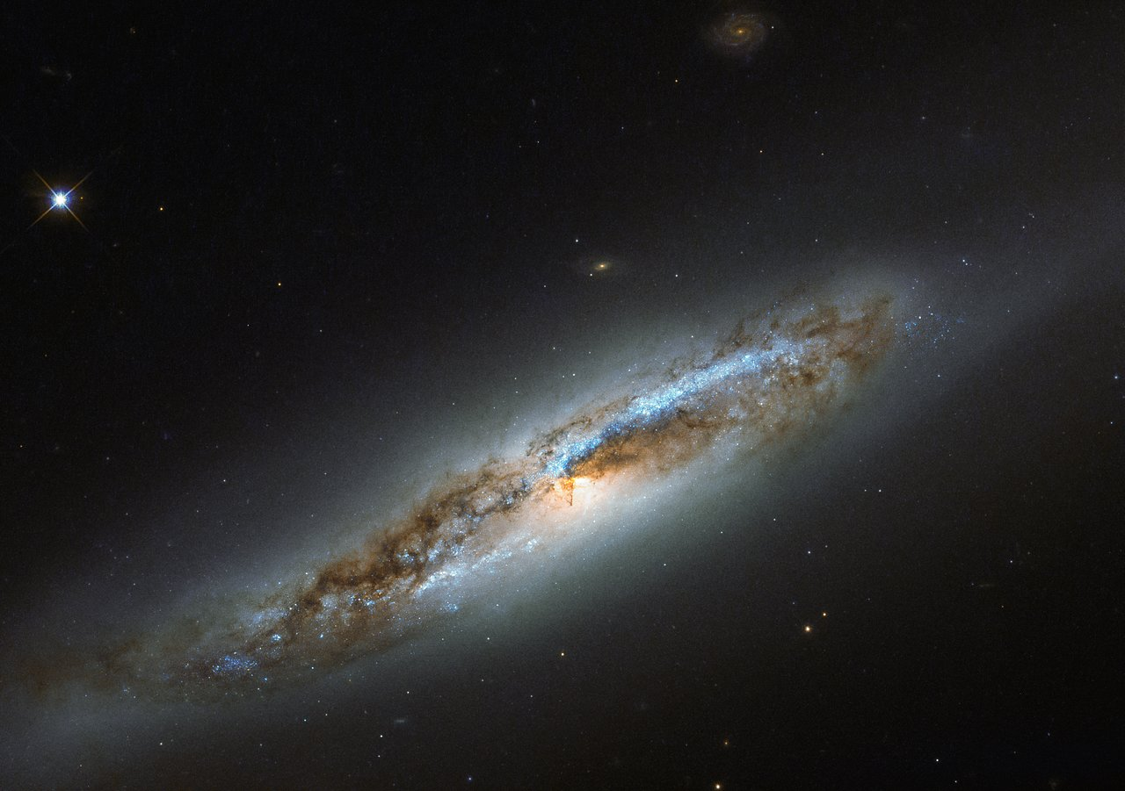

Slide 2
God is Creator
The Significance & Consequence

Slide 3
REVELATION 4.9-11
“Worthy are You, our Lord and our God, to receive glory and honor and power; for You created all things, and because of Your will they existed, and were created.”
NASB95

Slide 4
Context of Rev. 4.11
3 Reasons
Created All Things – Worthy of Power
Your will, they “were” – Worthy of Honor
“were created” – Worthy of Glory

Slide 5
The Rightful Will of the Ceator

Slide 6
How One Honors?

Slide 7
Mal.1.6-8
Mal. 1:6 “‘A son honors his father, and a servant his master. Then if I am a father, where is My honor? And if I am a master, where is My respect?’ says the LORD of hosts to you, O priests who despise My name. But you say, ‘How have we despised Your name?’ ⁷ “You are presenting defiled food upon My altar. But you say, ‘How have
NASB95

Slide 8
Mal.1.6-8
we defiled You?’ In that you say, ‘The table of the LORD is to be despised.’ ⁸ “But when you present the blind for sacrifice, is it not evil? And when you present the lame and sick, is it not evil? Why not offer it to your governor? Would he be pleased with you? Or would he receive you kindly?” says the LORD of hosts.
NASB95

Slide 9
How One Honors?
Offering gifts WORTHY of the Honoree

Slide 10
Is. 58.13
“If because of the sabbath, you turn your foot
From doing your own pleasure on My holy day,
And call the sabbath a delight, the holy day of the LORD honorable,
NASB95

Slide 11
Is. 58.13
And honor it, desisting from your own ways,
From seeking your own pleasure
And speaking your own word,
NASB95

Slide 12
How One Honors?
Offering gifts WORTHY of the Honoree
Putting another’s WILL above your own
Embodiment of Almighty nature
– spoken existence AND exertion of WILL

Slide 13
Creator’s Will Looks Like…?
Is. 45.1-13
Isaiah is prophesying about God using Cyrus
vs. 11-13

Slide 14
Is. 45.11-13
Is. 45:11 Thus says the LORD, the Holy One of Israel, and his Maker:
“Ask Me about the things to come concerning My sons,
And you shall commit to Me the work of My hands.
¹² “It is I who made the earth, and created man upon it.
I ^{b}stretched out the heavens with My hands
And I ¹ordained ^{c}all their host.
¹³ “I have aroused him in ªrighteousness
And I will ^{b}make all his ways smooth;
He will ^{c}build My city and will let My exiles go ^{d}free,
Without any payment or reward,” says the LORD of hosts.
NASB95

Slide 15
Is. 45.11-13
upon it.
I stretched out the heavens with My hands
And I ordained all their host.
¹³ “I have aroused him in righteousness
And I will make all his ways smooth;
NASB95

Slide 16
Is. 45.11-13
He will build My city and will let My exiles go free,
Without any payment or reward,” says the LORD of hosts.
NASB95

Slide 17
Creator’s Will Looks Like…?
Is. 45.1-13
vs. 11-13
“Tell me things concerning my sons…”
i.e. telling God about the future is speaking HIS Will
Cyrus will build my city – b/c I want Him to
Cyrus will release my captives – b/c I want Him to

Slide 18
Creator’s Will Looks Like…?
Is. 45.1-13
vs. 11-13 – Connected to being Creator
“Tell me things concerning my sons…”
i.e. telling God about the future is speaking HIS Will
Cyrus will build my city – b/c I want Him to
Cyrus will release my captives – b/c I want Him to

Slide 19
Creator’s Will Looks Like…?
Is. 45.1-13
vs. 11-13 – Creators will WILL be done
vs. 9,10

Slide 20
Isaiah 45.9-10
⁹ “Woe to the one who quarrels with his Maker —
An earthenware vessel among the vessels of earth!
Will the clay say to the potter, ‘What are you doing?’
Or the thing you are making say, ‘He has no hands’?
NASB95

Slide 21
Isaiah 45.9-10
¹⁰ “Woe to him who says to a father, ‘What are you begetting?’
Or to a woman, ‘To what are you giving birth?’”
NASB95

Slide 22
Creator’s Will Looks Like…?
Is. 45.1-13
vs. 11-13 – Creators will WILL be done
vs. 9,10
What is being described? – Created asking questions
WOE/Trouble to the “curious” Creation – WHY?

Slide 23
Isaiah 48.17
Thus says the LORD, your Redeemer, the Holy One of Israel,
“I am the LORD your God, who teaches you to profit,
Who leads you in the way you should go.
NASB95

Slide 24
Creator’s Will Looks Like…?
Is. 45.1-13
vs. 11-13 – Creators will WILL be done
vs. 9,10
What is being described? – Created asking questions
WOE/Trouble to the “curious” Creation – WHY?
How different is the potter’s understanding vs. the clay’s?
The newborn’s to the parent’s?

Slide 25
Creator’s Will Looks Like…?
Is. 45.1-13
vs. 11-13 – Creators will WILL be done
vs. 9,10 –B/C of Creator’s Understanding
Creation being designed for the PURPOSE of Creator
Point of potter imagery in Jer. 18 & Rom 9

Slide 26
Creator’s Will Looks Like…?
Is. 45.1-13
vs. 11-13 – Creators will WILL be done
vs. 9,10 –B/C of Creator’s Understanding
vs. 8

Slide 27
Isaiah 45.8
⁸ “Drip down, O heavens, from above,
And let the clouds pour down righteousness;
Let the earth open up and salvation bear fruit,
And righteousness spring up with it.
I, the LORD, have created it.
NASB95

Slide 28
Creator’s Will Looks Like…?
Is. 45.1-13
vs. 8
Purpose Defining (potter imagery) stems from MORAL Authority
Claim of vs. 8: Creator exerts will by defining (/creating) morality
Again recall the connection to “almighty” (absolute authority)

Slide 29
Creator’s Will Looks Like…?
Is. 45.1-13
vs. 8 – B/C Creator Defines Morality
1st Way:
Defines proper parameters of creation (Mt. 19.4-6)
Simply being Creator gives him this right
Does so in order to profit Creation (Is. 48.17)

Slide 30
Creator’s Will Looks Like…?
Is. 45.1-13
vs. 8 – B/C Creator Defines Morality
1st Way: b/c Creator offers direction to Creation
Defines proper parameters of creation (Mt. 19.4-6)
Simply being Creator gives him this right
Does so in order to profit Creation (Is. 48.17)

Slide 31
Creator’s Will Looks Like…?
Is. 45.1-13
vs. 8 – B/C Creator Defines Morality
2nd Way:
Eternal Nature Defines “Eternal Morality”
James 1.17; Tit. 1.2

Slide 32
James 1.17
Every good thing given and every perfect gift is from above, coming down from the Father of lights, with whom there is no variation or shifting shadow.
NASB95

Slide 33
Titus 1.2
in the hope of eternal life, which God, who cannot lie, promised long ages ago,
NASB95

Slide 34
Creator’s Will Looks Like…?
Is. 45.1-13
vs. 8 – B/C Creator Defines Morality
2nd Way:
Eternal Nature Defines “Eternal Morality”
James 1.17; Tit. 1.2
Creator’s eternal nature defines “eternal morality”

Slide 35
Creator’s Will Looks Like…?
Is. 45.1-13
vs. 8 – B/C Creator Defines Morality
2nd Way: b/c Gives meaning to existence
Eternal Nature Defines “Eternal Morality”
James 1.17; Tit. 1.2
Creator’s eternal nature defines “eternal morality”

Slide 36
Creator’s Will Looks Like…?
Is. 45.1-13
vs. 8 – B/C Creator Defines Morality
Worthy B/C Creator ACTS on Morality
Imagine a world where Creator NEVER stopped sin

Slide 37
Pro. 17.5
He who mocks the poor taunts his Maker;
He who rejoices at calamity will not go unpunished.
NASB95

Slide 38
Creator’s Will Looks Like…?
Is. 45.1-13
vs. 8 – B/C Creator Defines Morality
Worthy B/C Creator ACTS on Morality
Imagine a world where Creator NEVER stopped sin
Creator CREATES SALVATION…morally

Slide 39
Creator’s Will Looks Like…?
Is. 45.1-13
vs. 7

Slide 40
Isaiah 45.7
The One forming light and creating darkness,
Causing well-being and creating calamity;
I am the LORD who does all these.
NASB95

Slide 41
Creator’s Will Looks Like…?
Is. 45.1-13
vs. 7
Maintains control over all pain and comfort
Thus Creator DESERVES Honor for ALL the comfort

Slide 42
Rom. 1.21
For even though they knew God, they did not honor Him as God or give thanks, but they became futile in their speculations, and their foolish heart was darkened.
NASB95

Slide 43
Creator’s Will Looks Like…?
Is. 45.1-13
vs. 7
Maintains control over all pain and comfort
Thus Creator DESERVES Honor for ALL the comfort
Example: Parental Omission

Slide 44
Creator’s Will Looks Like…?
Is. 45.1-13
vs. 7 - B/C Creator creates well-being/calamity
Maintains control over all pain and comfort
Thus Creator DESERVES Honor for ALL the comfort
Example: Parental Omission
BUT what about the PAIN?

Slide 45
WHY…?
Why Does the Creator have rights over
Over Purpose, Morality, Comfort & Pain
Why Does the Creator deserve Honor?

Slide 46
Psalm 95.5
The sea is His, for it was He who made it,
And His hands formed the dry land.
NASB95

Slide 47
WHY…?
Why Does the Creator own the Sea?
BECAUSE HE MADE IT!
Creatorship CONFERS Ownership
We believe this of humans…where is that from?
Stems from God’s Eternal nature/morality

Slide 48
WHY…?
Why Does the Creator own the Sea?
What rights do OWNERSHIP confer?
ALL of them! (Matt. 20.15)

Slide 49
Matt. 20.15
‘Is it not lawful for me to do what I wish with what is my own? Or is your eye envious because I am generous?’
NASB95

Slide 50
Is. 44.24
Thus says the LORD, your Redeemer, and the one who formed you from the womb,
“I, the LORD, am the maker of all things,
Stretching out the heavens by Myself
And spreading out the earth all alone,
NASB95

Slide 51
WHY…?
Why Does the Creator own the Sea?
What rights do OWNERSHIP confer?
ALL of them! (Matt. 20.15)
SOLE Creator shares rights with NO ONE
Has EVERY right for His creation to submit their wills to HIS and this is HONOR (Is. 58.13)

Slide 52
Application
Are we Honoring our Creator?
1) Do we offer Him the best we can?
2) Do we differ to His will instead of ours?
3) Do we TRUST our Creator?

