Slide 1
Lights IN the Home
A Study of Ephesians 5:21-6:9

Slide 3
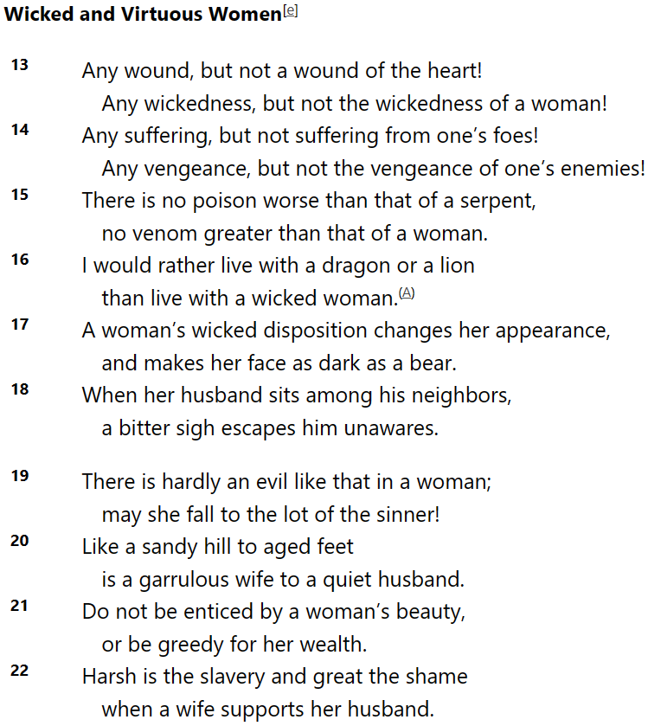
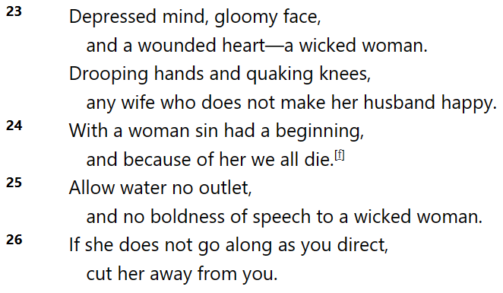
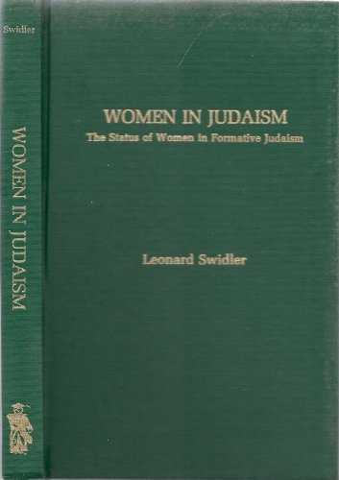
Lights In The HOme
A Study of Ephesians 5:21-6:9
Women have always been extremely important.
But try telling that to Aristotle who felt they were inferior.
Or the Rabbi who said, “Don’t talk to them, even your wife.”
Or try [Sirach 25:13-26]
Imagine the NT scandal!
They eat & worship together!
“Mistresses we keep for the sake of pleasure, concubines for the daily care of our persons, but wives to bear us legitimate children & to be faithful guardians of our households.”

Slide 4
Lights In The HOme
A Study of Ephesians 5:21-6:9
Women have always been extremely important.
But the ancient world, unlike Paul, didn’t see it that way.
Children have also always been important.
But, submission to parents used to last a lifetime! The Father carried almost unlimited power, including death.
Sirach 30 speaks of refusing to join in their laughter!
Slavery, often voluntary & freedom often purchased.
Knowing the 1st century context is crucial!

Slide 5
Lights In The HOme
A Study of Ephesians 5:21-6:9
The New Humanity, A Divine Creation Ch 1-3
Ch 1 Paul’s Praise & Petition For God’s Blessings
Ch 2 God’s New Creation: His New Temple, His People
Ch 3 Paul’s Mission & His Prayer For God’s Power
The New Man’s Life On Earth Ch 4-6
Ch 4 Maintaining A New Unity By A New Life
Ch 5 Out Of The Darkness & Into The Light!
Ch 6 Strength In The Lord For the Daily Fight
A continuation of ‘filled with the Spirit’ 5:18
Each area challenges subjection 5:21
Husbands, Fathers, Masters, etc. [Php 2]
Doctrinal
Practical

Slide 6
Lights In The HOme
A Study of Ephesians 5:21-6:9
Husbands & Wives [5:21-33]
The parallel to Christ & the church is difficult, but clear.
Husbands must give themselves up like Christ.
Submission doesn’t mean you’re a doormat to the other.
Fathers & Children [6:1-4]
Fathers must nurture their children better than the world.
Don’t let personal issues become wrath towards them.
Children, love is a choice of gratitude towards them.
Show each other grace, neither of us are perfect.
“We are rarely whole without being whole with them.”

Slide 7
Lights In The HOme
A Study of Ephesians 5:21-6:9
Let us be a light in EVERY place,
but especially in the HOME.
Unless the Lord builds the house, he who labors, labors in vain.
Husbands & Wives [5:21-33] Husbands must give themselves up like Christ.
Fathers & Children [6:1-4] Fathers must nurture their children better than the world.
Masters & Servants [6:5-9]
Remember who our Ultimate Master & Judge really is.
Masters must not threaten in order to get their way.
Treat those who ‘serve’ us as we would treat Jesus.

