Slide 1
Speak The Truth
A Study of Ephesians 4:25-5:2

Slide 2
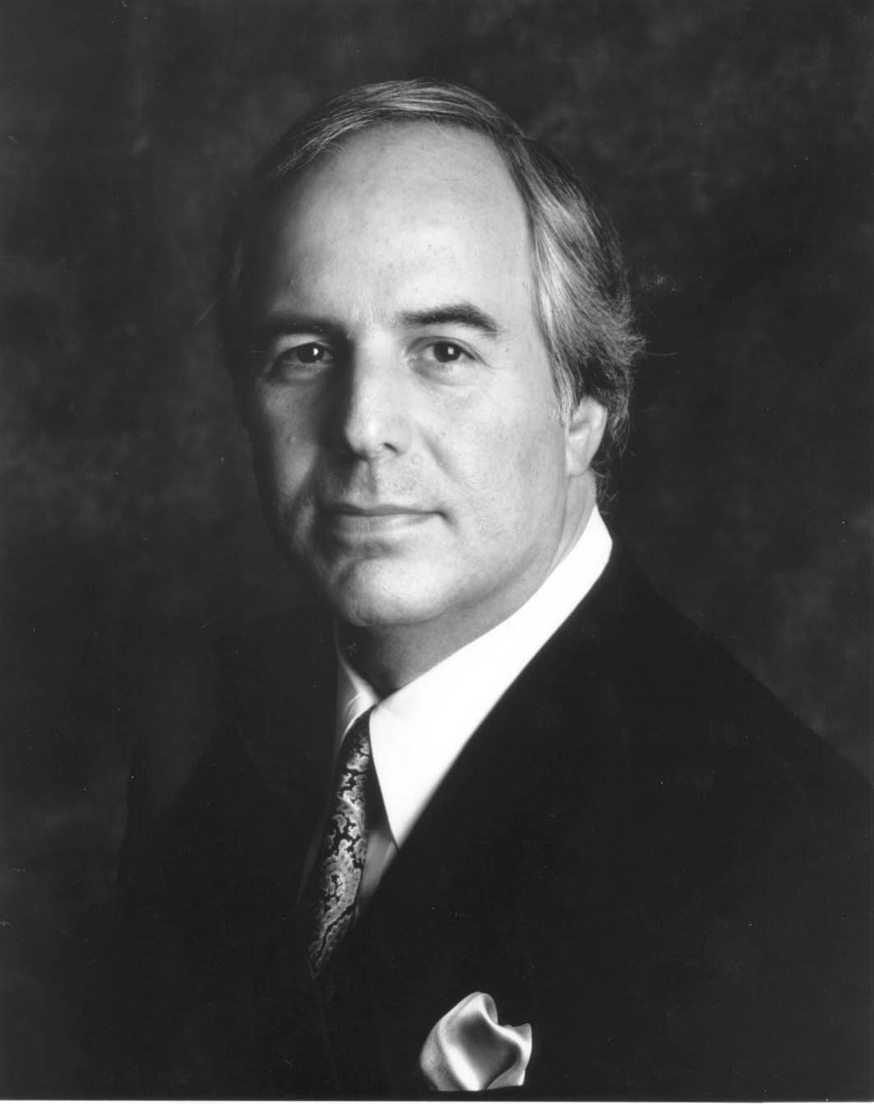
“Your sin will find you out.”
–Moses (Nu 32:23)

Slide 3
Speak The Truth
A Study of Ephesians 4:25-5:2
The New Humanity, A Divine Creation Ch 1-3
Ch 1 Paul’s Praise & Petition For God’s Blessings
Ch 2 God’s New Creation: His New Temple, His People
Ch 3 Paul’s Mission & His Prayer For God’s Power
The New Man’s Life On Earth Ch 4-6
Ch 4 Maintaining A New Unity By A New Life
Ch 5 Out Of The Darkness & Into The Light!
Ch 6 Strength In The Lord For the Daily Fight
4:1 Walk In A Worthy Manner
4:17 Do NOT Think Like The World
But be renewed in the spirit of our minds (v23)
Doctrinal
Practical

Slide 4
Speak The Truth
A Study of Ephesians 4:25-5:2
What a ‘new life’ means & why it matters:
Be truthful because deception hurts all of us.
Don’t let the devil divide us with anger & anxiety.
Work with your hands to share with the needy.
Edify others so you’ll give grace to everyone.
Don’t grieve the Holy Spirit
Be kind to each other b/c we need good attitudes.
Imitate God: Be a pleasing, fragrant aroma. [2Co2:14-17]
Imitation is not only a need to but what we CAN DO!
He won’t ask His children to do something they can’t.
Our Father wants us to look like Him! (1 John 3:1)

