Slide 2
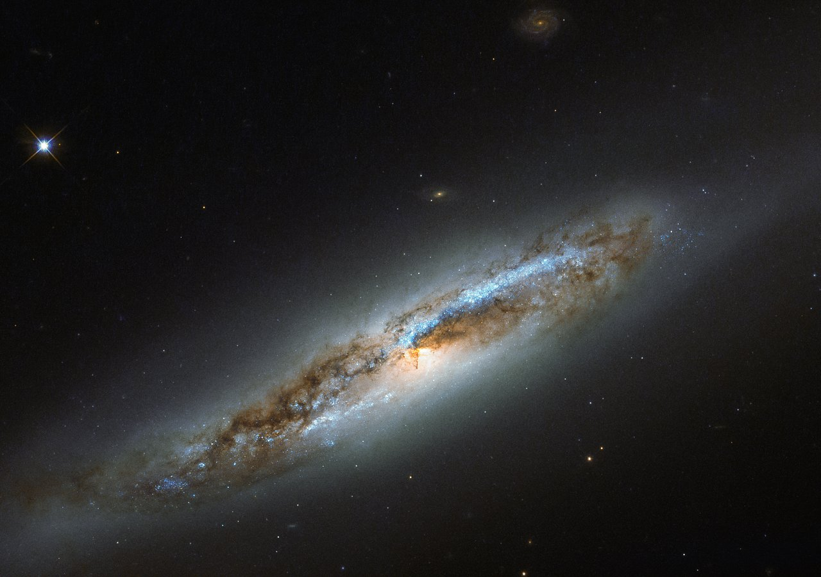
Jeremiah 9.23,24
NASB95
Thus says the LORD, “Let not a wise man boast of his wisdom, and let not the mighty man boast of his might, let not a rich man boast of his riches; but let him who boasts boast of this, that he understands and knows Me, that I am the LORD who exercises lovingkindness, justice and righteousness on earth; for I delight in these things,” declares the LORD.

Slide 3
REVELATION 4.8
And the four living creatures, each one of them having six wings, are full of eyes around and within; and day and night they do not cease to say, “HOLY, HOLY, HOLY IS THE LORD GOD, THE ALMIGHTY, WHO WAS AND WHO IS AND WHO IS TO COME.”
NASB95

Slide 4
REVELATION 4.8
And the four living creatures, each one of them having six wings, are full of eyes around and within; and day and night they do not cease to say, “HOLY, HOLY, HOLY IS THE LORD GOD, THE ALMIGHTY, WHO WAS AND WHO IS AND WHO IS TO COME.”
NASB95

Slide 5
God is Almighty
The Significance & Consequence

Slide 6
What Does It Mean to Be Almighty?
The Words/Phrases
Greek N.T. – “Pantokrator” (Pantokra/twr)
~10x in N.T. (9x in Rev.)
Rev. 1.8; 4.8; 11.17; 15.3; 16.7, 14; 19.6, 15; 21.22
King
Reign
Wrath
Judgment

Slide 7
What Does It Mean to Be Almighty?
The Words/Phrases
Greek N.T. – “Pantokrator” (Pantokra/twr)
~10x in N.T. (9x in Rev.)
Rev. 1.8; 4.8; 11.17; 15.3; 16.7, 14; 19.6, 15; 21.22
Related to God’s “ROYAL RIGHT to JUDGE”

Slide 8
What Does It Mean to Be Almighty?
The Words/Phrases
Greek N.T. – “Pantokrator” (Pantokra/twr)
~10x in N.T. (9x in Rev.)
2 Cor. 6.18

Slide 9
2 Cor. 6.16-18
¹⁶ Or what agreement has the temple of God with idols? For we are the temple of the living God; just as God said,
“I WILL DWELL IN THEM AND WALK AMONG THEM;
AND I WILL BE THEIR GOD, AND THEY SHALL BE MY PEOPLE.
NASB95

Slide 10
2 Cor. 6.16-18
¹⁷ “Therefore, COME OUT FROM THEIR MIDST AND BE SEPARATE,” says the Lord.
“AND DO NOT TOUCH WHAT IS UNCLEAN;
And I will welcome you.
¹⁸ “And I will be a father to you,
And you shall be sons and daughters to Me,”
Says the Lord Almighty.
NASB95

Slide 11
What Does It Mean to Be Almighty?
The Words/Phrases
Greek N.T. – “Pantokrator” (Pantokra/twr)
~10x in N.T. (9x in Rev.)
2 Cor. 6.18
God BEING a people’s God/Being their Father
Having a belonging to God

Slide 12
What Does It Mean to Be Almighty?
The Words/Phrases
“Almighty”~48x in O.T. (NASB95)
Hebrew O.T. – “El Shadai” (yD^V^ la@)
LXX translates as “Pantokrator” only in Job
Name, Blessings, Fear/Reverence, Righteousness/Destruction

Slide 13
What Does It Mean to Be Almighty?
The Words/Phrases
And one called out to another and said,
“Holy, Holy, Holy, is the LORD of hosts,
The whole earth is full of His glory.”
Isaiah 6.3
NASB95

Slide 14
What Does It Mean to Be Almighty?
The Words/Phrases
Hebrew O.T. – “Yahweh Tsabaoth”
Or ”Sabaoth”(tvwabx÷h yhla hwhy)
Pantokrator translates “Yahweh Tsabaoth”

Slide 15
What Does It Mean to Be Almighty?
The Words/Phrases
Hebrew O.T. – “Yahweh Tsabaoth”
Isaiah 48x vs & Jeremiah 71x vs (of 229 vs)
+50% times in Is./Jer.: Judgment (Is. 2.12)

Slide 16
Isaiah 2.12
For the LORD of hosts will have a day of reckoning
Against everyone who is proud and lofty
And against everyone who is lifted up,
That he may be abased.
NASB95

Slide 17
What Does It Mean to Be Almighty?
The Words/Phrases
Lord of Hosts is His Name/Whose name…
14x in O.T. (Almost all in Isaiah/Jeremiah)
Judgment: Is. 47.4; Jer. 46.18; 48.15; 51.57; 50.34; Amos 5.27

Slide 18
What Does It Mean to Be Almighty?
The Words/Phrases
Lord of Hosts is His Name/Whose name…
14x in O.T. (Almost all in Isaiah/Jeremiah)
Creation: *Is. 54.5; Jer. 10.16; *31.35

Slide 19
Isaiah 54.5
For your husband is your Maker,
Whose name is the LORD of hosts;
And your Redeemer is the Holy One of Israel,
Who is called the God of all the earth.
NASB95

Slide 20
Jeremiah 31.35
Thus says the LORD,
Who gives the sun for light by day
And the fixed order of the moon and the stars for light by night,
Who stirs up the sea so that its waves roar;
The LORD of hosts is His name:
NASB95

Slide 21
What Does It Mean to Be Almighty?
The Words/Phrases
Lord of Hosts is His Name/Whose name…
14x in O.T. (Almost all in Isaiah/Jeremiah)
Creation: *Is. 54.5; Jer. 10.16; *31.35
Both: Is. 51.15; *Jer. 32.18; 51.19; Amos 4.13

Slide 22
Jeremiah 32.17,18
¹⁷ ‘Ah Lord GOD! Behold, You have made the heavens and the earth by Your great power and by Your outstretched arm! Nothing is too difficult for You, ¹⁸ who shows lovingkindness to thousands, but repays the iniquity of fathers into the bosom of their children after them, O great and mighty God. The LORD of hosts is His name;
NASB95

Slide 23
What Does It Mean to Be Almighty?
The Words/Phrases
Lord of Hosts is His Name/Whose name…
14x in O.T. (Almost all in Isaiah/Jeremiah)
Outlier: Is. 48.2
+50% are statements of the “Lord of Hosts”

Slide 24
What Does It Mean to Be Almighty?
The Words/Phrases
Lord of Hosts is His Name/Whose name…
14x in O.T. (Almost all in Isaiah/Jeremiah)
Outlier: Is. 48.2
+50% are statements of the “Lord of Hosts”
Almighty = ALL Authority

Slide 25
What Does It Mean to Be Almighty?
The Words/Phrases
Lord of Hosts is His Name/Whose name…
14x in O.T. (Almost all in Isaiah/Jeremiah)
Outlier: Is. 48.2
Gen. 1; Matt. 8.8,9
Authority: Marriage of Power-Might in Word

Slide 26
Consequences
Irrevocable Nature of God’s word (Is. 40.8; 55.11)

Slide 27
Isaiaih 40.8
The grass withers, the flower fades,
But the word of our God stands forever
NASB95

Slide 28
Isaiah 55.11
So will My word be which goes forth from My mouth;
It will not return to Me empty,
Without accomplishing what I desire,
And without succeeding in the matter for which I sent it.
NASB95

Slide 29
Consequences
Irrevocable Nature of God’s word (Is. 40.8; 55.11)
Indisputable Nature of God’s word (Job 40.1-9)
Finality of God’s Judgment (John 12.48)

Slide 30
John 12.48
He who rejects Me and does not receive My sayings, has one who judges him; the word I spoke is what will judge him at the last day.
NASB95

