Slide 1
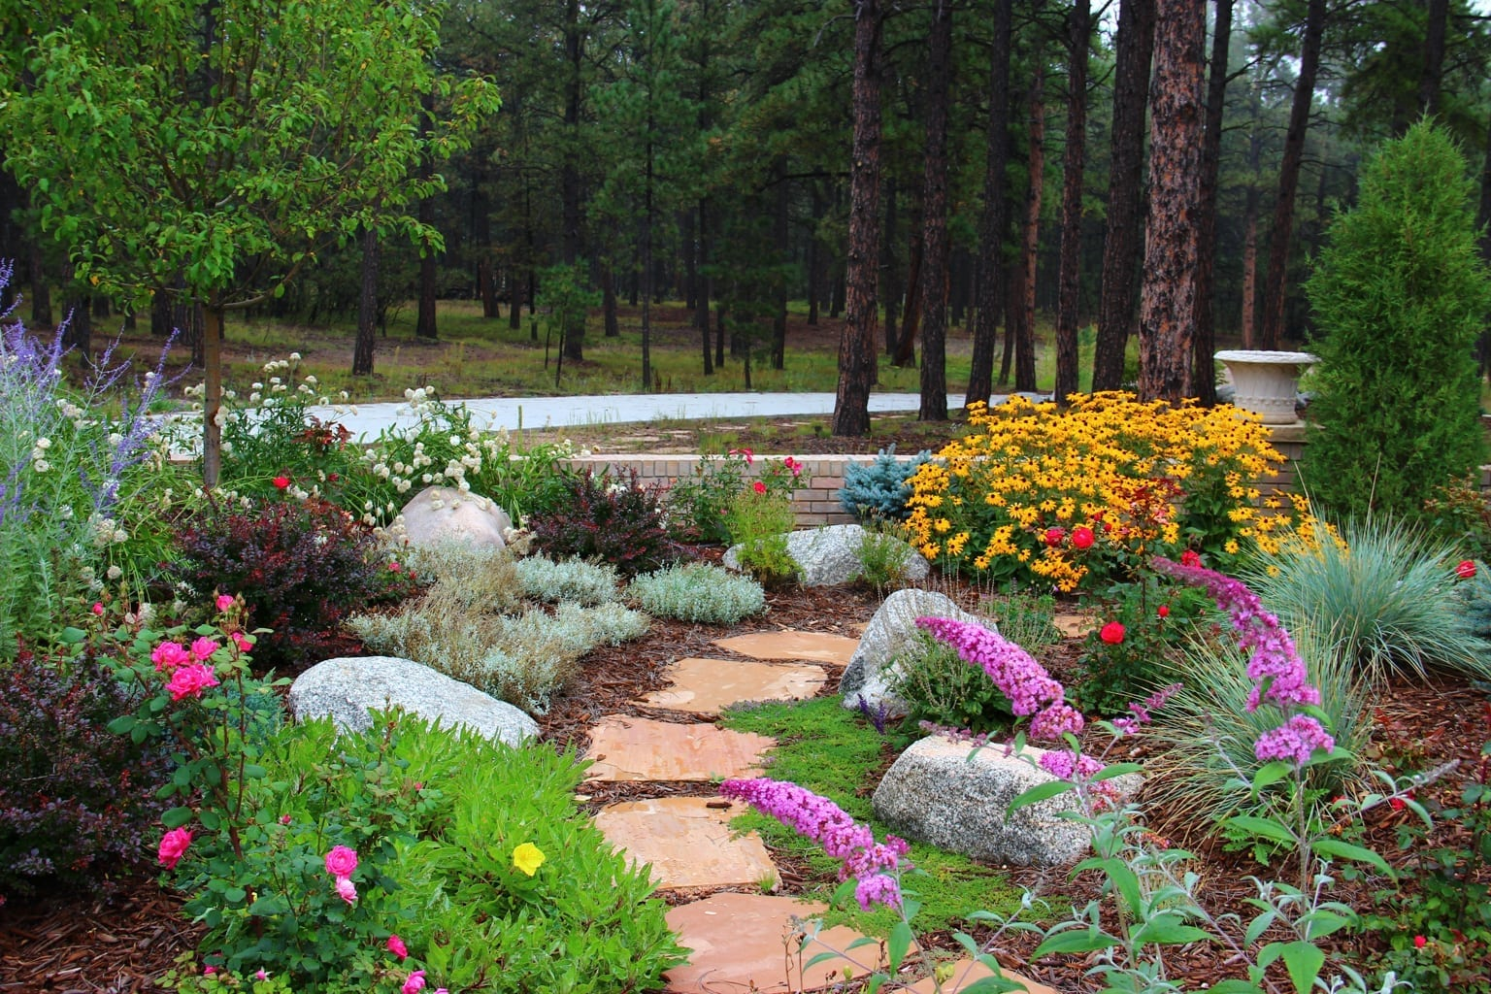
God the Gardener Psalm 107:4-9

Slide 2
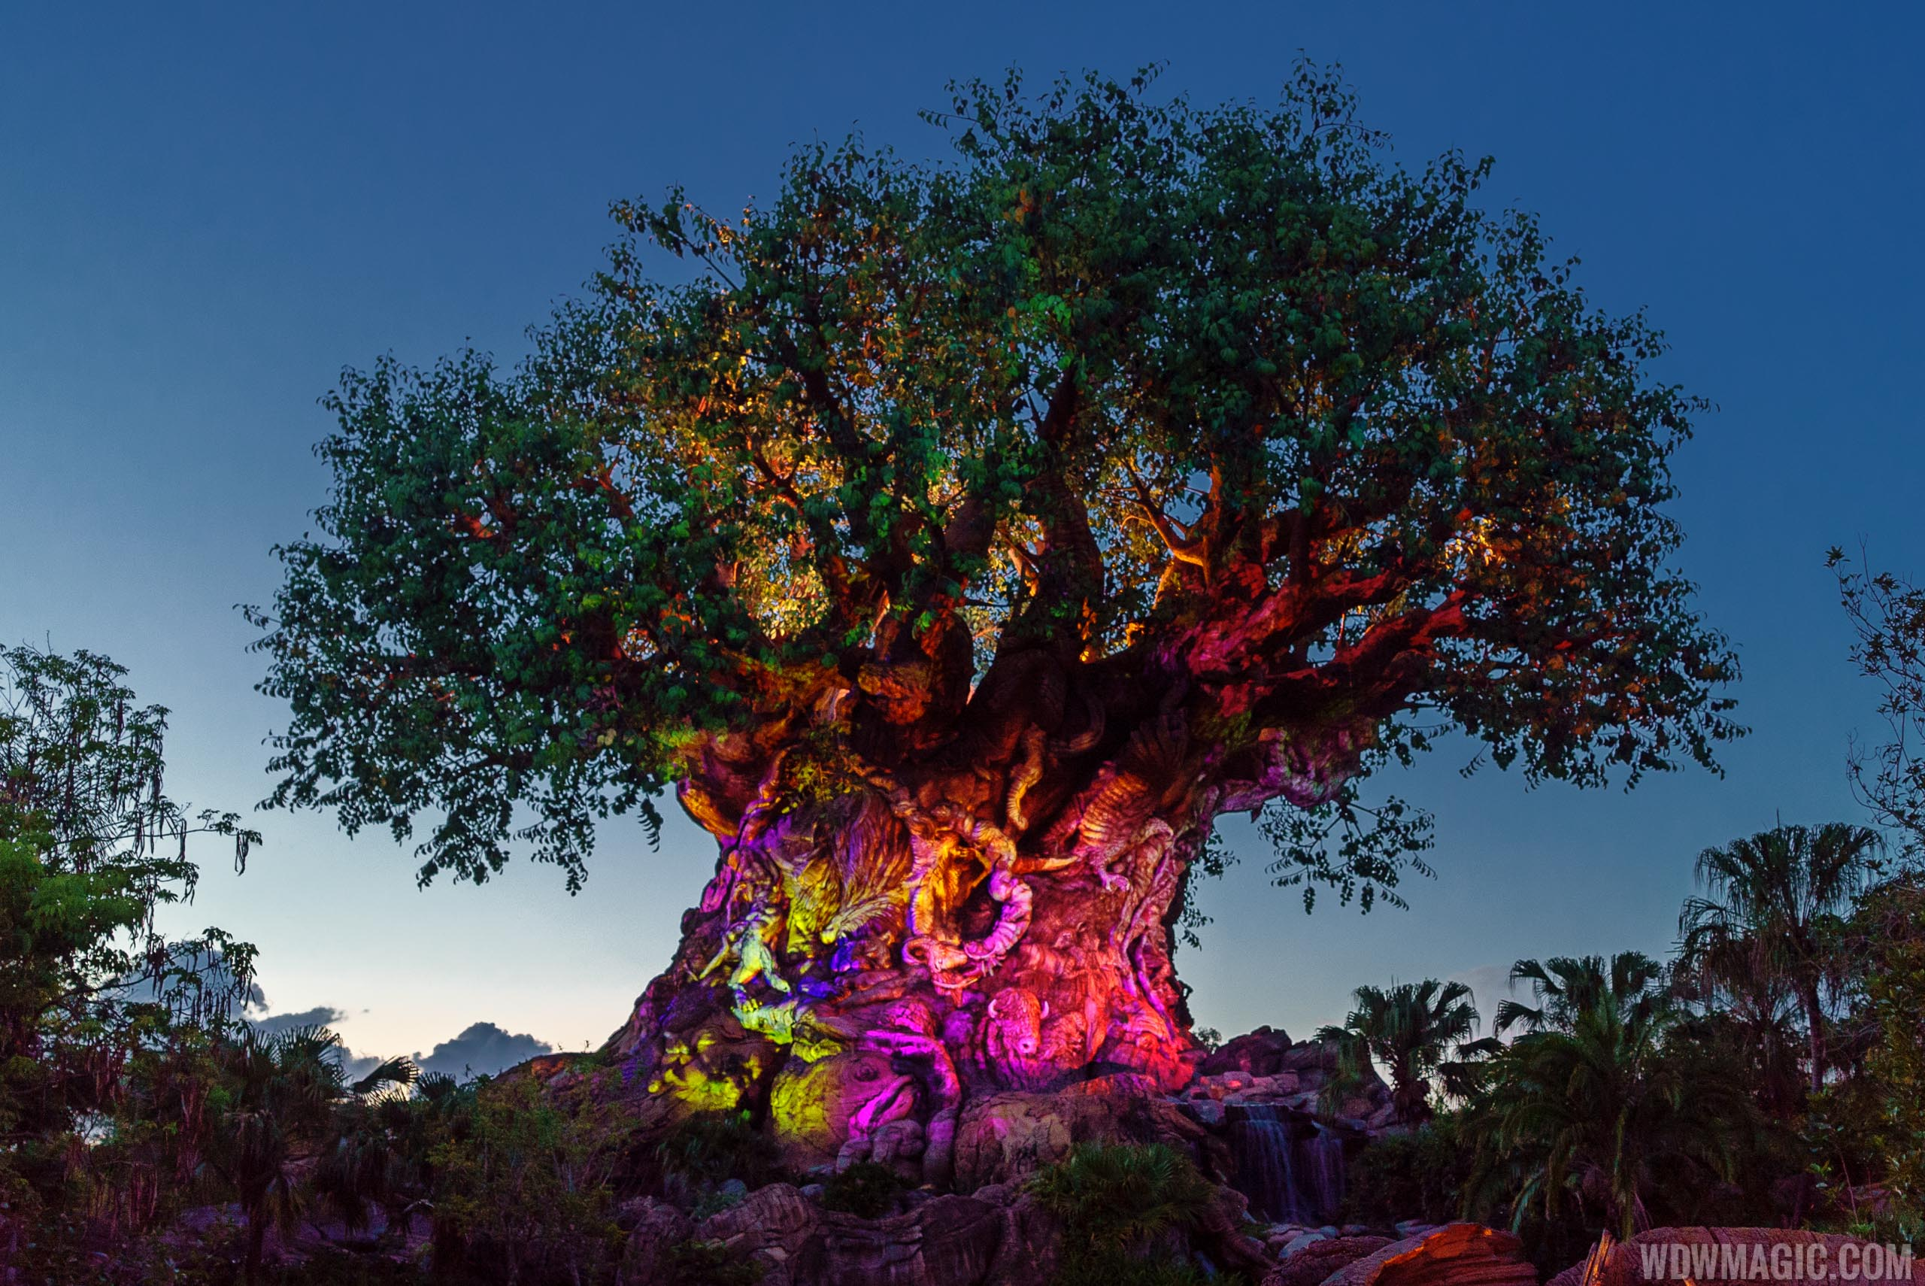
Christ the Carpenter
Col 1; Mk 6:3

Slide 3
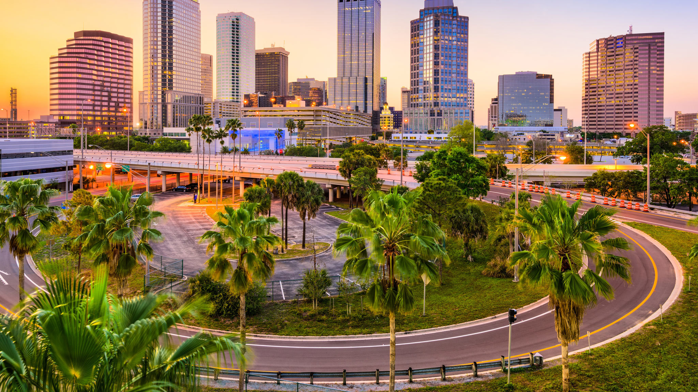
God the Citybuilder
Heb 11:10

Slide 4
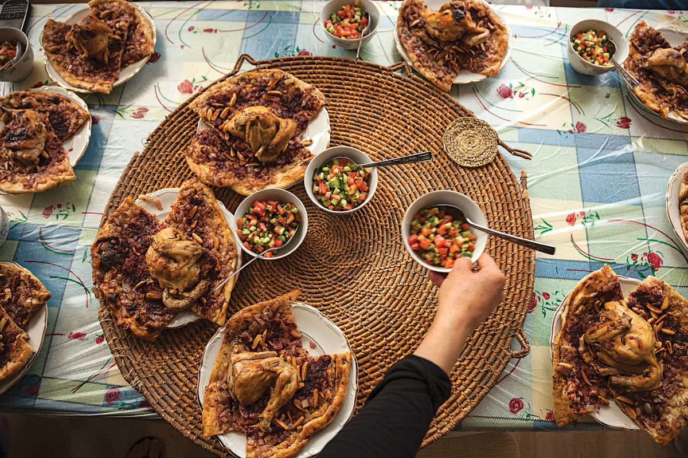
God the Provider
Psalm 23

Slide 5
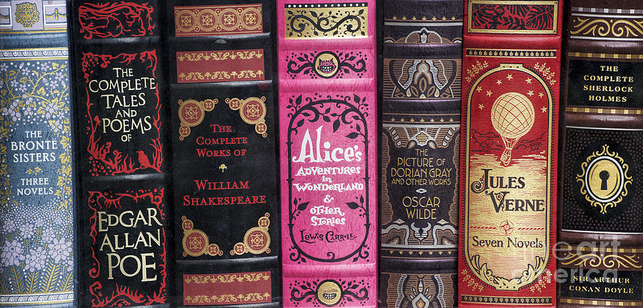
“The Gospels contain… a story of a larger kind which embraces all the essence of other stories. But this story has entered history & the primary world… This story is supreme; & it is true.”
-J.R.R. Tolkien

Slide 6
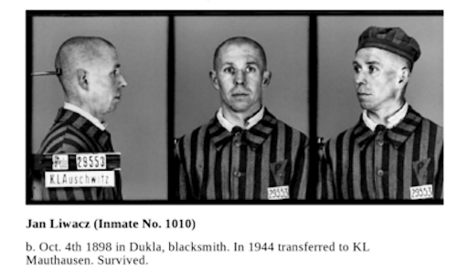

Slide 8
God, The Blacksmith
The Garden of Eden had precious metals.
Metal has always been highly valued.
Due to the difficulty of mining, [Job 28:1-11]
But Wisdom was valued higher. [28:12-22]
Wisdom is humility & the fear of God. [28:23-28]

Slide 9
God, The Blacksmith
Metal is often connected with worship.
In idols… & ordained by God. [Exod 31:1-5]
The metal is used in both good & bad ways.
A refinery passage stands out [Prov 27:21]:
Be introspective with the praise we hear.
What do we need to add or remove for purity?

Slide 10
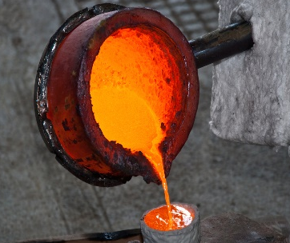
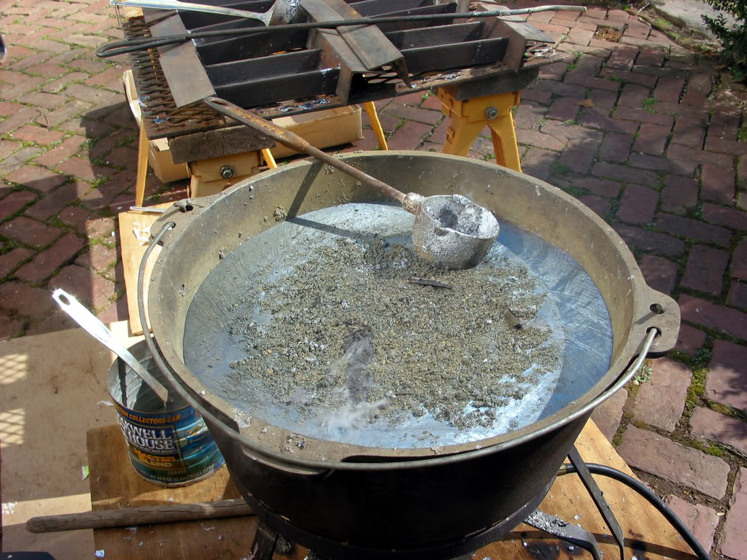
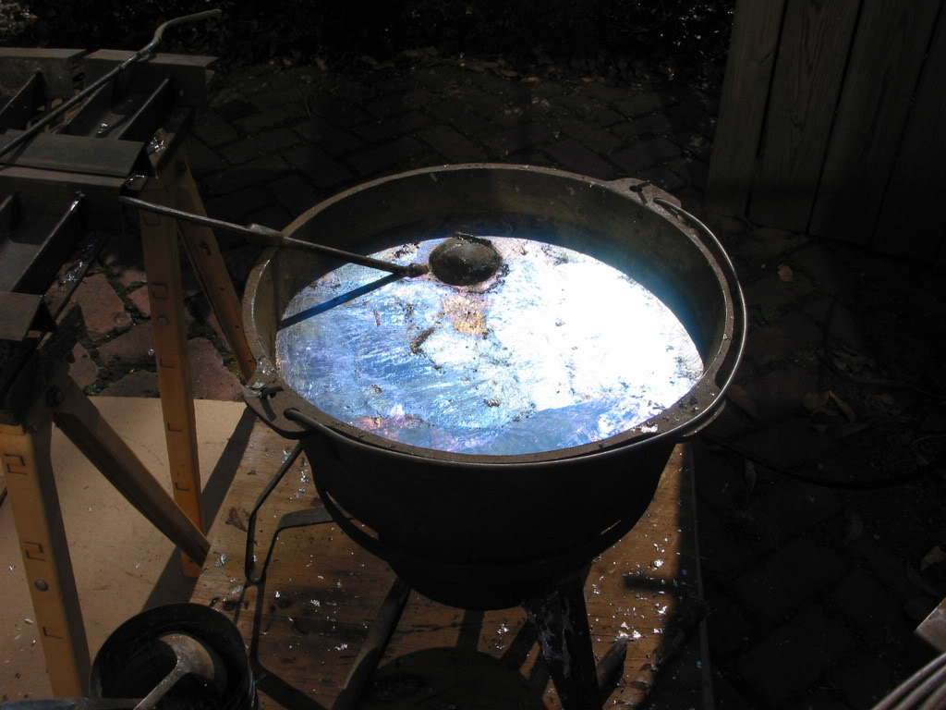
Salvation: The Production of Purity
God The Metal-Worker: Isa 1:21-26, 48:10; Jer 6:27-30, 9:7; Lam 4:1; [Ezk 22:17-22]
Occasionally in The 12, EG [Zech 13:7-9]
Refining Metal: An easy to understand process but difficult, long, & repetitious.
God refines His people for purity, holiness.

Slide 11
God, The Blacksmith
God uses metal analogies for our purity.
Often in the OT prophets [Ezekiel 22:17-22]
Sanctification is a process that must be repeated.
Sin ought not ruin us but remind us of His grace.
Refinery depicts The Final Judgement [2 Pet 3:10-12]
How will our work hold up? [1 Cor 3:10-13]

Slide 12
“The iron gates of death” Job 38:17; Psm 107
Death cannot keep it’s prey, Jesus, my Savior
He tore the bars away, Jesus, my Lord!
The iron bars of death are no match for… the Carpenter of Nazareth!

