Slide 1
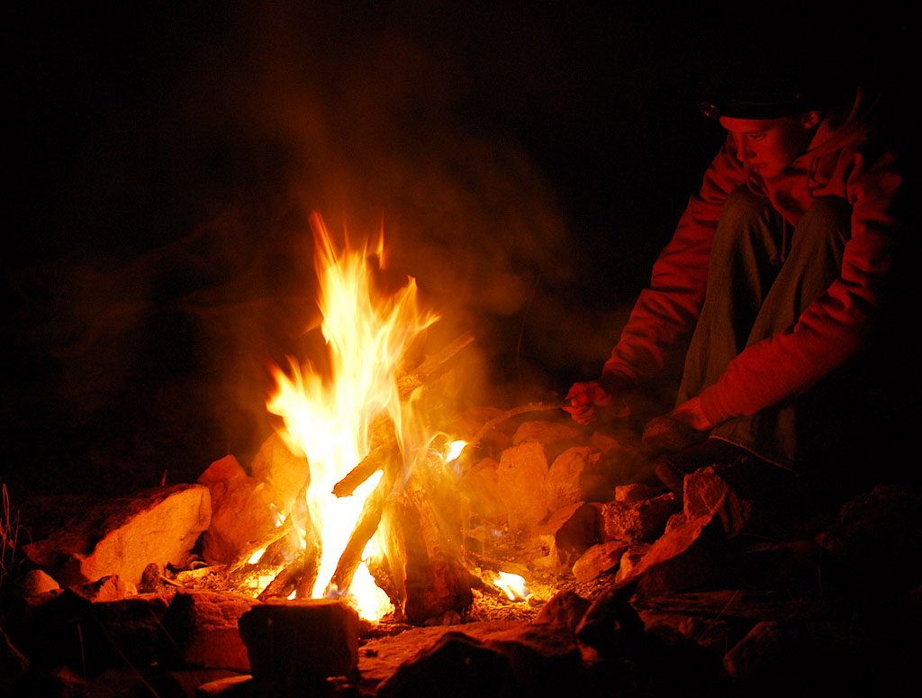
Seek Peace & Pursue It -Psalm 34:11-18
Peace, A Fruit of The Spirit & Important Aspect for Disciples of Jesus

Slide 2
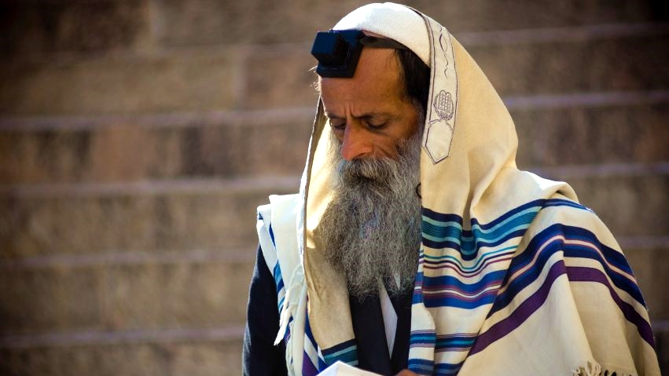
Hear the Priestly Blessing of [Num 6:22-27] cf. Num 25:12-13

Slide 3
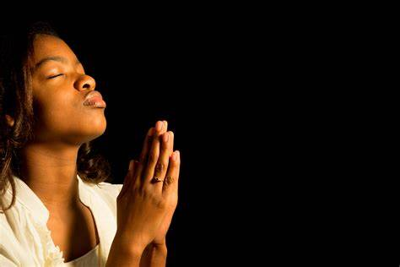
Peace is a major part of the bible story long before we get to… The Prince of Peace & The God of All Peace. Isa 9:6-7; 1 Th 5:23

Slide 4
Peace, A Fruit of The Spirit
Defined: It is more than “lack of war.” Includes, well-being.
Jesus: Declared peace-makers as sons of God. Mt 5:9 His famous sermon advises peace. Mt 5:38-48 It is Peter’s summary of God’s Word in Acts 10:36. Reminiscent of the angels in Lk 2:14: Glory to God in the highest, peace & good will among men.
YET, He gives realistic advice: [Lk 12:51-53; 19:41-46]. Some religious people will reject “terms of peace.”

Slide 5
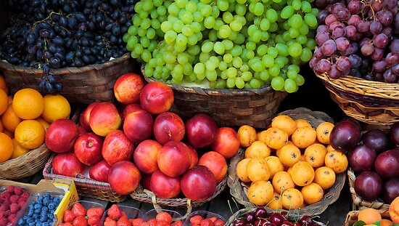
Peace, A Fruit of The Spirit
Defined: It is more than “lack of war.” Includes, well-being.
Jesus: Declared peace-makers as sons of God. Mt 5:9 YET, He gives realistic advice: [Lk 12:51-53; 19:41-46].
NT Letters: Strongest descriptions in Hebrews & James. Our opening psalm appears in [Heb 12:11-15] Similar to [1 Pet 3:8-12]. Righteousness=seeking peace. [Ja 3:13-18; 1:19-22; 2:15-16] Peace needs words & actions.

Slide 6
Peace, A Fruit of The Spirit
Jesus: Declared peace-makers as sons of God. Mt 5:9 YET, He gives realistic advice: [Lk 12:51-53; 19:41-46].
NT Letters: Strong descriptions, Heb 12 & James 1-3. Righteousness=seeking peace with words & actions.
Paul & Peace: Responding to the offer of God & His Son. The buildup in Romans leads to [Rom 8:1-8, 12-17]. …A belief relevant to “living life”: [12:14-21; 14:17-19].
The Spirit, fruit, & peace gathers in Galatians 5: Our walk [5:13-18] opposes the flesh [5:19-21]… and The Spirit leads us to righteous fruit: [5:22-24].
In [Eph 2:13-18] Christ made peace by sacrificially tearing down a wall that divided two groups.

Slide 7
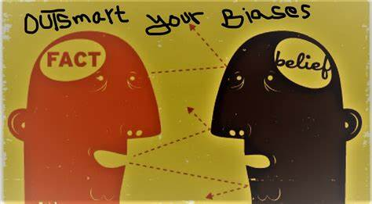
Peace, A Fruit of The Spirit
Jesus: Declared peace-makers as sons of God. Mt 5:9 YET, He gives realistic advice: [Lk 12:51-53; 19:41-46].
NT Letters: Strong descriptions, Heb 12 & James 1-3. Righteousness=seeking peace with words & actions.
Paul & Peace: A life led by The Spirit will seek peace! (Eph 2) See the buildup in Romans & the gathering in Galatians 5.
We must fight our confirmation bias!
Do we see others... positively or negatively?
Live by Christ’s rule! [Gal 6:2-3, 14-16]

