Slide 2
2 Corinthians 12:7
Because of the surpassing greatness of the revelations, for this reason, to keep me from exalting myself, there was given me a thorn in the flesh, a messenger of Satan to torment me to keep me from exalting myself!

Slide 3
2 Corinthians 12:8, 9
Concerning this I implored the Lord three times that it might leave me.
9 And He has said to me, “My grace is sufficient for you, for power is perfected in weakness.”

Slide 4
The Word “Grace”
Always associated with superlatives – (Jn. 1:16 Eph. 1:7, 8; 1 Tim. 1:14; 2 Cor. 9:8, 14)
“Grace upon grace…”
“Riches of Grace” “lavished” (ESV)
Overflowed (ESV)“More than abundant”
“Abound”
“Surpassing”

Slide 5
The Word “Grace”
We associate it with salvation (Ephesians 2:8)
But, it even goes beyond that, indicating God’s approval (James 1:18)

Slide 6
Many do not believe grace is sufficient
The prosperity gospel

Slide 7
‘Creflo Dollar’
“Some people come to me and say,, “I came here to seek peace and not money. I tell them, “You need money or you’re not going to have peace. Some people say that it all has to do with peace, joy and love. No, it all has to do with money.”

Slide 8
Many do not believe grace is sufficient
The prosperity gospel
The gospel of health

Slide 9
God’s power is perfected in weakness
It helped Paul not to exalt himself

Slide 10
2 Corinthians 9b
Most gladly, therefore, I will rather boast about my weaknesses, so that the power of Christ may dwell in me.

Slide 11
2 Corinthians 12:10
Therefore I am well content with weaknesses, with insults, with distresses, with persecutions, with difficulties, for Christ’s sake; for when I am weak, then I am strong.

Slide 12
“When I am weak, then I am strong”

Slide 13
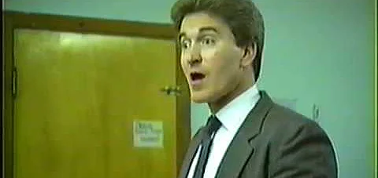
“When I am weak, then I am strong”

Slide 14
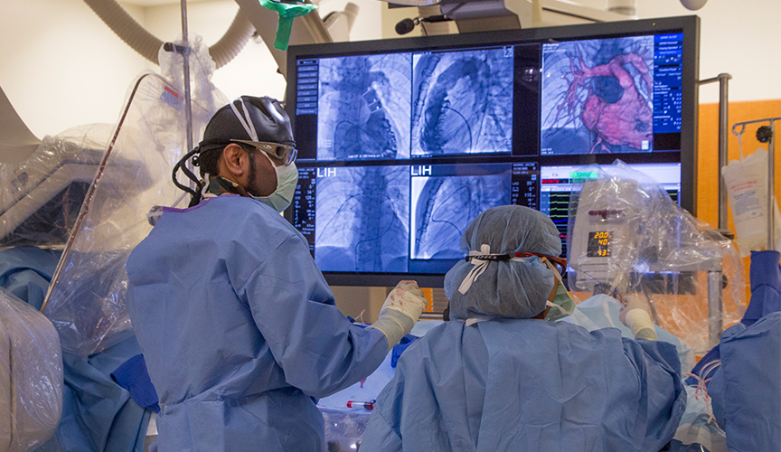
“You’ve had two heart attacks”

Slide 15
Dreams versus reality
The Dreams of Youth
The reality of life

Slide 16
“My grace is sufficient for you.”

