Slide 2
Giver or Taker?
Acts 20:35

Slide 3
God wants us to be givers!
Proverbs 11:25; 22:9
Acts 20:35 “More blessed to give than to receive”
Luke 6:38
1 Timothy 6:18
Hebrews 13:16
1 Corinthians 13:4-7

Slide 4
Givers in the Bible
Abraham
Boaz
Good Samaritan
Onesiphorus (2 Timothy 1)
Jesus (Matthew 20:28; John 10)
“The son of man did not come to be served but to serve and to give his life…”
“The good shepherd gives his life for the sheep.” (Jn 10:11)

Slide 5
Takers in the Bible
Jacob
Absalom
Ahab and Jezebel
Gehazi
Rich Young Ruler
Diotrephes
Satan

Slide 6
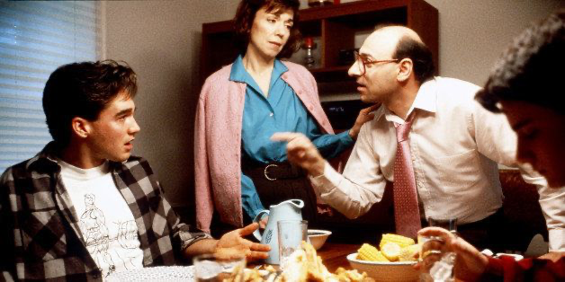
Problems caused by takers… in the home
Husbands
Wives
Parents
Children
Friends

Slide 7
Problems caused by takers in the local church
Attitudes about attendance
Attitudes towards service
Attitudes in controversy

Slide 8
The description of a “giver” in controversy - James 3:17,18
17 But the wisdom that is from above is first pure, then peaceable, gentle, willing to yield, full of mercy and good fruits, without partiality and without hypocrisy.
18 Now the fruit of righteousness is sown in peace by those who make peace.

Slide 9
How to root out “takerism”
Learn not to worry so much about self
Follow the examples of givers
Make a list of people you can help
Dedicate time each week for…
Calls, notes - babysitting
Visiting sick, shut ins - etc.
Pray!

