Slide 1
The three greatest spiritual enemies that threatens God’s people?
Different answers from men and women
Different answers from those 50 years and older and those younger.

Slide 2
Four Facts About Spiritual Enemies
Ephesians 6:12

Slide 3
1. You need to recognize that you have them!
Psalm 97:10 - “You that love the Lord hate evil!”

Slide 4
1. You need to recognize that you have them!
Psalm 119:104 - “Through your precepts I get understanding. Therefore I hate every false way.”

Slide 5
1. You need to recognize them!
Luke 6:26 - “Woe to you when all men speak well of you…”

Slide 6
2. Different enemies threaten more at different stages...
Stages of life (2 Tim. 2:22; Titus 2)

Slide 7
Titus 2 – Different threats at different stages of life
Older men – “Sound in love and patience” (vs. 2)
Older women – “Not given to much wine” (vs. 3)
Younger men – “Sound speech that cannot be condemned” (vs. 8)

Slide 8
2. Different enemies threaten more at different stages...
Stages of Bible history
Egyptian “gods” - Josh. 24:14
Canaanite “gods” - Judges 2:12
Apathy, Discouragement - Haggai
Spiritual Pride - Matthew 23
Judaizing teachers - Galatians
Gnosticism - 1 John, 1,2 Corinthians
Persecution - Revelation

Slide 9
2. Different enemies threaten more at different stages...
In “recent” history - known disciples:
1800 - 1860 - Denominations
1860 - 1900 - Prosperity, Desire to copy denominations
1900 - 1950 - Infighting
1950 - 1970 - Prosperity, Desire to copy denominations
1970 - 2000 - Infighting
2000 - Worldliness

Slide 10
3. Different generations often fear different enemies
Christians over 50 often fear…
Denominational error
“Institutionalism”
“Liberalism”

Slide 11
3. Different generations often fear different enemies
Christians under 40 often fear…
Overemphasis on externals
Pharisaism
Under emphasis on God’s grace and mercy

Slide 12
3. Different generations often fear different enemies

Slide 13
4. The enemy that “gets us” is usually the one we don’t fear.
Numbers 13:32, 33 -
…“All the people whom we saw in it are men of great stature.”
“There we saw the giants … and we were like grasshoppers in our own sight, and so we were in their sight.

Slide 14
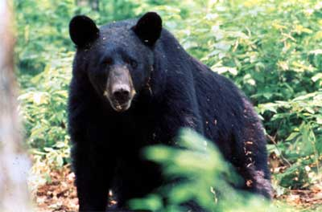
4. The enemy that “gets us” is usually the one we don’t fear.

Slide 15
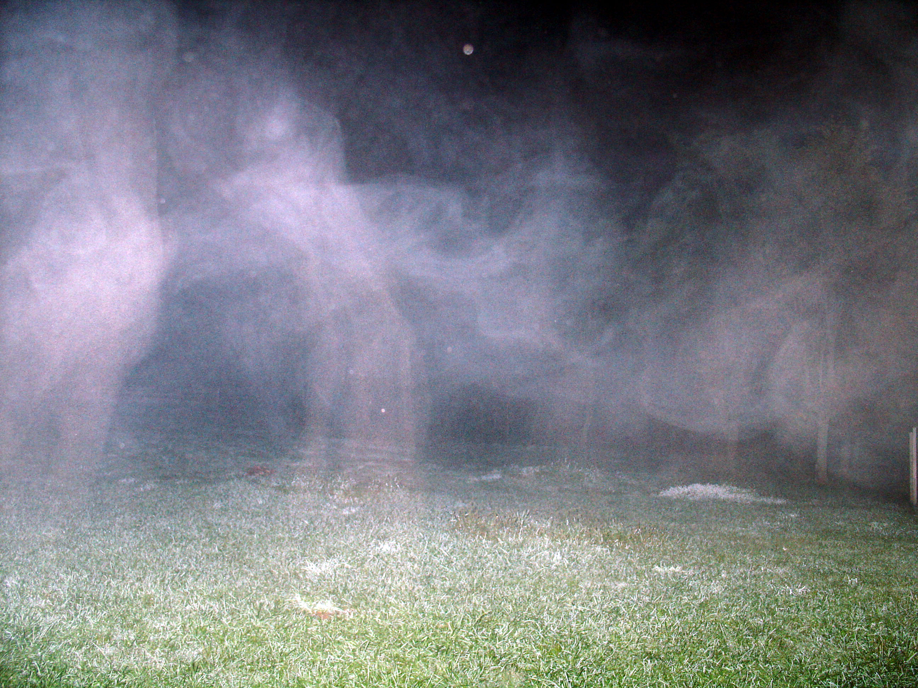
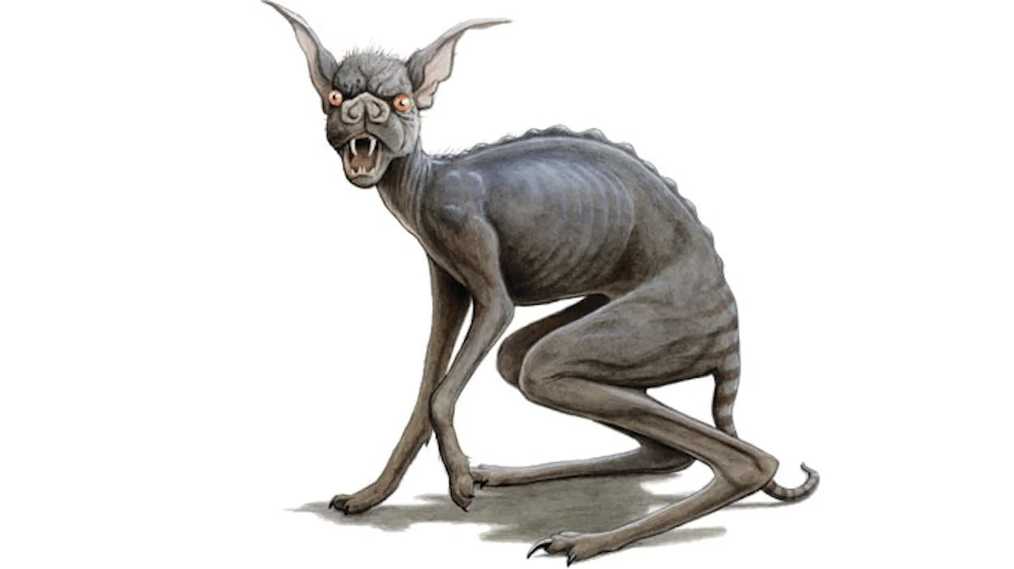
4. The enemy that “gets us” is usually the one we don’t fear.
1 Jn 2:16 – “the lust of the flesh and the lust of the eyes and the boastful pride of life,”

Slide 16
Satan’s 10 most effective weapons
10. Antireligious scientific theories
9. False religions
8. Party spirit among Christians
7. Spirit of presumption
6. Postmodernism

Slide 17
Satan’s 10 most effective weapons
5. Materialism
4. Comfortable Christianity
3. Worldliness (TV, movies, entertainment culture)
2. Lust of flesh, pornography
1. Pride/selfishness, lack of love

Slide 18
Enemies Beyond Our Comprehension
Eph. 6:12 “…powers, against the rulers of the darkness of this age, against spiritual hosts of wickedness in the heavenly places.”

Slide 19
Enemies Beyond Our Comprehension
But God has not left us defenseless - Ephesians 6:14 - 18 - The armor of God
Our greatest defense - A fervent love for God

