Slide 1
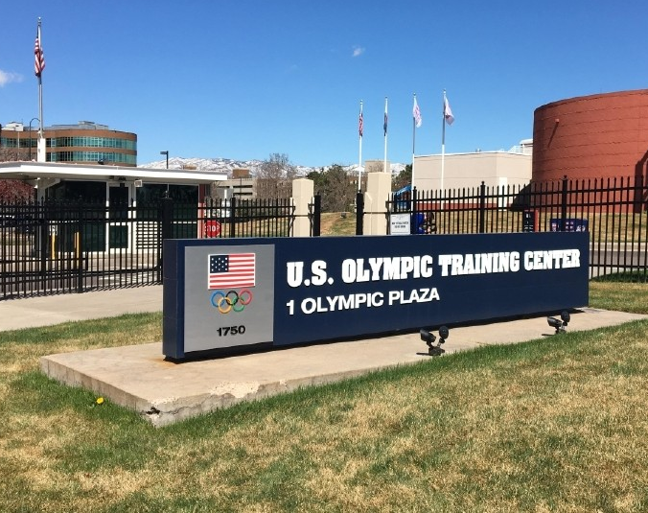
Training for Righteousness
1 Timothy 4:7-8

Slide 2
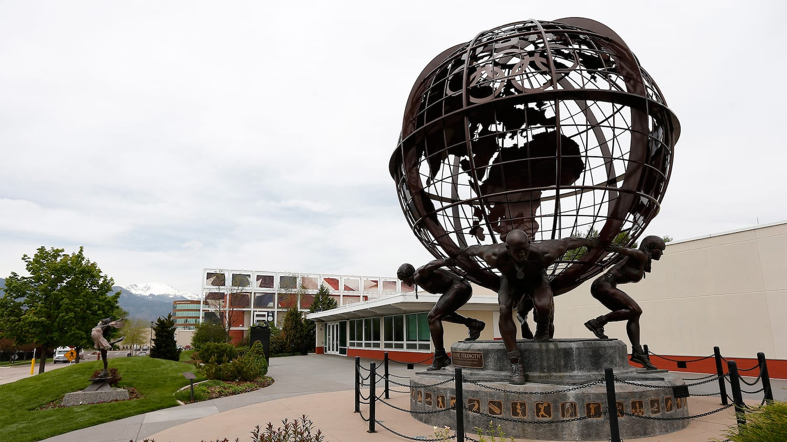
Training for Righteousness
1 Tim 4:7-8
What? Training involves small repetitive habits that make small changes over time…
Why? In preparation for a battle/event that will require skills to conquer/succeed.
Illustration: Physically fit for emergency.
Jesus’ View of The Event [John 12:27-28]
Jesus, Peter, & Prayer [Matt 26:30-46, 57-75]
What small disciplines will we do, to yield GREAT strength to deliver?

