Slide 1
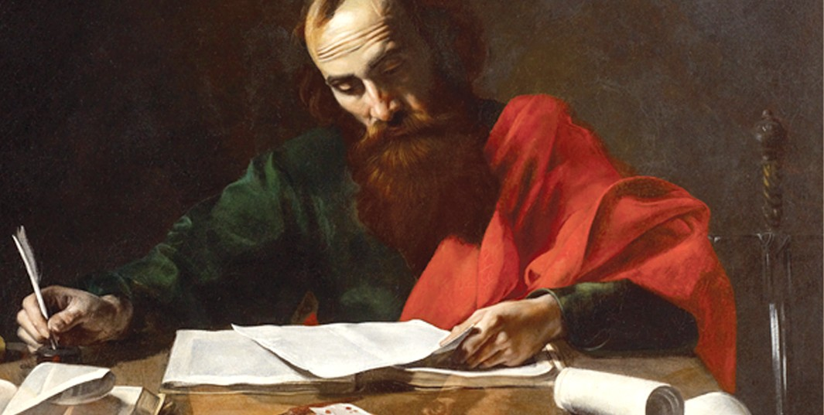
Paul & His Friends Romans 16

Slide 2
Paul & His Friends Rom 16
Conclusions Are Critical, Don’t Skip Them: [15:14-21]
He loved these saints & wanted to give reminders. He gave all credit to Christ & solicited prayers [30-33].
Paul’s Friends In Rome: [16:1-16]
Women, like deaconess Phoebe, were important to Paul. Prisca & Aquila, risked their necks for Paul. Included fellow kinsman & those in Christ before him. These families of co-workers were of great benefit!
Paul’s Warnings [17-20] & Paul’s Friends With Him [21-27]
“We can only guess which ones might have been ‘weak’ & which ‘strong’ but we can be reasonably sure he was careful to greet them all with equal enthusiasm. All sorts of things can be read into accidental omissions. Paul did not want to arrive at Rome & find that he had caused fresh divisions by appearing to favor one group over another.”
(Wright, 761)

Slide 3
Paul & His Friends Rom 16
Conclusions Are Critical, Don’t Skip: [15:14-21, 30-33] Paul’s Friends In Rome Were Diverse & Brave: [16:1-16]
Paul’s Warnings [17-20]
This hard truth is abundant in Paul’s letters. [2 Th 3] Note those who are divisive & don’t follow the NT. [Titus 3]
Paul’s Friends With Him [21-27]
Praise for Timothy [Php 2:19-24]. Some incredible saints! And finally, incredible praise for God’s Full Powerful Plan!

