Slide 1
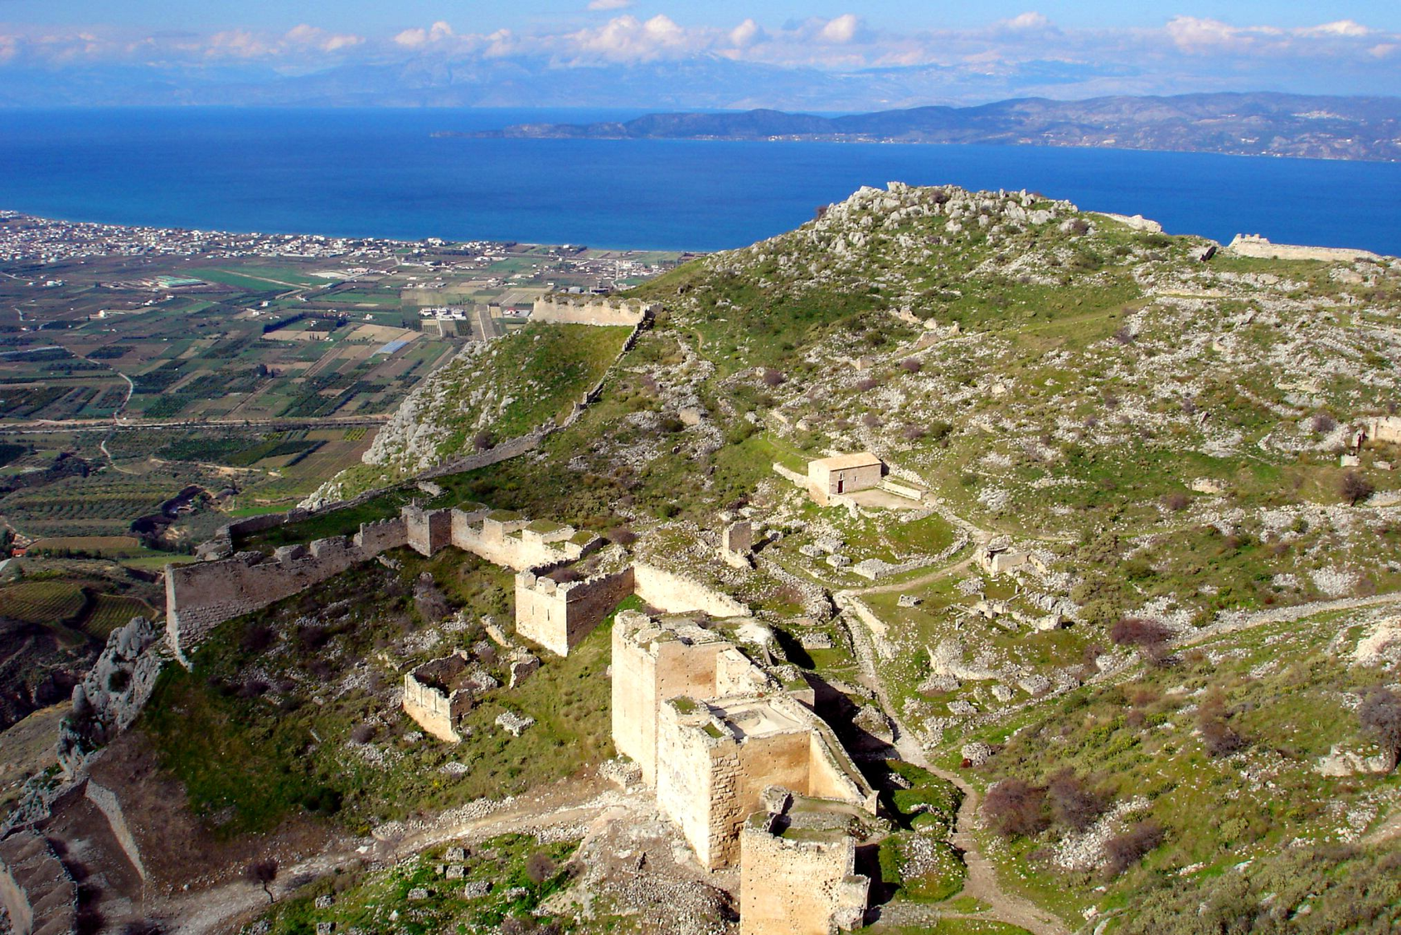
Concerns at Corinth
How did they think of Christ?

Slide 2
Opening someone else’s mail
Could be taken as:
“I have no business reading it”
“It does not apply to me”
However, for us the history helps to understand the subjects written about and how they apply to us!

Slide 3
Opening someone else’s mail
Philippians 3:17 (ESV)
¹⁷Brothers, join in imitating me, and keep your eyes on those who walk according to the example you have in us.

Slide 4
Opening someone else’s mail
2 Timothy 1:13 (ESV)
¹³Follow the pattern of the sound words that you have heard from me, in the faith and love that are in Christ Jesus.

Slide 5
Opening someone else’s mail
1 Corinthians 11:1 (ESV)
Be imitators of me, as I am of Christ.

Slide 6
Concerns at Corinth
How did they think of Christ?
Notes:
1 Corinthians is a letter in response to things reported to Paul, and questions asked of him. Today’s focus is on some of the ways they thought of Christ, pointing toward the Lord’s supper in chapter 11.
Paul approaches idolatry, boasting, judgement, conscience, spiritual gifts, behavior as things they need to work on; he goes back and forth on the subjects, some of which are introduced but addressed later in the letter.
Remember that these are subjects relevant to them regarding things they would be familiar with, and the letter would most likely have been read at once, so the matters addressed would be understood even when given in different places.

Slide 7
Concerns at Corinth
How did they think of Christ?
Jews and Greeks (gentiles) worshipped there:
1 Corinthians 1:24 (ESV)
²⁴but to those who are called, both Jews and Greeks, Christ the power of God and the wisdom of God.
1 Corinthians 12:13 (ESV)
¹³For in one Spirit we were all baptized into one body—Jews or Greeks, slaves or free—and all were made to drink of one Spirit.
Notes:
The reading in Acts gives a backdrop for Paul being there. Acts 18:27 (Achaia) and 19:1 places Apollos in Corinth upon his understanding the word more accurately. The passage also signifies both Jews and gentiles believing. These passages reinforce them being both Jews and gentiles; 12:13 also shows different social classes.

Slide 8
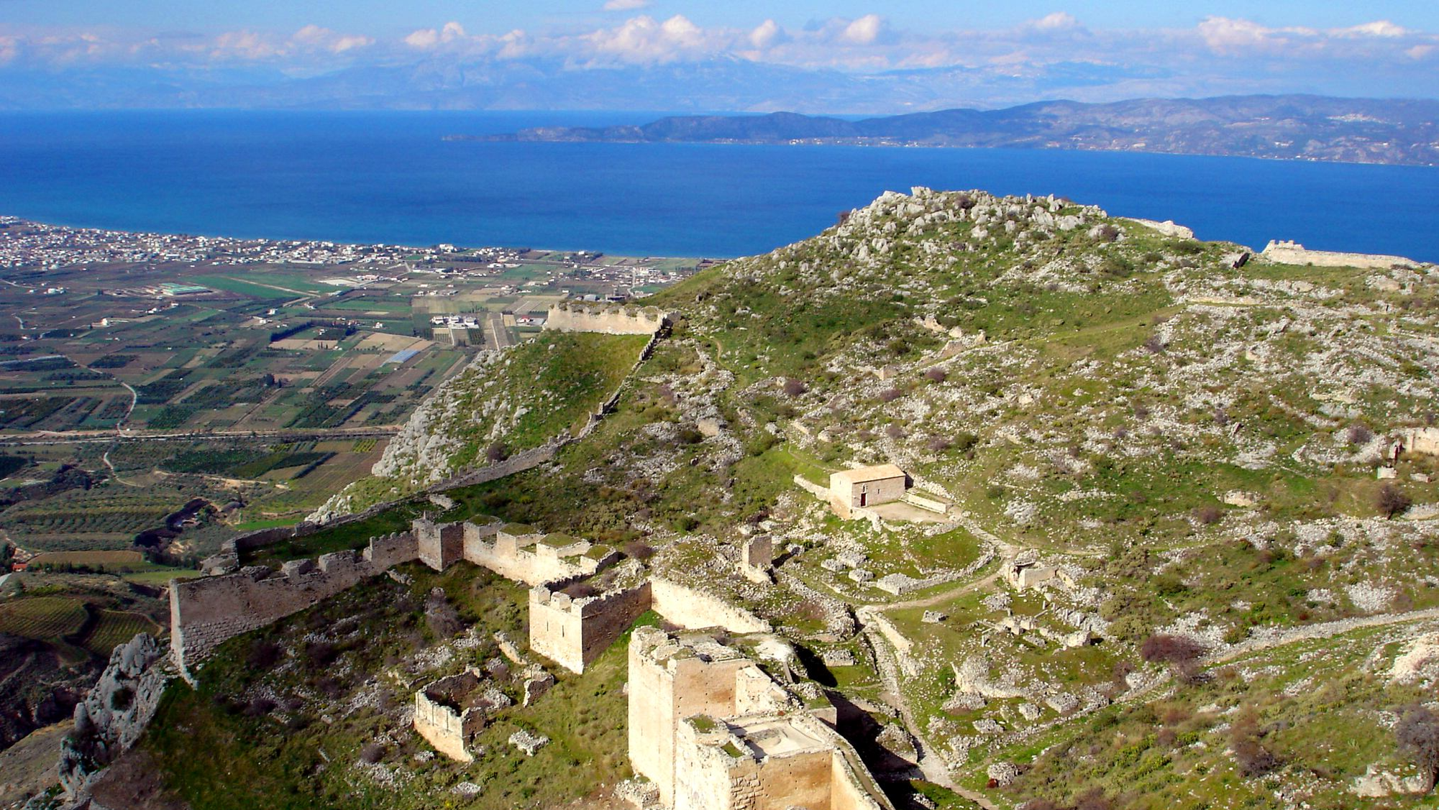
Concerns at Corinth
How did they think of Christ?
Summation of the city:
The city of Corinth was at the heart of an important trade route in the ancient world. Like many cities that thrive on trade, Corinth had a reputation for sexual immorality, religious diversity, and corruption.
The Holy Bible: English Standard Version (1 Co). (2016). Crossway Bibles.

Slide 9
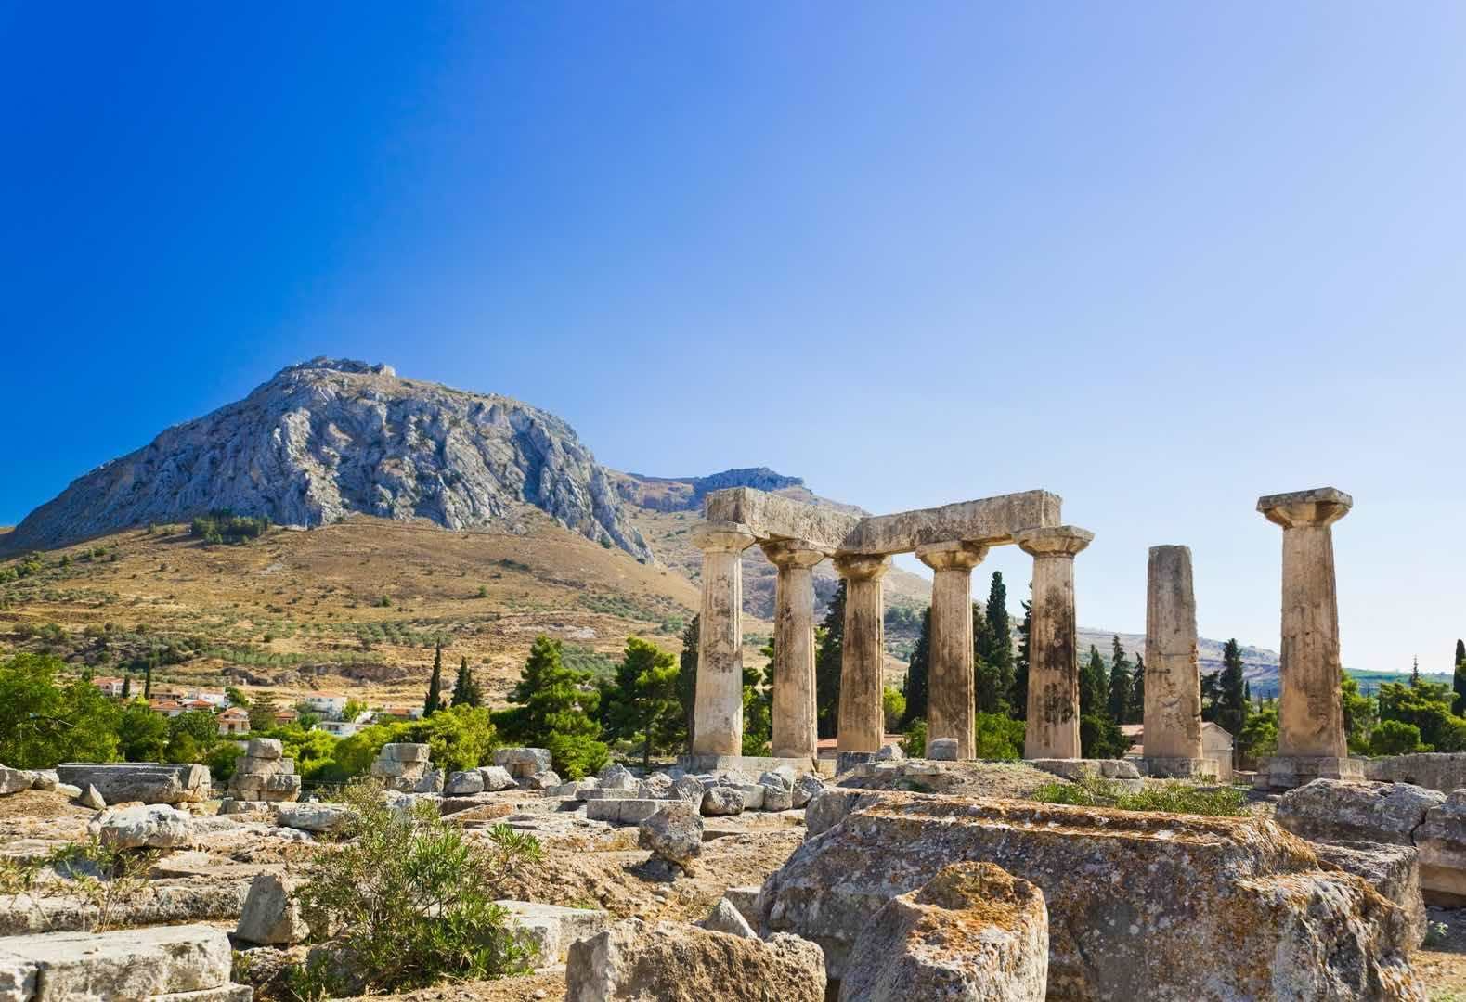
Notes:
Acropolis (Acrocorinth)

Slide 10
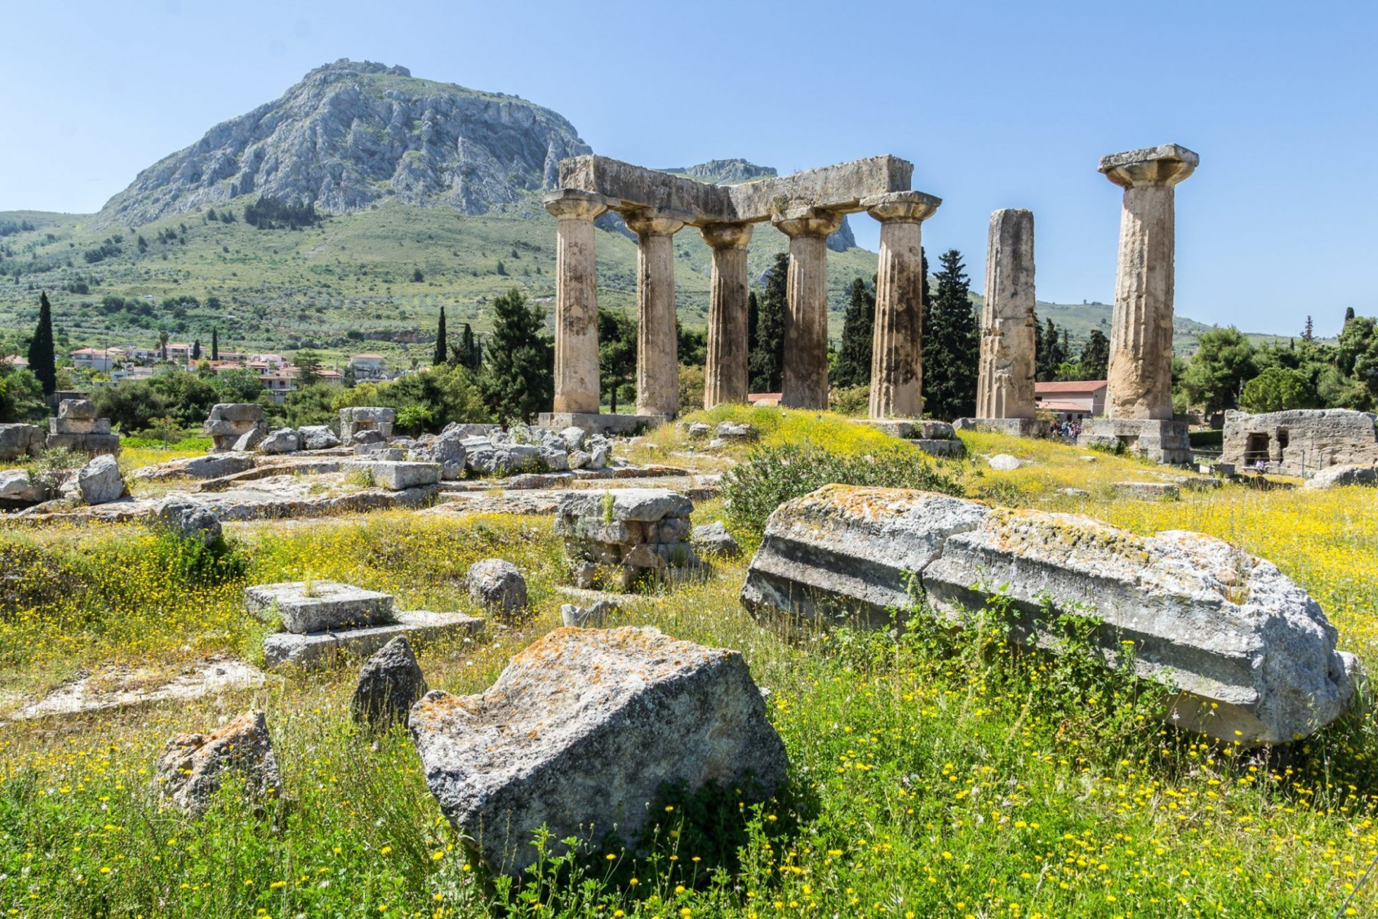

Slide 11
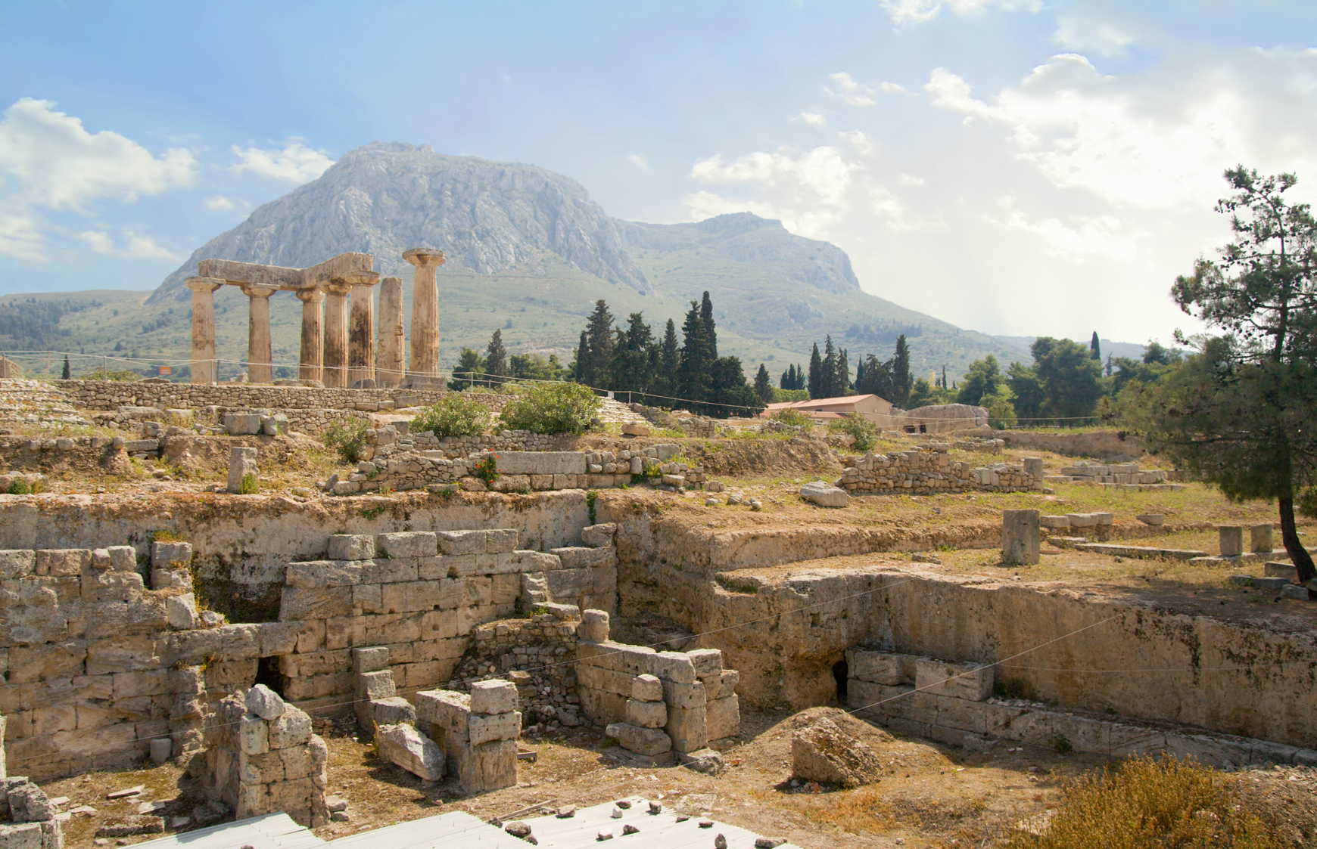

Slide 12
Concerns at Corinth
How did they think of Christ?
Divisions: 1 Corinthians 1:10–13 (ESV)
¹⁰I appeal to you, brothers, by the name of our Lord Jesus Christ, that all of you agree, and that there be no divisions among you, but that you be united in the same mind and the same judgment.
¹¹For it has been reported to me by Chloe’s people that there is quarreling among you, my brothers.
¹²What I mean is that each one of you says, “I follow Paul,” or “I follow Apollos,” or “I follow Cephas,” or “I follow Christ.”
¹³Is Christ divided? Was Paul crucified for you? Or were you baptized in the name of Paul?
Notes:
Divisions – “I follow Carl” or “I follow Coulter”; “I follow Roger” or “I follow Christ” – remember, the Jews had different sects – Scribes, Pharisees, Sadducees, Essenes

Slide 13
Concerns at Corinth
How did they think of Christ?
Paul glorifies Christ:
1 Corinthians 2:2 (ESV)
²For I decided to know nothing among you except Jesus Christ and him crucified.
1 Corinthians 3:11 (ESV)
¹¹For no one can lay a foundation other than that which is laid, which is Jesus Christ.

Slide 14
Concerns at Corinth
How did they think of Christ?
As some of them deny the resurrection:
1 Corinthians 15:12 (ESV)
¹²Now if Christ is proclaimed as raised from the dead, how can some of you say that there is no resurrection of the dead?

Slide 15
Concerns at Corinth
How did they think of Christ?
Leaven (an appeal to Jews using the Passover):
1 Corinthians 5:6–8 (ESV)
⁶Your boasting is not good. Do you not know that a little leaven leavens the whole lump?
⁷Cleanse out the old leaven that you may be a new lump, as you really are unleavened. For Christ, our Passover lamb, has been sacrificed.
⁸Let us therefore celebrate the festival, not with the old leaven, the leaven of malice and evil, but with the unleavened bread of sincerity and truth.
Notes:
Problem with boasting, and that about evil. Unleavened bread was commanded during the passover.
What is our festival? Observing the Body and the Blood of Christ!

Slide 16
Concerns at Corinth
How did they think of Christ?
Christ’s Use of Leaven, both good and bad:
Matthew 13:33 (ESV)
³³He told them another parable. “The kingdom of heaven is like leaven that a woman took and hid in three measures of flour, till it was all leavened.”
Matthew 16:6 (ESV)
⁶Jesus said to them, “Watch and beware of the leaven of the Pharisees and Sadducees.”
Notes:
Growth of the kingdom; spread of evil

Slide 17
Concerns at Corinth
How did they think of Christ?
Background of idolatry (an appeal to the gentiles):
1 Corinthians 6:9–11 (ESV) ⁹Or do you not know that the unrighteous will not inherit the kingdom of God? Do not be deceived: neither the sexually immoral, nor idolaters, nor adulterers, nor men who practice homosexuality, ¹⁰nor thieves, nor the greedy, nor drunkards, nor revilers, nor swindlers will inherit the kingdom of God. ¹¹And such were some of you. But you were washed, you were sanctified, you were justified in the name of the Lord Jesus Christ and by the Spirit of our God.
1 Corinthians 10:7 (ESV)
⁷Do not be idolaters as some of them were; as it is written, “The people sat down to eat and drink and rose up to play.”
Notes:
Justified in Christ
Warning not to be idolaters

Slide 18
Concerns at Corinth
How did they think of Christ?
1 Corinthians 10:14–22 (ESV)
¹⁴ Therefore, my beloved, flee from idolatry. ¹⁵ I speak as to sensible people; judge for yourselves what I say. ¹⁶ The cup of blessing that we bless, is it not a participation in the blood of Christ? The bread that we break, is it not a participation in the body of Christ? ¹⁷ Because there is one bread, we who are many are one body, for we all partake of the one bread. ¹⁸ Consider the people of Israel: are not those who eat the sacrifices participants in the altar?
Notes:
Participation in the Blood and Body of Christ

Slide 19
Concerns at Corinth
How did they think of Christ?
1 Corinthians 10:14–22 (ESV)
¹⁹ What do I imply then? That food offered to idols is anything, or that an idol is anything? ²⁰ No, I imply that what pagans sacrifice they offer to demons and not to God. I do not want you to be participants with demons. ²¹ You cannot drink the cup of the Lord and the cup of demons. You cannot partake of the table of the Lord and the table of demons. ²² Shall we provoke the Lord to jealousy? Are we stronger than he?
Notes:
He has been addressing food offered to idols and conscience, but boldly states it is either Christ or demons!

Slide 20
Concerns at Corinth
How did they think of Christ?
1 Corinthians 11:17–34 (ESV)
¹⁷But in the following instructions I do not commend you, because when you come together it is not for the better but for the worse.
¹⁸For, in the first place, when you come together as a church, I hear that there are divisions among you. And I believe it in part,
¹⁹for there must be factions among you in order that those who are genuine among you may be recognized.
²⁰When you come together, it is not the Lord’s supper that you eat.
²¹For in eating, each one goes ahead with his own meal. One goes hungry, another gets drunk.
Notes:
He commends them in 11:2, but here he specifically does not!
When they are assembled
Divisions, factions (which shows those who are genuine – they are not judged)
What are they observing? Eating a meal, not together; from no food to gluttonous – remember different social classes? Like a meal in an idol’s temple? Table of demons?

Slide 21
Concerns at Corinth
How did they think of Christ?
1 Corinthians 11:17–34 (ESV)
²²What! Do you not have houses to eat and drink in? Or do you despise the church of God and humiliate those who have nothing? What shall I say to you? Shall I commend you in this? No, I will not.
Notes:
Eat at home! (May be an example of assembling somewhere besides someone’s home) 1 Corinthians 16:19 (ESV)
¹⁹The churches of Asia send you greetings. Aquila and Prisca, together with the church in their house, send you hearty greetings in the Lord.
They were leaving others out – imagine rushing to finish before someone in need comes, or possibly eat in front of them without sharing!
The reverse of a commendation!

Slide 22
Concerns at Corinth
How did they think of Christ?
1 Corinthians 11:17–34 (ESV)
²³For I received from the Lord what I also delivered to you, that the Lord Jesus on the night when he was betrayed took bread,
²⁴and when he had given thanks, he broke it, and said, “This is my body, which is for you. Do this in remembrance of me.”
²⁵In the same way also he took the cup, after supper, saying, “This cup is the new covenant in my blood. Do this, as often as you drink it, in remembrance of me.”
²⁶For as often as you eat this bread and drink the cup, you proclaim the Lord’s death until he comes.
Notes:
He was not at the table with Christ and the apostles but received instruction from the Lord.

Slide 23
Concerns at Corinth
How did they think of Christ?
1 Corinthians 11:17–34 (ESV)
²⁷Whoever, therefore, eats the bread or drinks the cup of the Lord in an unworthy manner will be guilty concerning the body and blood of the Lord.
²⁸Let a person examine himself, then, and so eat of the bread and drink of the cup.
²⁹For anyone who eats and drinks without discerning the body eats and drinks judgment on himself.
Notes:
They were so self consumed that what they did was unrecognizable as the Lord’s supper!
The guilt of crucifying Christ would be incurred because of improper observance!
Examine ourselves (individual observance) and discern that we are remembering Christ and not eating or drinking anything else!

Slide 24
Concerns at Corinth
How did they think of Christ?
1 Corinthians 11:17–34 (ESV)
³⁰That is why many of you are weak and ill, and some have died.
³¹But if we judged ourselves truly, we would not be judged.
³²But when we are judged by the Lord, we are disciplined so that we may not be condemned along with the world.
³³So then, my brothers, when you come together to eat, wait for one another—
³⁴if anyone is hungry, let him eat at home—so that when you come together it will not be for judgment. About the other things I will give directions when I come.
Notes:
Some, not all are guilty of these practices. No judgement to those who are true in discerning
The rebuke is from the Lord as discipline for their own good.
To be taken together - not to exclude and not a common meal.
We do not eat of this to satisfy our hunger! We do that at home, never in worship.

Slide 25
Concerns at Corinth
How did they think of Christ?
Paul’s admonitions:
1 Corinthians 15:58 (ESV)
⁵⁸Therefore, my beloved brothers, be steadfast, immovable, always abounding in the work of the Lord, knowing that in the Lord your labor is not in vain.
1 Corinthians 16:13–14 (ESV)
¹³Be watchful, stand firm in the faith, act like men, be strong.
¹⁴Let all that you do be done in love.

Slide 26
Concerns at Corinth
How should we think of Christ
when observing the Lord’s Supper?
As our Passover Lamb ”celebrating the festival” in sincerity and truth. 1 Corinthians 5:6–8
Choose to serve and remember Christ! 1 Corinthians 10:14-22
We eat of the bread, His “body”
We drink of the cup, the new covenant in His blood
We remember Him
We proclaim the Lord’s death until he comes!

