Slide 1
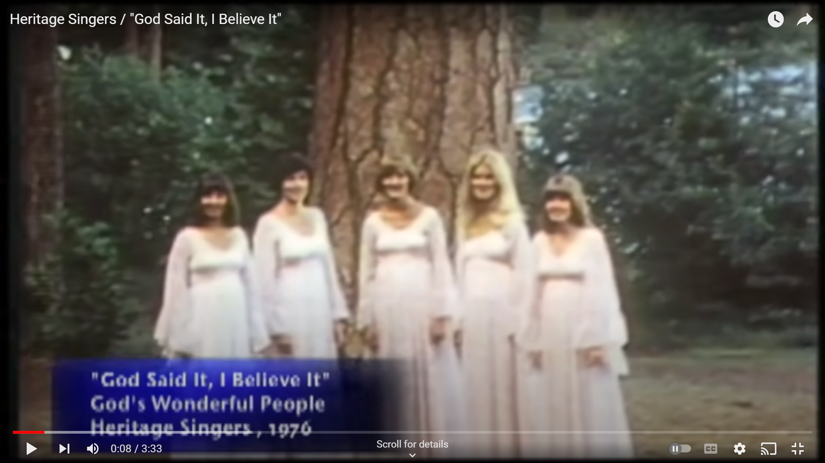
Another evidences Lesson
The Heritage Singers:
God Said It, I Believe It, That Settles It For Me (1976)

Slide 3
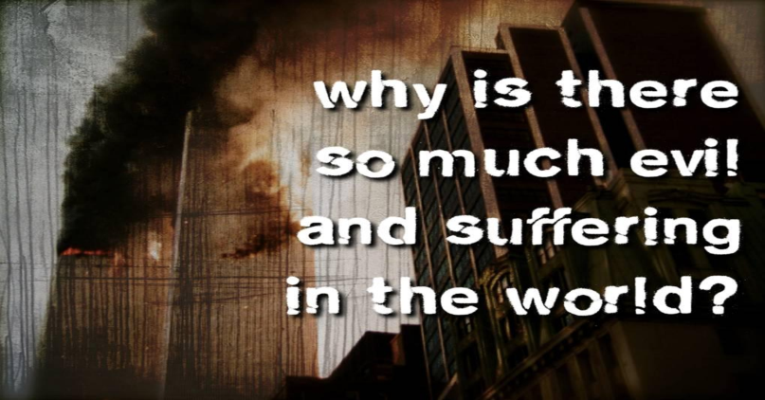
Parents…
Have we spent time on this question?
Are we training their mind to think deeply?
Do we know them well enough for conversation?
Do we know the question?
If God is all-loving & all-powerful, Why does he allow great suffering in this world?

Slide 4
The Question…
If God is all-loving & all-powerful, Why does he allow great suffering in this world?
Two Approaches: Emotional or Intellectual
1) Atheism: Suffering argues against God of Bible.
2) Theism: a) Finitism: God isn’t all-powerful.
b) Sadism: God isn’t all-loving.
3) Hinduism: It’s all your imagination. Buddhism, inherited. Judaism, a variety of answers.
4) Agnosticism: Sometimes it can be admirable humility.

Slide 5
Definitions…
All-powerful? Doesn’t mean: God can make a round square. That’s absurd.
All-loving? Doesn’t mean: God will force people to sincerely love others.
Suffering? Good & evil requires a standard? But what or who defines what is EVIL?
Press for a Clarification: Is it impossible or improbable that God exists?

Slide 6
Three Things…
Be Careful Determining Your Answer
What are the human limitations? Can we see the bigger picture needed?
What is the full scope of ALL the evidence? Probability is affected by background info. Which side has more arguments?
Why does Christianity embrace suffering? Our heroes are models of suffering: [2 Cor 11:23-28; 6:3-5] They look beyond today. [6:9-10; 4:7-12; 4:16-18]

