Slide 1
What “Traditions” Did the Apostles Teach
A foundational sermon on “1st Principles.”
[2 Thessalonians 2:15]

Slide 2
“Traditions” Taught By The Apostles
1) Traditions Could Be Positive [2 Thess 3:6-12]
2) Devotion to Apostolic Teaching [Acts 2:42] Ac 5:28, 11:25-26, 13:12, 17:19, 18:12-16, 19:8-10, 20:17-21, 28:30-31].
3) An Inspired Standard of Teaching [Ro 6:17-19] Paul claims his standard is inspired [2Ti 1:10-11, 13-14]. Hear His praise for the Thessalonians, [1 Th 2:3-7, 11-13]. And Peter calls Paul’s writings Scripture. 2 Peter 3:15-16
The FOUNDATION for 1st principles: We must first be united on the Apostolic Texts!

Slide 3
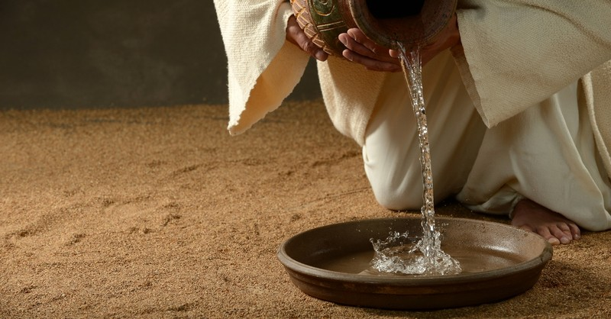
Jesus & 1st Principles
God
Jesus
The Spirit
Apostles

Slide 4
Jesus & 1st Principles
1) The 1st & 2nd Greatest Commands: [Mk 12:28-34]
This principle should clearly change our behavior. Cf. Mk 12:38-40
2) Jesus Emphasized Proper Character: [Matt 23:23]
Justice. Mercy. Faithfulness. Treat God & others right.
3) Jesus Praised Humility & Service: (John 13:12-17)
A) Parables on Humility:
Don’t presumptuously take the best seat. [Lk 14:7-11]
The Prayer Parable may say it best, (Lk 18:13) Be merciful!
B) Service was clearly taught to His Leaders:
He defined LOVE by humble service in Jn 13:12-17.
All humanity shares this struggle [Mt 23:11-12; 20:20-28].

Slide 5
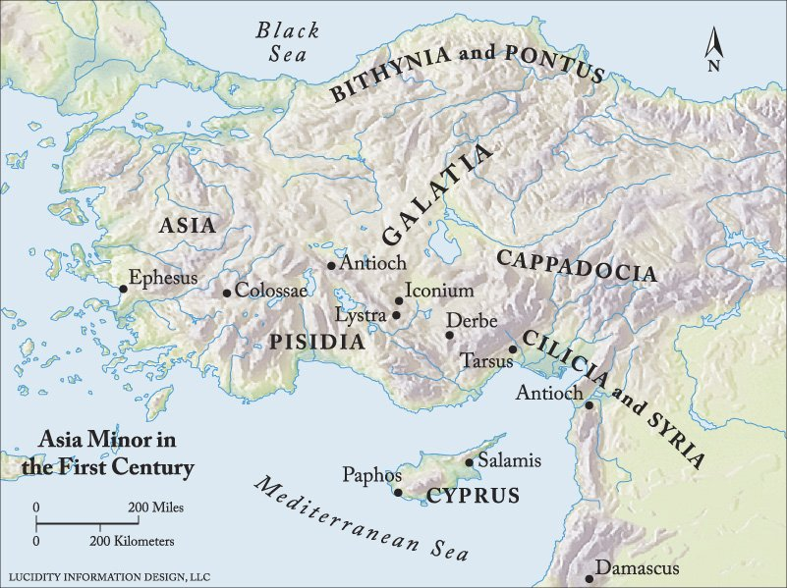
1st Principles at Galatia
1) Acts 13-14 Highlights Things They Taught & Did
2) The Reality of Falling from Grace [1:6-9; 5:1-7]
3) The Danger of Trying to Please Men (2:11-14)
4) The Truth of The Law of Moses [3:10-14, 23-29]
5) The Need to Leave Worldly Principles [4:8-11]
6) The Purpose of Our Freedom [5:13-15, 5:25-6:1]
7) Bonus Blessing: Walking By This RULE [6:14-18]
God, His Son, & The Spirit turn us into new creatures. 3:27
We now walk by The Spirit with the promise to Abraham!

Slide 6
1st Principles from Thessalonica
1) Acts Highlights Early Traits of Apostolic Churches
2) Apostolic Teaching=Divine Origin [2:13-16; 5:27]
3) Properly Define Faith & Love [1:2-3,9-10; 2:9-12]
4) Again, Please God Not Man [2:4-7; 5:12-15]
5) The Reality Is: Faith Can Falter [3:1-6] cf. 5:21
6) Early Priority, Quiet Hard-Work & Love [4:9-12]
7) A Blessing: We Can Know Our Final Destiny [5:1-11] Live soberly. [5:23-24] God will surely do it!

Slide 7
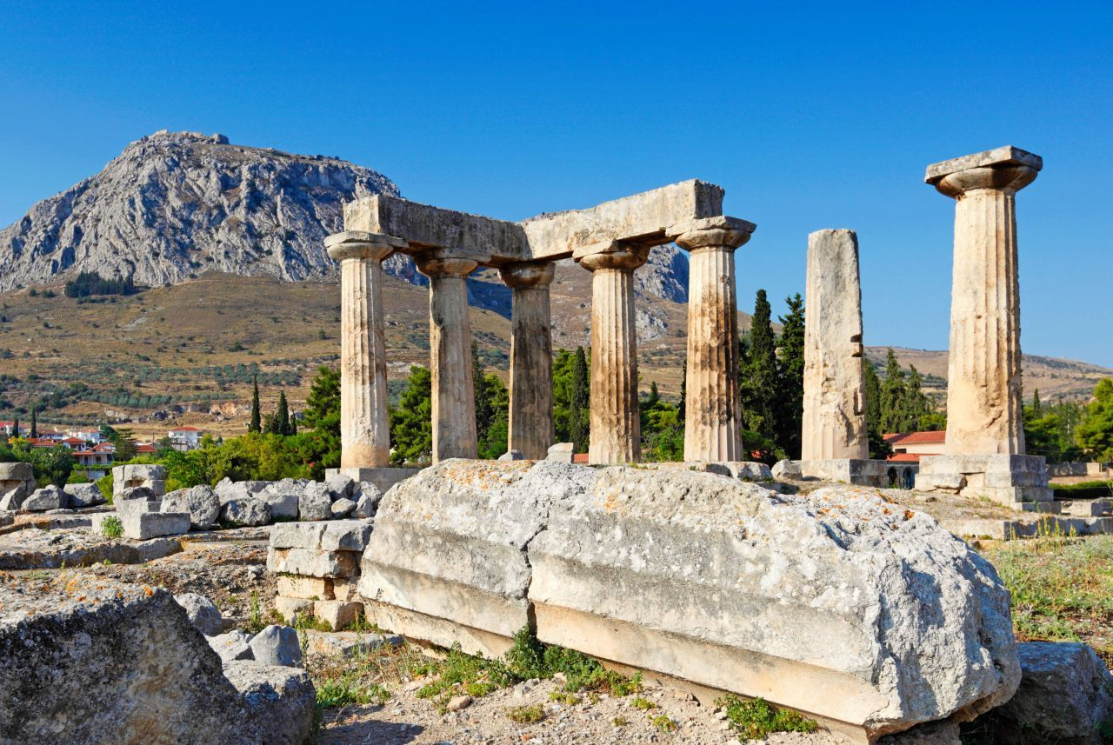
1st Principles at Corinth
1) Paul Saw “Traditions” As Good [2 Th 2:15; 3:6-12]
2) [1 Co 15:1-19] Paul Clearly Gives a “First Importance”
Paul is blunt: We must point to The Resurrection!
3) Ch 5-6 Sexual Purity & Church Discipline [5:1-2, 9-13]
4) Ch 7-10 Is Based On Jesus’ Second Greatest Command
5) Ch 11-14 Discusses Key Public Worship Principles [11:17] 6) Ch 1-4 Don’t Divide Into Labeled Groups [1:10-17]
7) Finally, a Blessing, God Is Faithful! [1:4-9]
Even for a messy & hypocritical church, Paul had love & gratitude. Beyond love, He had confidence, because He knew God’s power!

Slide 8
1st Principles of Communication
A) God Expects Us To WORK At Understanding Him (Eph 4-5)
B) There Are Wrong Methods of Discernment
C) How Does God Communicate? Like all His beings…
He can Tell, Show, or Imply something in His words.
D) Jesus Used These Three Methods:
[Mk 12:28-34] Clarity about commands.
[12:38-40, 41-44] Both bad & good examples.
[12:35-37] Jesus draws a forced conclusion.
Jesus walked as a man & reasoned with man.
Later, Peter has the same thing in [Act 10:25-29, 34]

Slide 9
1st Principles & Tithing Herbs
Discern what is pleasing to God… even the details!
A) There Is General & Specific Communication
B) We Must Listen To ALL God Says On A Subject
C) Being Divisive Is Condemned [Titus 3:8-11]
D) Embrace Biblical Patterns & Terminology
NT examples show what God allows, what pleases Him.
What actions did God permit that we should join in?
E.g. In Acts 28:30 money is spent on a meeting space.
Each group must choose in scriptural wisdom… keeping in mind General & Specific communication.

Slide 10
Simple church
What makes us DIFFERENT is NECESSARY to understand but may not be a 1st principle.

Slide 11
Simple church
Differences are necessary but not 1st principles.
A) We don’t all share the same definition of 1st Principles.
We don’t all share the same priorities, degrees of conviction. What makes us unique may still be important & necessary. But, some people have never heard differences explained.
For example, managing money & making music.
B) Discussion is necessary to maintain John 17 & Eph 4-5.
That they may be sanctified in truth… that they may be one as we are one.
Be eager to maintain unity… try to discern what is pleasing to God.
To be clear: We are only talking about Northeast Church of Christ.

Slide 12
Simple church
Differences are necessary but not 1st principles.
A) We don’t all share the same definition of 1st Principles.
B) Discussion is necessary to maintain John 17 & Eph 4-5.
C) Why are we narrowly focused with money?
Churches did collect & send money [1 Cor 16:1-4]
Paul elaborates on this idea in [2 Cor 8:1-11; 20-21]
It appears to ALWAYS be for the saints. Cf. [Rom 15:22-29]
Paul utilizes detailed commands in [1 Tim 5:7-12, 16].
A KEY Phrase: Let not the church be burdened.
When groups lose focus, the primary can become secondary.
We don’t want to restrict your giving, please give freely!

Slide 13
Simple church
Differences are necessary but not 1st principles.
A) We don’t all share the same definition of 1st Principles.
B) Discussion is necessary to maintain John 17 & Eph 4-5.
C) Why are we focused with money? [Rom 15; 1 Tim 5:16]
Why are we specific about our music? [Col 3:14-17]
Consider Paul’s point with instruments in [1 Cor 13:1, 14:6-20]
This is why we submit to instructive singing [Eph 5:15-21]. We desire to imitate the simplicity of Jesus [Matt 26:30].
We don’t desire a return to OT animal sacrifices or standards.
Either of these subjects is worthy of longer discussion.

Slide 14
Simple church
Differences are necessary but not 1st principles.
A) We don’t all share the same definition of 1st Principles.
B) Discussion is necessary to maintain John 17 & Eph 4-5.
C) Why are we focused with money? [Rom 15; 1 Tim 5:16]
Why are we specific about our music? [Col 3:14-17]
D) More Important: Messaging on Baptism (Eph 4:1-3)
Why do some say it isn’t necessary if Jesus commanded it.
It’s one of His most well-known decrees [Matt 28:16-20].
Why ignore Paul’s “greatest” letter which says to be “buried with Christ in baptism”? (Rom 6:4) OR
Peter who says in 1 Pet 3:21, “…baptism now saves you…”?

