Slide 1
Why Follow The APOSTLES?
Did The Apostles Know They Were Inspired?
Why did Paul defend his apostleship so vigorously? [1Co9:1-2; 2Co12:12; Gal1:1-12,2:3-9]
He says The Apostles held special authority: [Eph 2:19-22; 3:4-6]
Their miraculous signs had a purpose: [Heb 2:1-4]

Slide 2
Why Follow The APOSTLES?
The Apostles Knew Their Special Role: God-Inspired [1Co9:1-2; 2Co12:12; Gal1:1-12, 2:3-9; Eph 2:19-22; 3:4-6]
Did The Early Church Treat Them As Scripture?
Note: the context of [1 Cor 7:1, 5-12, 17, 25-28] Why ask Paul what he thinks? Why separate out his opinion?
If the oral teaching was obeyed, [2Th2:5,15,3:6,14-15], would early followers ignore their writings?

Slide 3
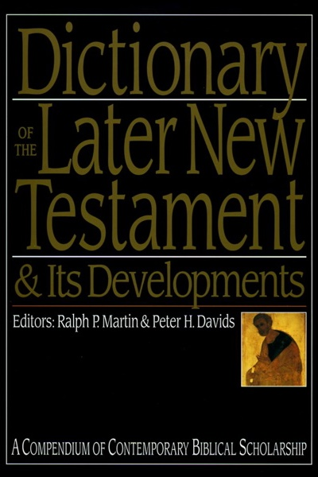
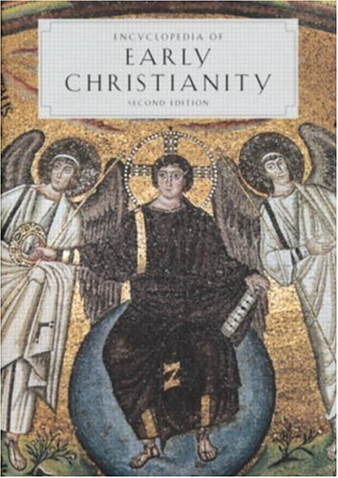
Why Follow The APOSTLES?
>When did the term originate?
>Who is in & who is out?
>How important are they?
The Apostles Knew Their Special Role: God-Inspired [1Co9:1-2; 2Co12:12; Gal1:1-12, 2:3-9; Eph 2:19-22; 3:4-6]
Did The Early Church Treat Them As Scripture?
Note: the context of [1 Cor 7:1, 5-12, 17, 25-28] Why ask Paul what he thinks? He separates out his opinion!
If the oral teaching was obeyed, [2Th2:5,15,3:6,14-15], would early followers ignore their writings?
What About The So-Called “Apostolic Fathers”?

Slide 4
Why Follow The APOSTLES?
The So-Called “Apostolic Fathers”?
Clement of Rome
Ignatius of Antioch
Polycarp of Smyrna
Others
The Didache
1 Clement 42 ca. 95AD
42:1 The Apostles received the Gospel for us from the Lord Jesus Christ; Jesus Christ was sent forth from God. 42:2 So then Christ is from God, & the Apostles are from Christ. Both therefore came of the will of God in the appointed order. 42:3 Having therefore received a charge & having been fully assured through the resurrection of our Lord Jesus Christ & confirmed in the word of God with full assurance of the Holy Ghost, they went forth with the glad tidings that the kingdom of God should come.
42:4 So preaching everywhere in country & town, they appointed their first fruits, when they had proved them by the Spirit, to be bishops & deacons unto them that should believe. 42:5 And this they did in no new fashion; for indeed it had been written concerning bishops & deacons from very ancient times; for thus saith the scripture in a certain place, I will appoint their bishops in righteousness & their deacons in faith. (Jer 3:15)
1) Bishops & deacons:
a) plurality like in Paul (Php 1:1; Acts 21)
b) presbyter & bishop interchangeable
2) Asserts the practice came from Apostles.

Slide 5
Why Follow The APOSTLES?
The So-Called “Apostolic Fathers”?
Clement of Rome
Ignatius of Antioch
Polycarp of Smyrna
Others
The Didache
To The Magnesians Ch 13 ca. 107AD
Study, therefore, to be established in the doctrines of the Lord & the apostles, that so all things, whatever you do, may prosper both in the flesh & spirit; in faith & love.
To The Romans Ch 4 ca. 107AD
I do not, as Peter and Paul, issue commandments unto you. They were apostles of Jesus Christ, but I am the very least [of believers]: they were free, as the servants of God; while I am, even until now, a servant.

Slide 6
Why Follow The APOSTLES?
The So-Called “Apostolic Fathers”?
Clement of Rome
Ignatius of Antioch
Polycarp of Smyrna
Others
The Didache
To The Philippians Ch 5 ca. 150AD
Let us then serve Him in fear, & with all reverence, even as He Himself has commanded us, & as the apostles who preached the Gospel unto us, & the prophets who proclaimed beforehand the coming of the Lord [have alike taught us]. Let us be zealous in the pursuit of that which is good, keeping ourselves from causes of offence, from false brethren, & from those who in hypocrisy bear the name of the Lord, & draw away vain men into error.

Slide 7
Why Follow The APOSTLES?
The So-Called “Apostolic Fathers”?
Clement of Rome
Ignatius of Antioch
Polycarp of Smyrna
Others
The Didache
Against Heresies Book 2 Ch 27 ca. 190AD
Ireneaus On Obscure Scripture:
1. A sound mind, & one which does not expose its possessor to danger, & is devoted to piety & the love of truth, will eagerly meditate upon those things which God has placed within the power of mankind, & has subjected to our knowledge, & will make advancement in [acquaintance with] them, rendering the knowledge of them easy to him by means of daily study. These things are such as fall [plainly] under our observation, & are clearly and unambiguously in express terms set forth in the Sacred Scriptures.

Slide 8
Why Follow The APOSTLES?
The So-Called “Apostolic Fathers”?
Clement of Rome
Ignatius of Antioch
Polycarp of Smyrna
Others
The Didache
Against Heresies Preface Ch 20, 35 ca. 200AD
Tertullian On Apostolicity:
(The apostles) obtained the promised power of the Holy Ghost for the gift of miracles; & after first bearing witness to the faith in Jesus Christ throughout Judaea, & surrounding churches (there), they next went forth into the world & preached the same doctrine of the same faith to the nations.
…in which their own authentic writings are read… the law and the prophets she unites in one volume with the writings of evangelists and apostles, from which she drinks in her faith.
The Teaching of the Lord Through The Twelve Apostles

Slide 9
Why Follow The APOSTLES?
The So-Called “Apostolic Fathers”?
Clement of Rome; Ignatius of Antioch; Polycarp of Smyrna
Eusebius
1st “Church Historian”
Church History 1.10 & 6.12 ca. 350AD
“Our Lord called the twelve apostles shortly after the start of his preaching, & these alone of all his disciples he named apostles, as a special honor.”
“We receive both Peter & the other apostles as Christ, but the writings which falsely bear their names we reject, as men of experience, knowing that such were not handed down to us.”

Slide 10
Why Follow The APOSTLES?
The So-Called “Apostolic Fathers”?
Clement of Rome; Ignatius of Antioch; Polycarp of Smyrna
“Clearly, the words of Jesus are treasured as of supreme authority parallel to, & indeed exceeding, the authority of the OT Scriptures themselves. That apostles share in the authority of Jesus, they are paralleled with the OT prophets, & the apostolic fathers can indicate their consciousness that their own authority is not on a par with that of the apostles. Thus, while it may be strictly true to conclude that prior to the middle of the 2nd century the NT writings were not regarded as “Scripture,” it must also be admitted that the apostolic fathers grant them an authority that amounts to such a designation & is fully consonant with it.”

