Slide 1
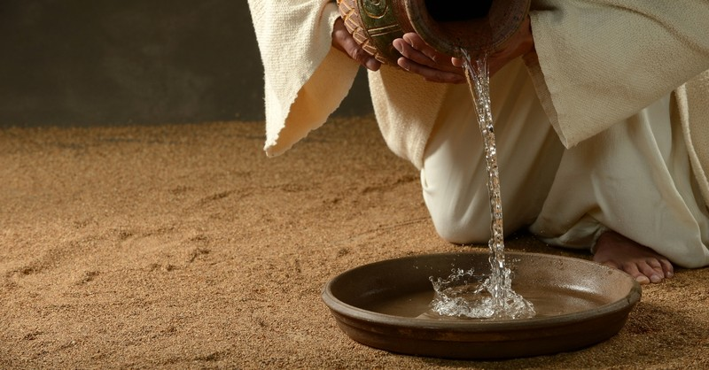
Jesus & 1st Principles
God
Jesus
The Spirit
Apostles

Slide 2
Jesus & 1st Principles
1) The 1st & 2nd Greatest Commands: [Mk 12:28-34]
A) Many of us have this principle nearly memorized.
The real issue is: How does it change my behavior?
How will that impact my time & treasure?
How will that impact my speech & actions?
B) Note the warning near this famous verse: [Mk 12:38-40]
They verbally honor God but disrespect people!
May God help us to keep Him first, others second, & ourselves last.
2) Jesus Emphasized Proper Character: [Matt 23:23]
3) Jesus Praised Humility & Service: (John 13:12-17)

Slide 3
Jesus & 1st Principles
1) The 1st & 2nd Greatest Commands: [Mk 12:28-34]
This principle should clearly change our behavior. Cf. Mk 12:38-40
2) Jesus Emphasized Proper Character: [Matt 23:23]
Justice. Mercy. Faithfulness.
A) These weightier matters continue OT ideals:
[Micah 6:6-8; Zech 7:4-12] Add Humility & Kindness.
B) Principles that tangibly impact how we interact with others.
May God help us to make these traits our foundation for right living before Him.
3) Jesus Praised Humility & Service: (John 13:12-17)

Slide 4
Jesus & 1st Principles
1) The 1st & 2nd Greatest Commands: [Mk 12:28-34]
This principle should clearly change our behavior. Cf. Mk 12:38-40
2) Jesus Emphasized Proper Character: [Matt 23:23]
Justice. Mercy. Faithfulness. Treat God & others right.
3) Jesus Praised Humility & Service: (John 13:12-17)
A) Parables on Humility:
Don’t presumptuously take the best seat. [Lk 14:7-11]
The Prayer Parable may say it best, (Lk 18:13) Be merciful!
B) Service was clearly taught to His Leaders:
He defined LOVE by humble service in Jn 13:12-17.
All humanity shares this struggle [Mt 23:11-12; 20:20-28].

