Slide 1
TAKE TIME TO BE HOLY

Slide 2
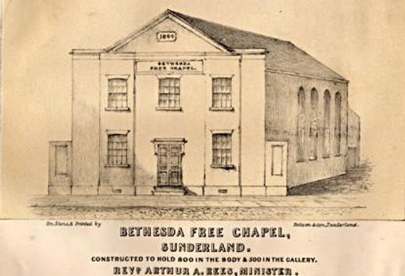
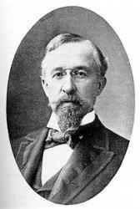
Take Time To Be Holy
Author: Businessman, William Dunn Longstaff
Early supporter of Bethesda Free Church
Father of SEVEN

Slide 3
Take Time To Be Holy
A) Take time to be holy, speak oft with thy Lord;
1) We must choose to give our time to growth. [1Th 3:12, 4:1, 9-10] 2) We must not give up on prayer. Pray w/o ceasing. 1 Thess 5:17
B) Abide in Him always, and feed on His Word.
1) We must always credit Him for growth. [Colossians 2:18-19] 2) We must recognize our need for the bread of life. John 6:35
C) Make friends of God’s children, help those who are weak,
1) Are we assembling & cultivating fellow faith co-workers? Heb 10 2) A hallmark of God’s character. E.g. Good Samaritan, Gala 6:9
D) Forgetting in nothing His blessing to seek.
Keep Him in EVERYTHING we do. He can bless it all. [Eph 3:14-21]
v1 We must CHOOSE to spend time in prayer, study His Word, & spend time with God’s children!
v2 Life is busy, so CHOOSE “much time” with Jesus.
“We may be the only Bible the world may ever read!”

Slide 4
Take Time To Be Holy
A) Take time to be holy, let Him be thy Guide;
Learn the context: [1 Cor 10:31-11:1; Eph 5:1-21, 4:17-32] Be imitators of God & Christ. Walk as children of Light!
B) And run not before Him, whatever betide.
[2 Jn 8-9] Could also be the idea in “Follow Me.” [Col 3:1-4]
C) In joy or in sorrow, still follow the Lord,
D) And, looking to Jesus, still trust in His Word.

Slide 5
Follow Me
I traveled down a lonely road And no one seemed to care, The burden on my weary back Had bowed me to despair, I oft complained to Jesus How folks were treating me,
And then I heard Him say so tenderly. "My feet were also weary, Upon the Calvary road; The cross became so heavy, I fell beneath the load, Be faithful, weary pilgrim, The morning I can see, Just lift your cross and follow close to me."

Slide 6
Follow Me
"I work so hard for Jesus," I often boast and say, "I've sacrificed a lot of things To walk the narrow way, I gave up fame and fortune; I'm worth a lot to Thee," And then I hear Him gently say to me,
"I left the throne of glory And counted it but loss, My hands were nailed in anger Upon a cruel cross, But now we'll make the journey With your hand safe in Mine, So lift your cross and follow close to Me."

Slide 7
Follow Me
O, Jesus if I die upon A foreign field someday,
'Twould be no more than love demands, No less could I repay,
"No greater love hath mortal man Than for a friend to die"
These are the words He gently spoke to me,
"If just a cup of water I place within your hand
Then just a cup of water Is all that I demand."
But if by death to living They can Thy glory see,
I'll take my cross and follow close to Thee.

Slide 8
Take Time To Be Holy
A) Take time to be holy, let Him be thy Guide;
Learn the context: [1 Cor 10:31-11:1; Eph 5:1-21, 4:17-32] Be imitators of God & Christ. Walk as children of Light!
B) And run not before Him, whatever betide.
[2 Jn 8-9] Could also be the idea in “Follow Me.” [Col 3:1-4]
C) In joy or in sorrow, still follow the Lord,
Paul’s steady attitude: [2Cor 4:5-12,15-18; 6:3-10; Php 4:4-13]
D) And, looking to Jesus, still trust in His Word.
There’ll be doubts, remember Jesus is trustworthy! [2 Pet 3:8-15]

