Slide 1
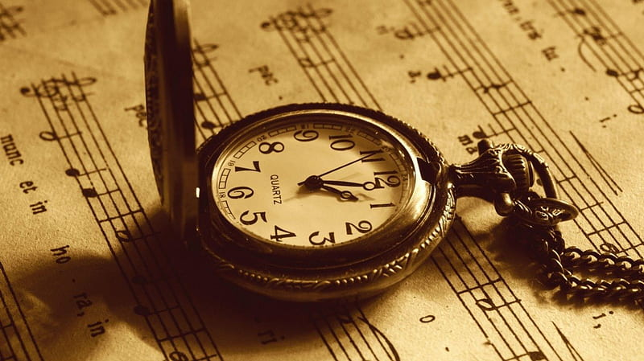
TAKE TIME TO BE HOLY

Slide 2
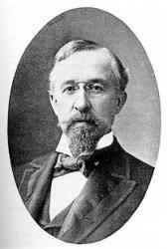
Take Time To Be Holy
Author, businessman, William Dunn Longstaff
Early supporter of Bethesda Free Church
He was the father of SEVEN!
Even in the 1800s he could write about busyness preventing our proper pursuit of holiness.

Slide 3
Take Time To Be Holy
A) Take time to be holy, the world rushes on;
1) We must make wise choices with our time. [Eph 5:15-17] 2) The cultural drift, or sprint, has long existed. [1 Pt 4:3-6]
B) Spend much time in secret, with Jesus alone.
1) Jesus encouraged “prayer closets.” [Matt 6:5-6] 2) To imitate Jesus, we should pray alone. [Matt 14:22-24] Mt 26
C) By looking to Jesus, like Him thou shalt be;
1) The grand conclusion of Hebrews 11 is LOOK TO JESUS. [12:1-4] 2) In time, others see Him more & less of us. [Col 1:27-29; 3:1-11]
D) Thy friends in thy conduct His likeness shall see.
Do people see a compelling transformation in us? [Act 4:13-22]

