Slide 1
The Letters to Asia
“Hate should not so fill our lives that when it is gone we have nothing to live for.”
“There is no comparable common expression for people “in hate” b/c few acknowledge that hate is mind-altering. But it is. Scripture is full of examples.”
What can we learn?

Slide 2
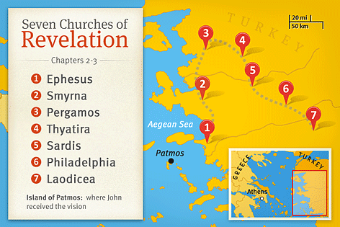
The Churches of Asia
Revelation 1:
v1 God revealed this to Jesus who gave it to John.
v3 This prophecy/revelation is supposed to BLESS.
v4 The 7 churches are to be a kingdom of priests. v6
v12-13 Jesus stands among the seven churches. [v17-20]
Ch1 Is the historical context of The Revelation. Much of Ch1 is in Ch2-3 which occurs again in Ch20.

Slide 3
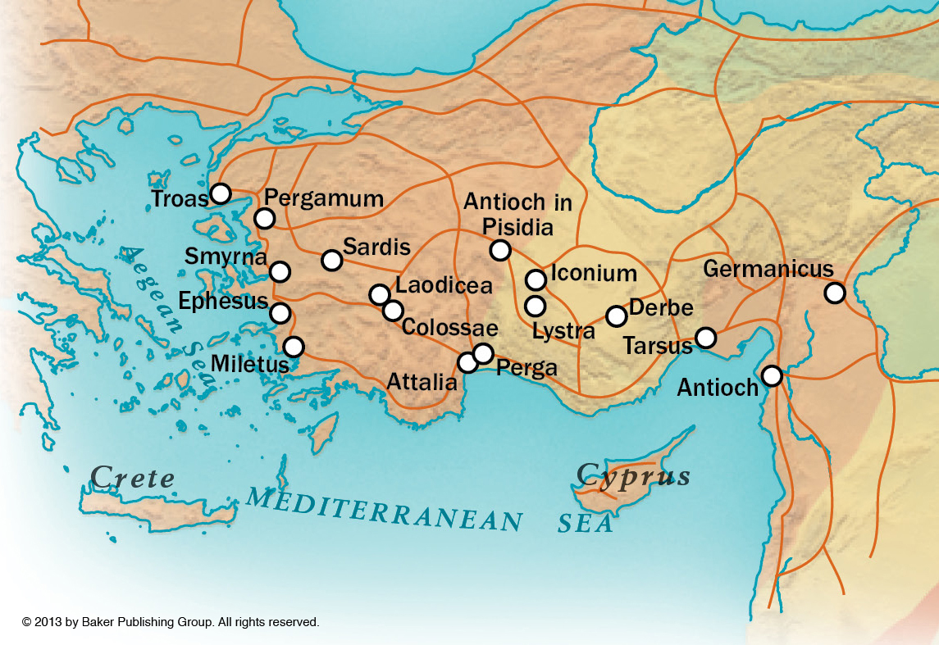
The Churches of Asia
Roman Roads In Asia Minor

Slide 4
The Churches of Asia

Slide 5
The Churches of Asia

Slide 6
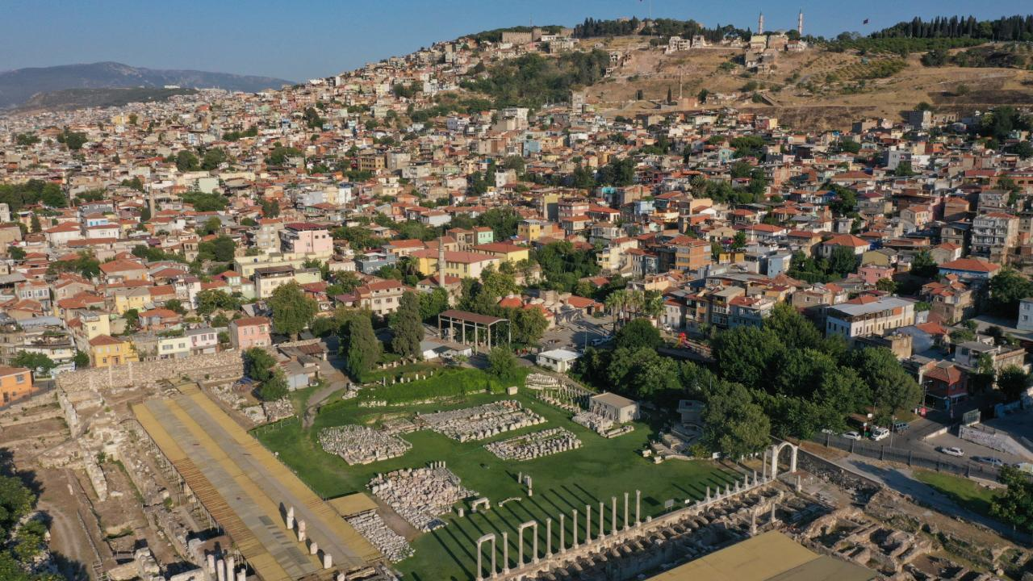
The Churches of Asia

Slide 7
The Churches of Asia

Slide 8
The Churches of Asia

Slide 9
The Churches of Asia

Slide 10
The Churches of Asia

Slide 11
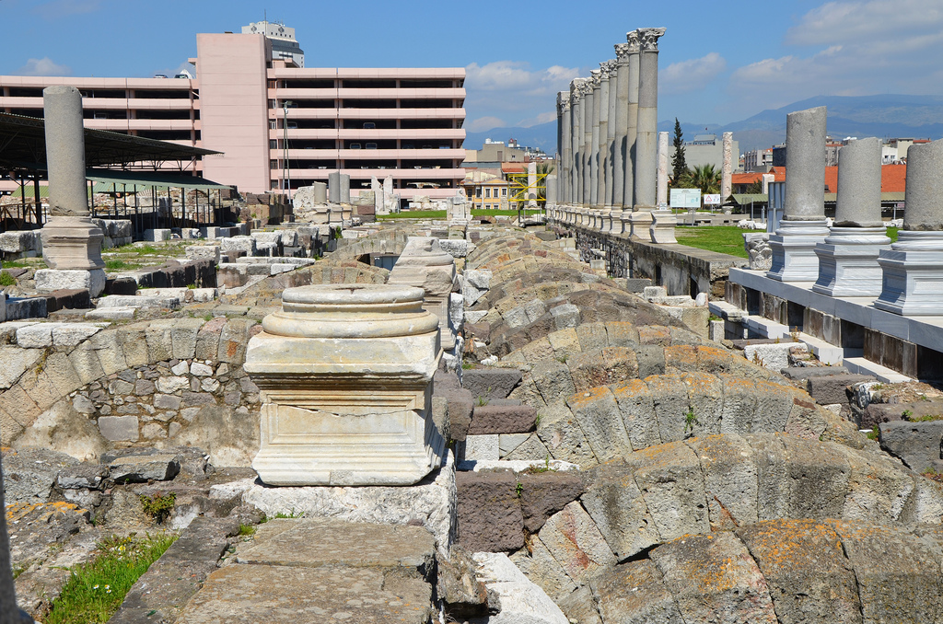
The Churches of Asia

Slide 12
The Churches of Asia

Slide 13
The Churches of Asia

Slide 14
The Churches of Asia

Slide 15
The Churches of Asia
Suffering Yet Steadfast Smyrna
Jesus’ Presence Among the churches. What about us?
Jesus’ Knowledge of who we are is what truly matters.
Self-Deception We can be wrapped up in the wrong ways: On the wrong thing or deceived about who we really are.
Suffering Superbly Will we embrace the winepress/grain mill?
Crowned with Thorns or Crowned with Titles? [Mt 10:24-39]
The Need for Introspection All the churches with ears listen!
Prepare for the 2nd Death [20:11-15 & 21:5-8]
“86 years have I served Jesus, & He never did me any injury; how then can I blaspheme my King & Savior?”
-Polycarp of Smyrna

