Slide 1
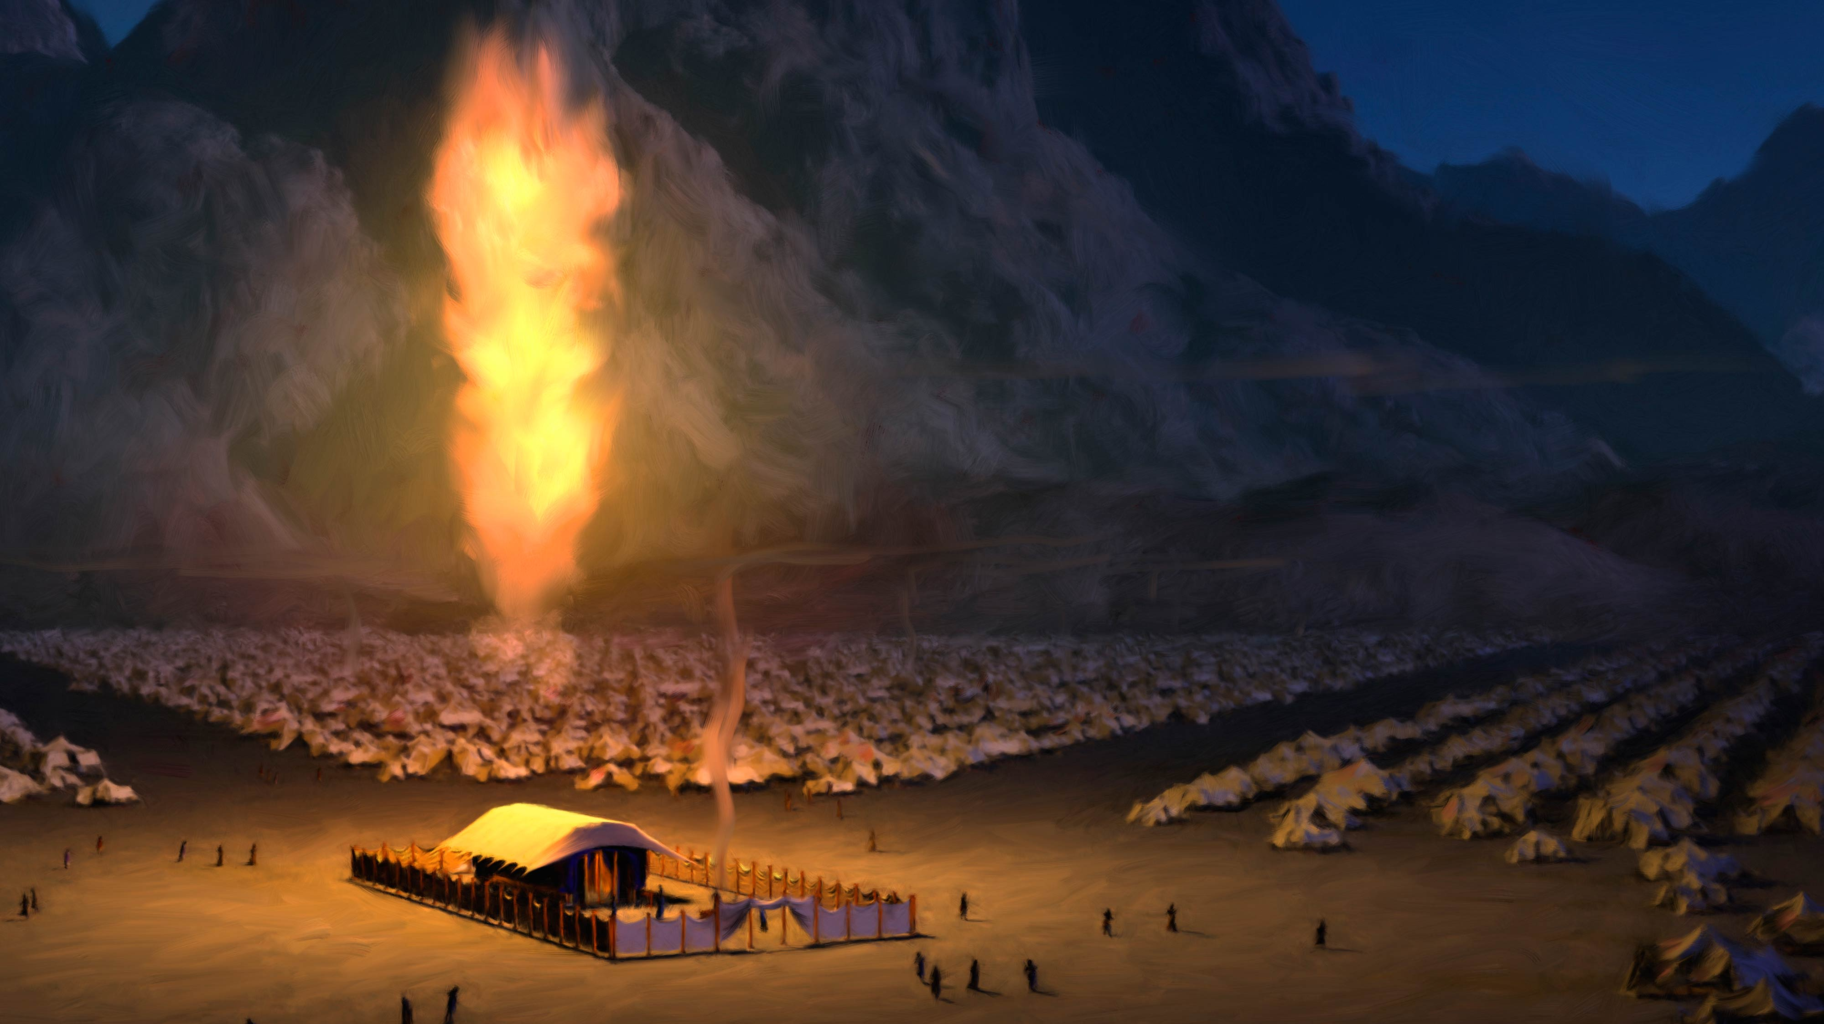
The Return of God’s Glory
Ezra 3:10-13
Details In The Well-Known Stories
Ezk 1-10; Lk 1-2

Slide 2
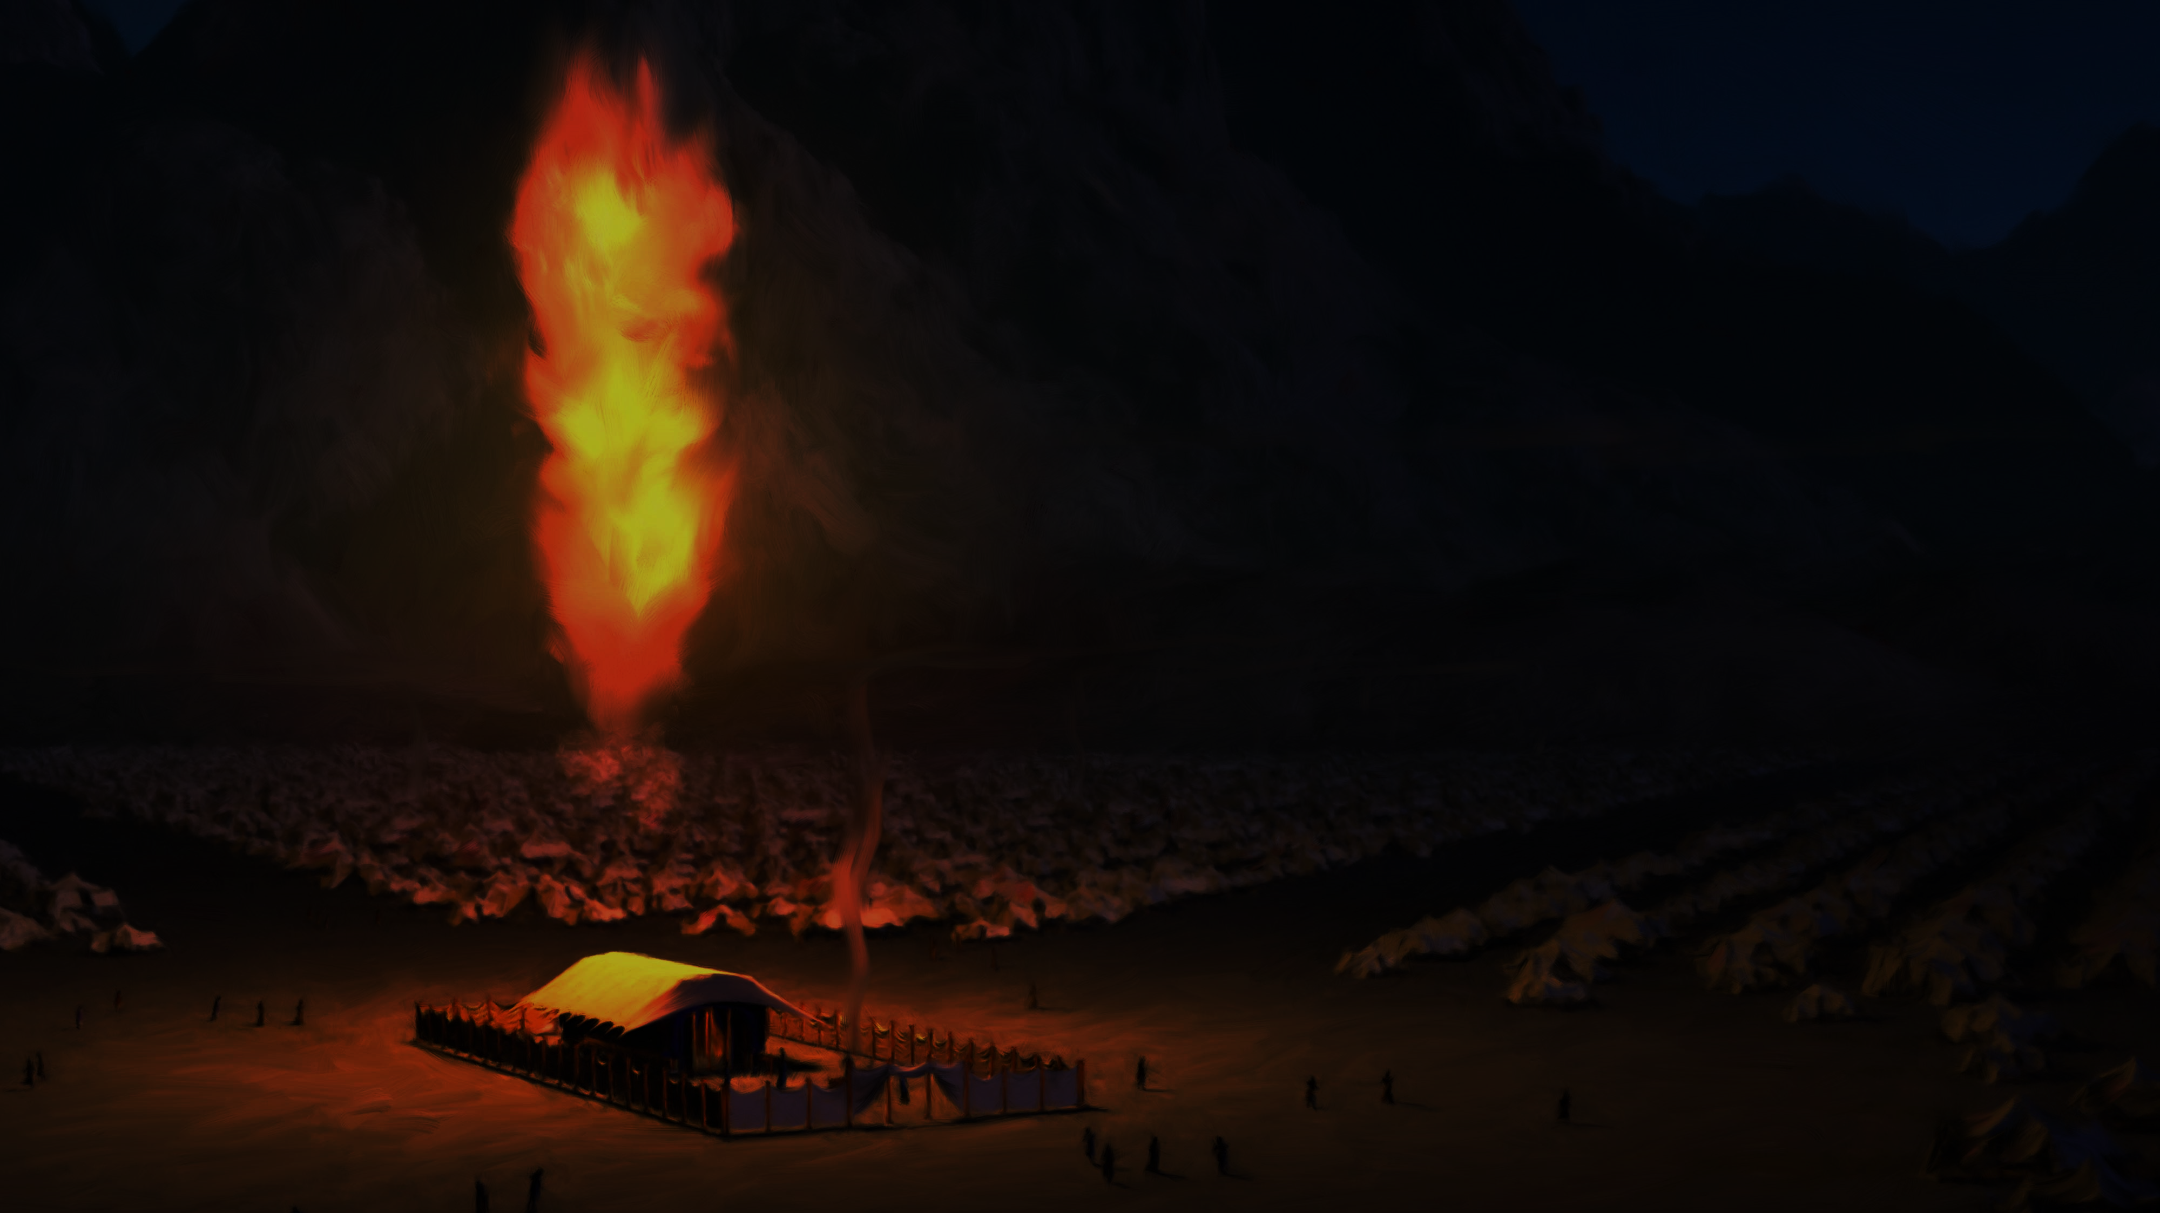
The Return of God’s Glory
Mary is overshadowed by God’s glory… [Lk 1:35-45] much like The Tent & Temple were. [Ex 40:34-35]
Mary went to hill country of Judea for Elizabeth. Lk 1:44 Similar details to The Ark’s return in (2 Sam 6:1-15).
Shepherds are surrounded by Divine glory. [Lk 2:8-15]
Perhaps, Luke intends for us to see… God’s Glory is returning as it has before.

Slide 3
The Return of God’s Glory
1) Ezekiel & Zechariah: Righteous priests, sinful nation.
Both must & must write out their message. Ezk 3:26; Lk 1:63
2) Angels attended both scenes: God’s departure & return.
Ezk 9-10 has four angels, Luke four angel visits. Lk 1:11, 1:26; 2:9, 2:13
3) Women worshippers are in both stories:
Sadly, women weeping for Tammuz in Ezk 8:14-15. Then, Elizabeth & Mary. And don’t overlook the widow, Anna of Asher. [Lk 2:36-38]
4) Rising of The Sun also connected to both: [Lk 1:76-79] No longer “sun worshippers” (Ezk 8:16-18) but The Sun of Righteousness.
5) All of this happened in The Temple, His Father’s House. We need to allow His Glory to return into our own hearts!

