Slide 1
The Letters to Asia
Enduring Ephesus,
Suffering Smyrna,
Permissive Pergamum,
Tolerant Thyatira,
Sleepy Sardis
Persevering Philadelphia
& Lukewarm Laodicea
25K Seat Theater
Underground Market
Massive Library
Specialized Industry
Large Places of Worship
Weather Evacuation Plans
…Regional Pride
What can we learn?

Slide 2
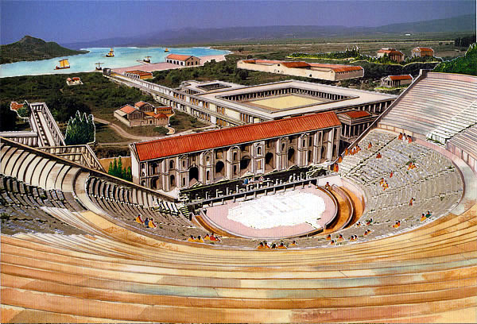
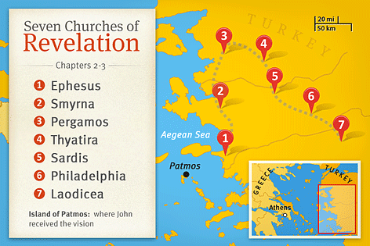
The Churches of Asia
Ephesus Reconstructed

Slide 3
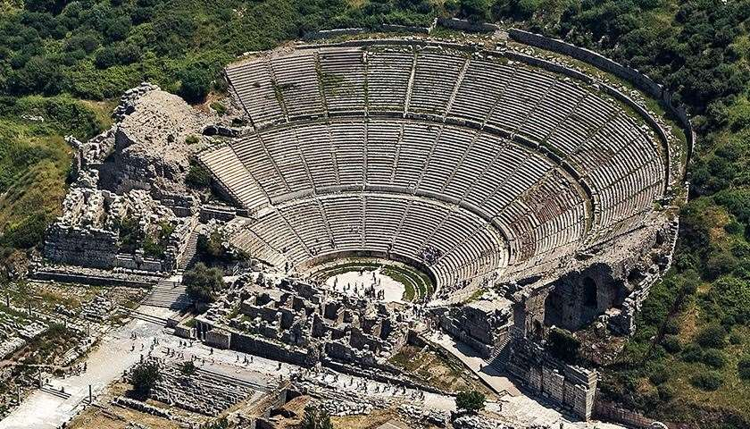
The Churches of Asia
Ephesus’ Theater

Slide 4
The Churches of Asia
Smyrna’s Marketplace

Slide 5
The Churches of Asia
Pergamum Overview

Slide 6
The Churches of Asia
Pergamum Altar

Slide 7
The Churches of Asia
Ruins in Thyatira

Slide 8
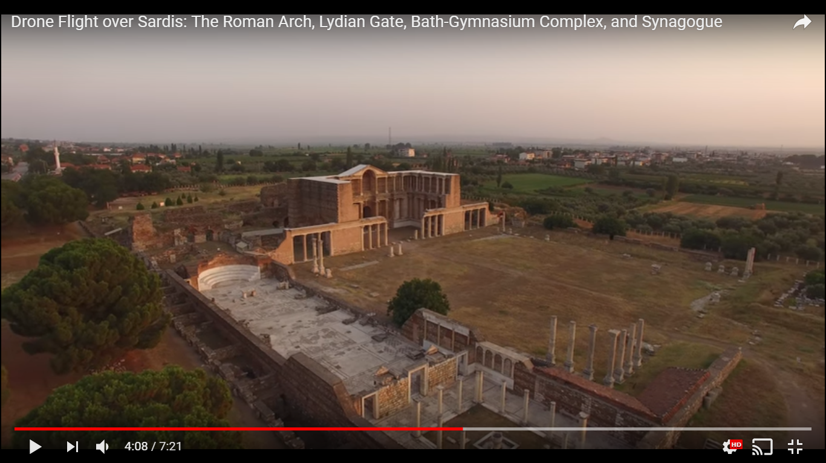
The Churches of Asia

Slide 9
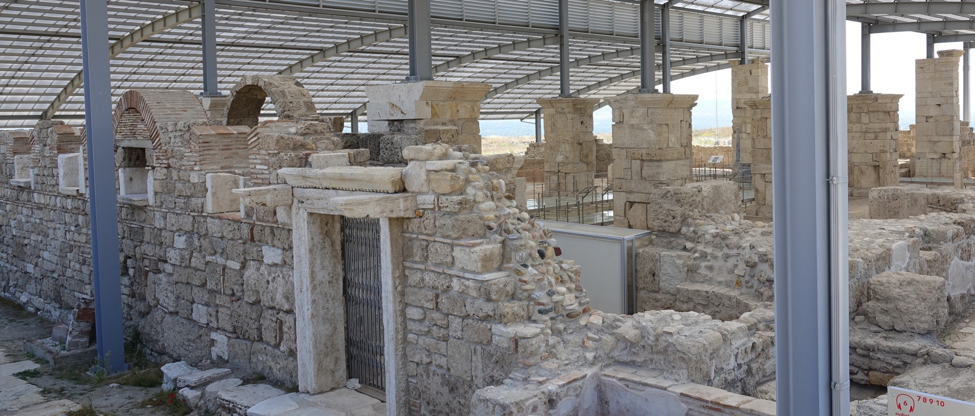
The Churches of Asia

Slide 10
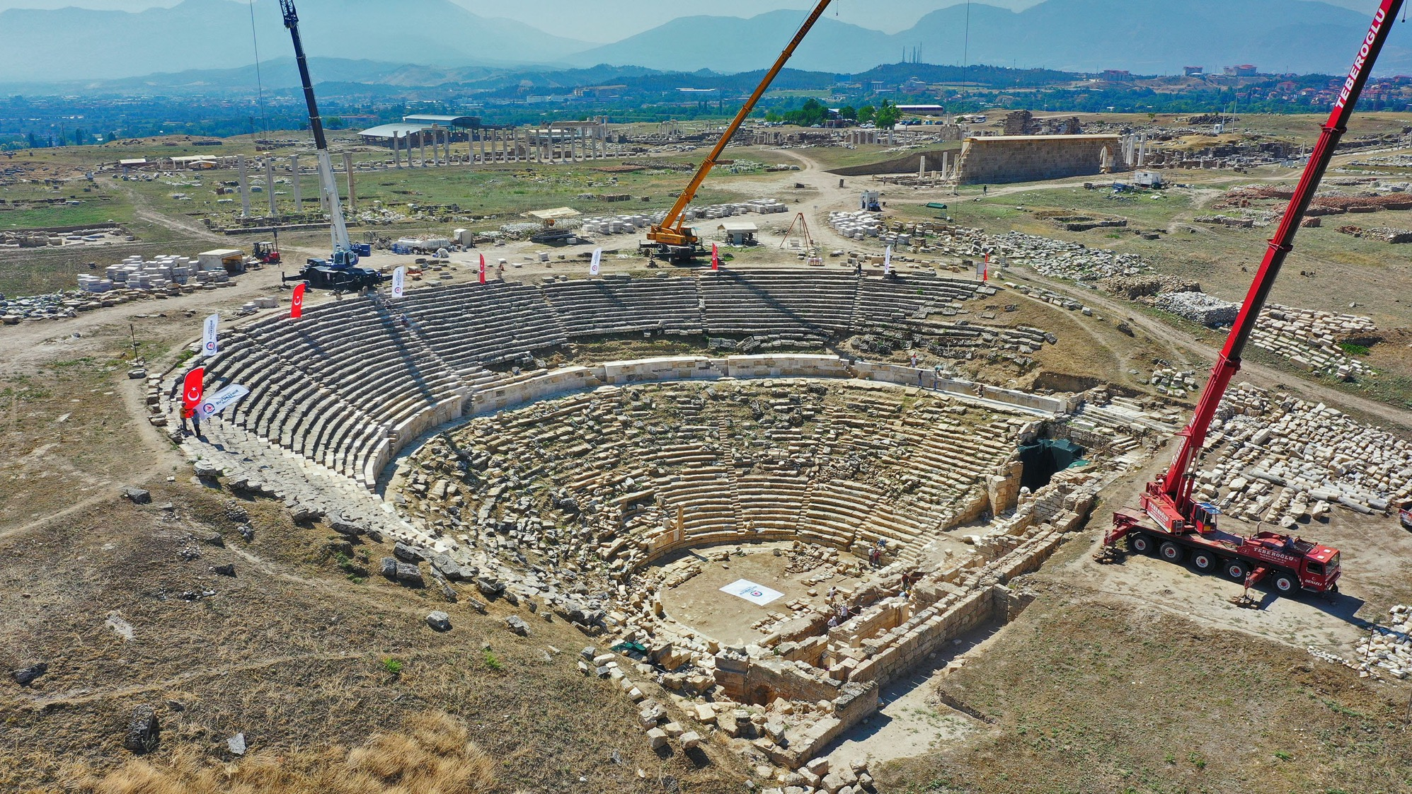
The Churches of Asia

Slide 11
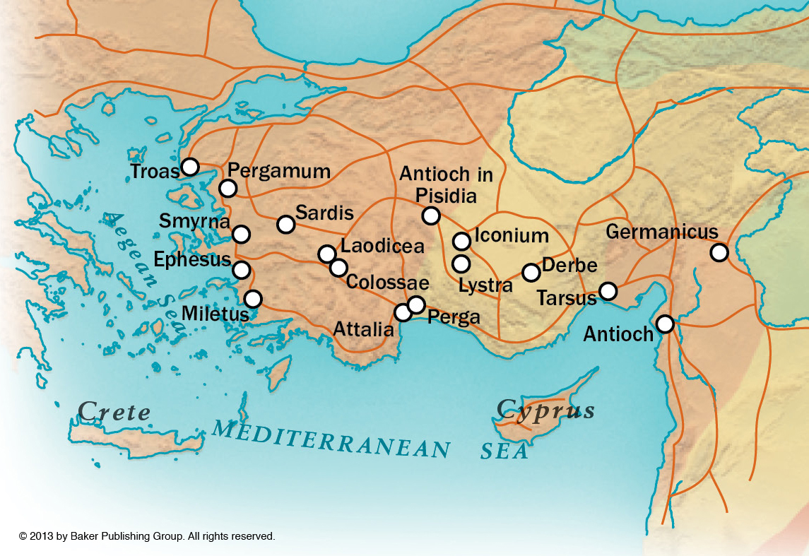
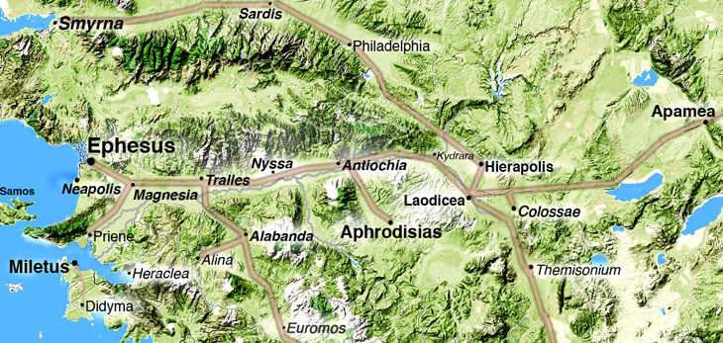
The Churches of Asia
Roman Roads In Asia Minor

Slide 12
The Churches of Asia
Colossae, pure, cold, life-giving water.
Hierapolis, famous healing hot springs.
Laodicea, lukewarm water with lime.
Also known for: banking center, dark wool, & optometry.
Cf. Jesus’ references to gold, white linen, & eye salve.
And calling them poor, naked, & blind!

Slide 13
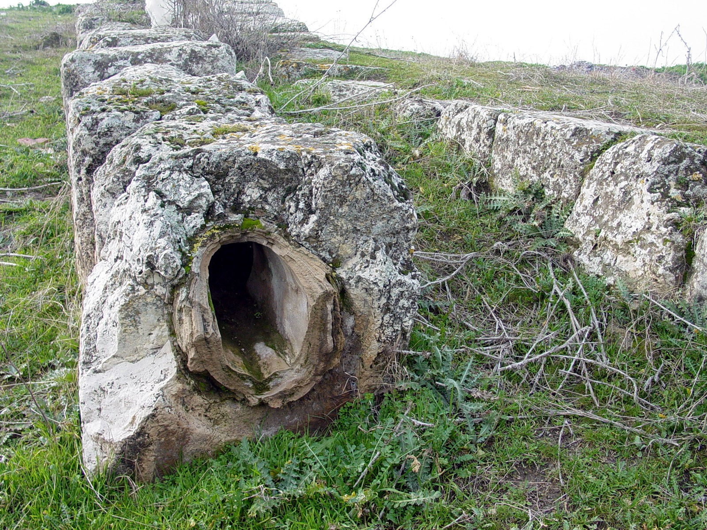
The Churches of Asia

Slide 14
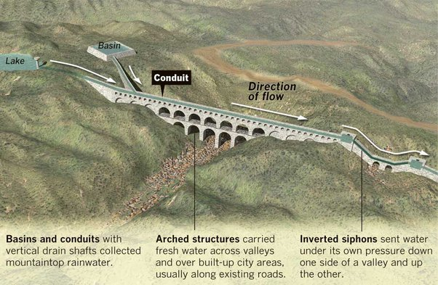
The Churches of Asia

Slide 15
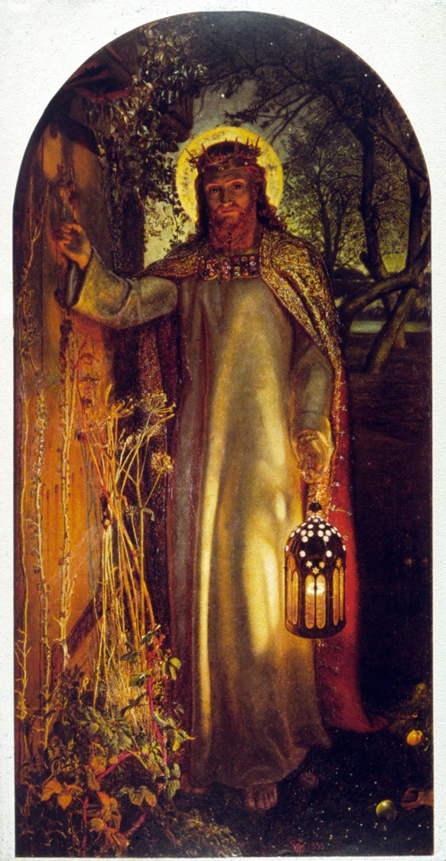
The Churches of Asia
Lukewarm Laodicea
Jesus’ Divine Titles He, the Prime Mover, is worthy of worship.
Jesus’ Powerful Presence He knows ALL that we hide from men.
Are We Useful? Or, would Jesus be sickened thinking of us?
The Need For Introspection SELF-Analysis>SELF-Esteem [Lk 6:26]
Jesus’ Offer of Real Wealth cf. [Mt6:19-21; 1Ti 6:17-19]
The Need For True Love Do we love as God loves us?
The Ability to Sit On His Throne! What an incredible promise!

