Slide 1
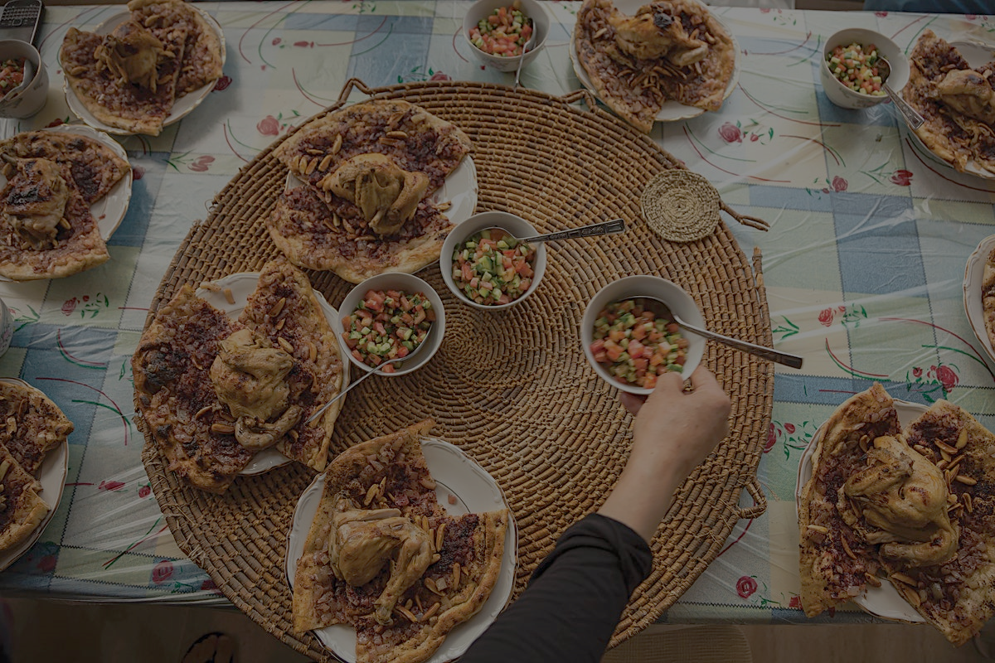
The Biblical Importance of Sharing A Meal

Slide 2
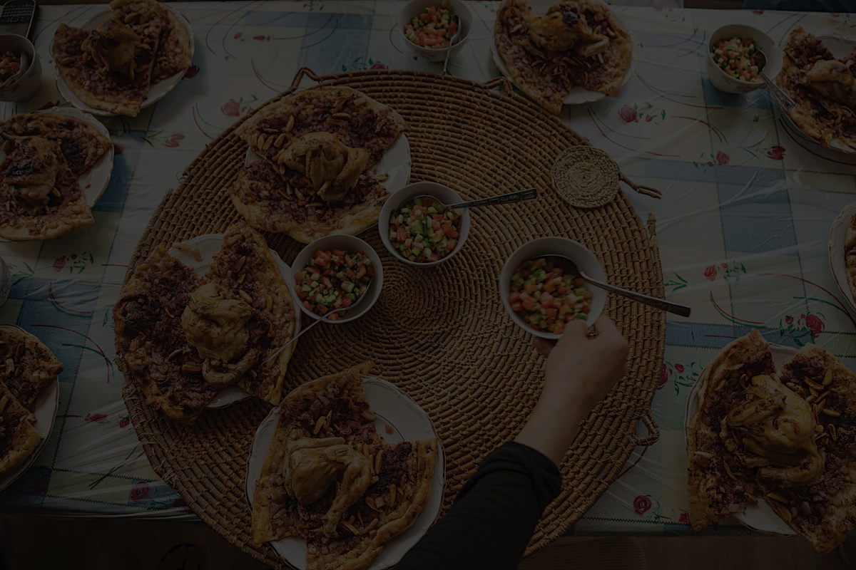
The Bible & Meals
God Designed Us for Conversation.
He designed food as a daily part of life.
He ate with Abraham. [Gen 18:1-8]
Ancients felt required to share meals.
Offering food helps others.
Conversations take things deeper.

Slide 3
The Bible & Meals
God Designed Us for Conversation.
The Law: Regular Worship Meals.
[Ex 23:10-17] Obviously Passover…
& Sabbath, Pentecost, F. of Booths.
For: Spiritual Reflection & Enjoyment.
Sacrifice: Trust & Thanksgiving.

Slide 4
The Bible & Meals
God Designed Us for Conversation.
The Law: Regular Worship Meals.
Several Meal Scenes In the OT:
David & Mephibosheth. 2 Sam 9
God Feeds Elijah w/ Ravens. 1 Ki 17
Esther’s Incredible Meal Scenes.
In [Isa 25:6-12] A Messianic Meal!

Slide 5
The Bible & Meals
“When Jesus Himself wanted to explain to His disciples what His forthcoming death was all about, He didn’t give them a theory, He gave them a meal.”
-N.T. Wright
God Designed Us for Conversation.
The Law: Regular Worship Meals.
Many Meals In the OT: [Isa 25].
Jesus Loved Meals For Teaching:
Parables, Miracles, & General Habits.
Most Important: Commanded a Meal!

Slide 6
The Bible & Meals
The Law: Regular Worship Meals.
Many Meals In the OT: [Isa 25].
Jesus Loved Meals For Teaching.
NT: ALL People Are To Be Hospitable.
[Romans 12:9-13] & in 1 Pet 4:8-10.
Beyond leaders, even widows. 1 Tim 5:10
God’s People Enjoy Gathering & Inviting.

Slide 7
The Bible & Meals
The Law: Regular Worship Meals.
Many Meals In the OT: [Isa 25].
Jesus Loved Meals For Teaching.
NT: ALL People Are To Be Hospitable.
[Romans 12:9-13] & in 1 Pet 4:8-10.
Beyond leaders, even widows. 1 Tim 5:10
God’s People Enjoy Gathering & Inviting.
Tips For Hospitality
-Plan ahead, move beyond intention.
-Keep it simple, fancy food not needed.
-Use your directories, invite a stranger.
-You don’t need a perfectly clean home.
-Ask your guests questions & listen well.
-Finally, ask how you can pray for them.

