Slide 1
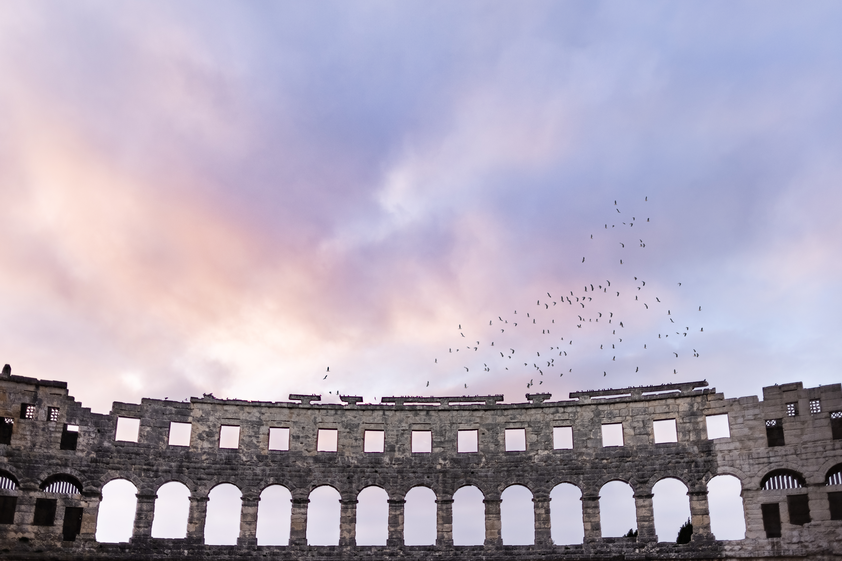
Follow the Pattern of
Sound Words
2 Timothy 1:13
Guard the Trust
[1 Tim 6:20-21]

Slide 2
Follow the Pattern of Sound Words
2 Timothy 1:1-18
Paul is encouraging Timothy to continue on:
1) Thanksgiving & Greeting [1:1-7]
2) A Call To Action & Suffering [1:6-12]
3) Follow the Pattern [1:13-14]
4) Three Examples [1:15-18]

Slide 3
A Faith I’m Sure Dwells In You
2 Timothy 1:1-18
Paul is encouraging Timothy to continue on:
1) Thanksgiving & Greeting [1:1-7]
Express gratitude in a regular daily fashion.
Be inspirational & humble about our families & faith.
Overcome fear by remembering God empowers us!
2) A Call To Action & Suffering [1:6-12]
3) Follow the Pattern [1:13-14]
4) Three Examples [1:15-18]

Slide 4
Follow the Pattern of Sound Words
2 Timothy 1:1-18
Paul is encouraging Timothy to continue on:
1) Thanksgiving & Greeting [1:1-7]
2) A Call To Action & Suffering [1:6-12]
Don’t be embarrassed to defend Jesus’ worldview.
Be prepared that doing so may bring suffering.
Sound words=HE saved us FOR His own purpose & grace.
Paul was confident: God is trustworthy & will defeat death.
3) Follow the Pattern [1:13-14]
4) Three Examples [1:15-18]

Slide 5
Follow the Pattern of Sound Words
2 Timothy 1:1-18
Paul is encouraging Timothy to continue on:
1) Thanksgiving & Greeting [1:1-7]
2) A Call To Action & Suffering [1:6-12]
3) Follow the Pattern [1:13-14]
Paul sets the standard for healthy teaching, not me.
Don’t resist his words: The pattern & The Spirit in us!
4) Three Examples [1:15-18]

Slide 6
Desertion or Discipleship?
2 Timothy 1:1-18
Paul is encouraging Timothy to continue on:
1) Thanksgiving & Greeting [1:1-7]
2) A Call To Action & Suffering [1:6-12]
3) Follow the Pattern [1:13-14]
4) Three Examples [1:15-18]
Sadly, desertion does happen. Jesus & Paul know the feeling.
But thankfully, many great saints deserve petitions for mercy:
After earnest searching, Onesiphorus often refreshed Paul.
Society hated Jesus’ people. But he wasn’t ashamed, he helped!

