Slide 1
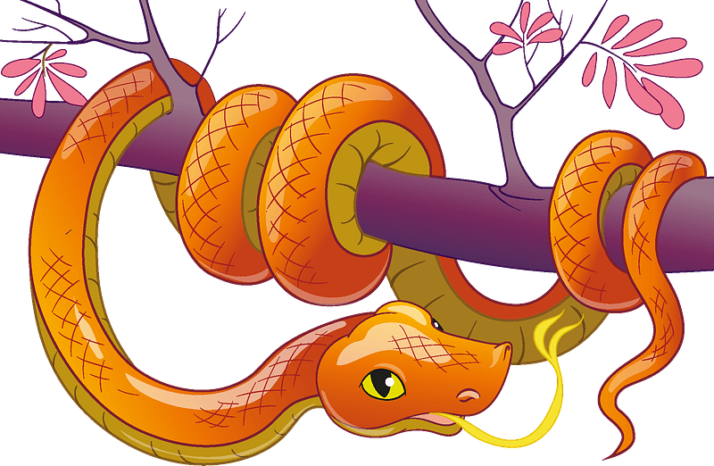
Fear the Serpent?
Now the serpent was more crafty than any beast of the field which the Lord God had made. And he said to the woman, “Indeed, has God said, ‘You shall not eat from any tree of the garden’?”
(Gen 3:1)

Slide 2
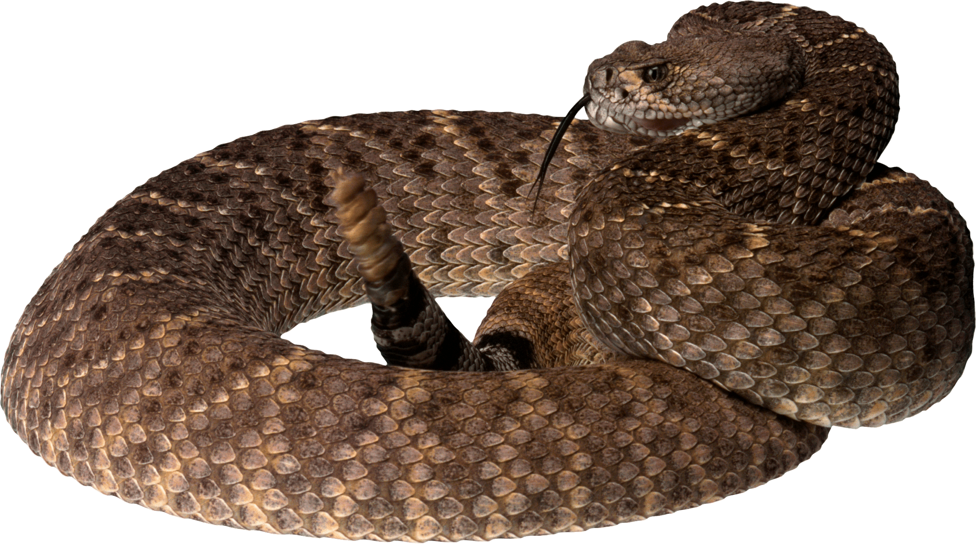

Slide 3
What/Who is the Serpent?
Lucifer – Cherub, cast down from heaven (Eze 28:12-19)
Model of perfection
In Eden, the garden of God, beautifully adorned
Ordained and anointed by God as mighty heavenly angelic guardian (cherub)
Had access to the mountain of God
Blameless in everything he did until the day that unrighteousness was found in him
His heart was proud because of his beauty and he corrupted his wisdom for the sake of his splendor

Slide 4
What/Who is the Serpent?
Lucifer – Cherub, cast down from heaven
Satan – “Adversary/accuser,” tempter and destroyer of man
Considered a title rather than a name
Appears prominently in Job 1-2
Strives for division, lawlessness, and hate
Devil – More common reference to Satan
Demons – Satan’s army of fallen angels

Slide 5
What/Who is the Serpent?
Lucifer – Cherub, cast down from heaven
Satan – “Adversary/accuser,” tempter and destroyer of man
Devil – Slightly more common reference to Satan
61 times in 57 verses (56 times in 49 verses for Satan)
Evil and irredeemable (1 Pet 5:8)
Demons – Satan’s army of fallen angels, his minions
Organized in hierarchical levels known as rulers, authorities, powers, and spiritual forces of evil (Eph 6:10-12)
Likely have a grasp of our weaknesses
Live to deceive people into worshiping themselves (1 Cor 10:20-21)

Slide 6
What is Fear?
Having a very unpleasant or disturbing feeling caused by the presence or imminence of danger, evil, or pain
To have profound reverence and awe, especially toward God
While traditionally considered a “negative” emotion, fear actually serves an important role in keeping us safe as it mobilizes us to cope with potential danger
Q: Should we be terrified of Satan? And what power does he have over us?

Slide 7
Devil’s Limitations
He is a created being
Depends on God for his existence and survival
Nowhere in Scripture indicates he has any sort of omnipresence
Can’t be everywhere at once (e.g., Job 1:7)
Can’t read our minds—that power rests with God
Not all-knowing: Satan is an observer
Been operating his way for thousands of years
Humans are predictable; we fall into the same traps
“There are two equal and opposite errors into which our race can fall about the devils. One is to disbelieve in their existence. The other is to believe, and to feel an excessive and unhealthy interest in them. They themselves are equally pleasured by both errors and hail a materialist or a magician with the same delight.” — C.S. Lewis, The Screwtape Letters

Slide 8
Satan’s Goal and Tactics
His nature is falsehood. He only speaks the truth to deceive.
Father of lies (John 8:44)
Opposes the truth reaching and converting people (Acts 13:8-10)
He attacks faith to destroy believers (2 Cor 11:3)
Dissension over doctrine and causes rifts (Rom 16:17-20)
He initiates doubt in our minds
Doubt God’s goodness
Doubt God’s word
Doubt God’s will

Slide 9
Avoid the Devil’s Schemes
Know God’s Word
Focus on God’s limitless power, not the Devil’s limited power
Pray for spiritual discernment
Stand firm in God’s goodness
Find full satisfaction in Jesus
Be alert and have a sober mind
Remain in community

Slide 10
Fear the Serpent?
And do not fear those who kill the body but cannot kill the soul. Rather fear him who can destroy both soul and body in hell. Matthew 10:28
… "God opposes the proud, but gives grace to the humble." Submit yourselves therefore to God. Resist the devil, and he will flee from you. James 4:6-7

