Slide 1
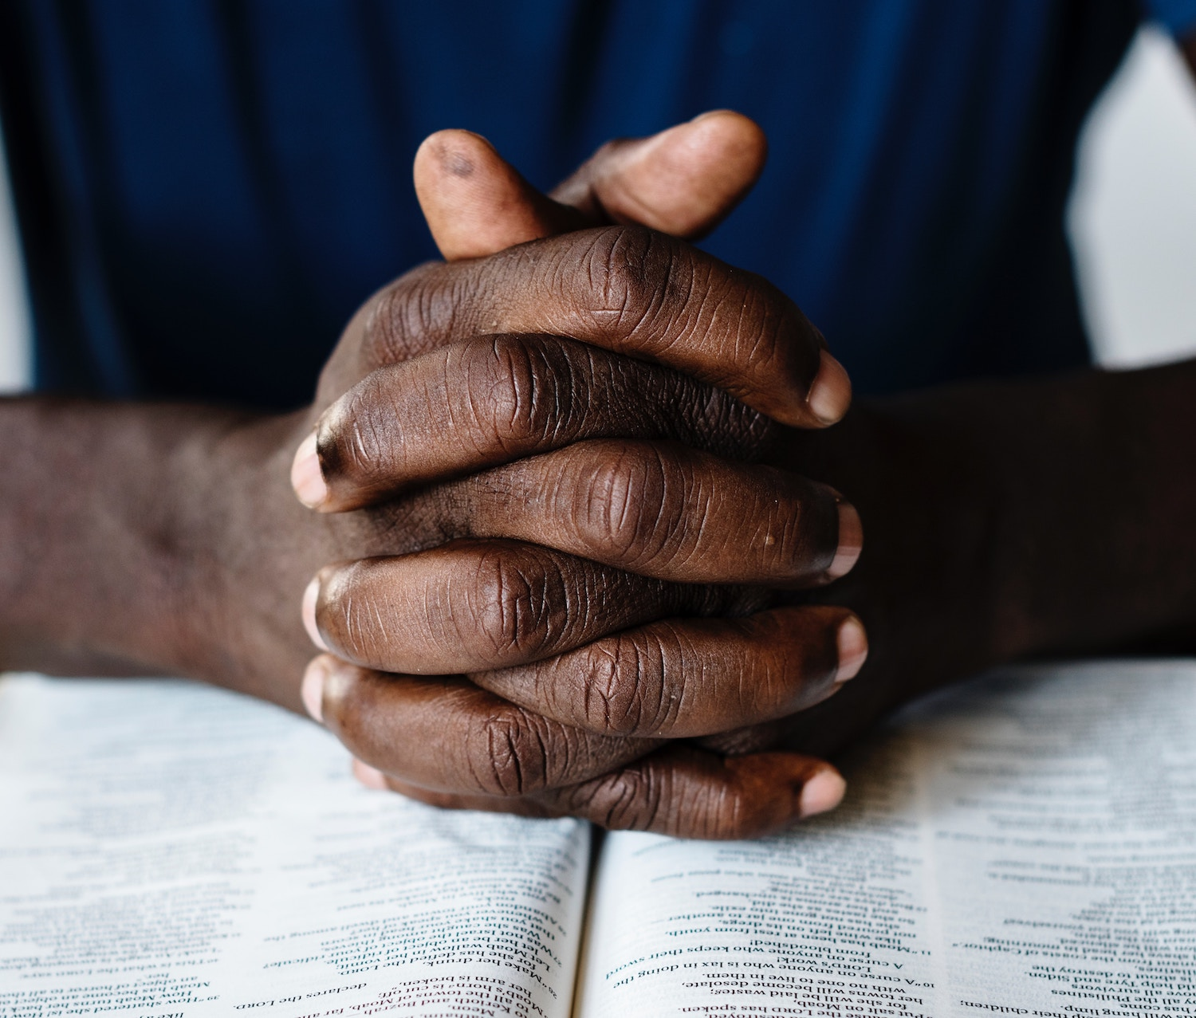
Devoted To Prayer Acts 2:42
How should we define “devoted”?

Slide 2
Devoted To Prayer
Many (97%) Are NOT Satisfied With Their Prayer Devotion.
We struggle because we have accessible technology. We struggle because we have abundant prosperity. We struggle because we’re conditioned for quick results.
But some of us have genuinely sincere questions:
“Of all the activities there is surely none which causes so much perplexity, & raises so many problems, as the activity which we call prayer.” –M. Lloyd Jones
2) We Hope To Answer Some of These & We Invite MORE:
If God knows everything what is the point? Does He heal? Does quantity matter? Does prayer change His mind?

Slide 3
Devoted To Prayer
1) Many (97%) Are NOT Satisfied With Their Prayer Devotion.
2) There Are Various Reasons, There Are Good Hard Questions.
3) The Apostles Had To Learn HOW TO Pray: [Lk 11:1-4]
1) Honor the Father’s Name as HOLY.
2) Desire the spread of HIS KINGDOM in our lives.
3) Ask Him unashamedly for our NECESSITIES.
4) Be FORGIVING. Holding a grudge holds us back.
5) Pray to AVOID temptation. Don’t then turn & run to it!

Slide 4
Devoted To Prayer
1) Many (97%) Are NOT Satisfied With Their Prayer Devotion.
2) There Are Various Reasons, There Are Good Hard Questions.
3) The Apostles Had To Learn HOW TO Pray: [Lk 11:1-4]
4) There Are Several “Devoted To Prayer” Passages:
a) [Col 4:2-6] Keep alert with an attitude of thanksgiving. Paul’s 1st priority was Kingdom spread. Not release.
b) [1 Th 5:12-18] What does “pray without ceasing” imply? It is a habit of prayerful attention. Cf. (Eph 6:18)
5) Behold Our Situation, The Magnitude of the Milky Way!
Consider [Ps 8]. It takes us +20hrs to contact Voyager 1!

Slide 5
Devoted To Prayer
1) Many (97%) Are NOT Satisfied With Their Prayer Devotion.
2) There Are Various Reasons, There Are Good Hard Questions.
3) The Apostles Had To Learn HOW TO Pray: [Lk 11:1-4]
4) Several “Devoted To Prayer” Passages: [Col 4:2-6; 1 Th 5:12-18]
5) Behold Our Situation, The Magnitude of the Milky Way! [Ps 8]
6) Scripture Shows Saints Begging God For Answers:
But consider what His answer was to Job [40:1-14; 42:1-6]
Live by the motto of Psm 46:10. Know that God will be exalted.
7) Will The Judge Know Who His People Are? [Lk 18:1-8] How would He describe our prayer life?

Slide 6
Devoted To Prayer
1) Many (97%) Are NOT Satisfied With Their Prayer Devotion.
2) There Are Various Reasons, There Are Good Hard Questions.
3) The Apostles Had To Learn HOW TO Pray: [Lk 11:1-4]
4) Several “Devoted To Prayer” Passages: [Col 4:2-6; 1 Th 5:12-18]
5) Behold Our Situation, The Magnitude of the Milky Way! [Ps 8]
6) Scripture Shows Begging God For Answers: Psm 46:10
7) Will The Judge Know Who His People Are? [Lk 18:1-8] Practical Tips: (1) Not specific goals, but systems. (2) Pray Shorter. Scripture does this & uses daily routines.
(3) In Long Prayer: Use Structure & Lessen Interruptions.
(4) Be Humble Enough To Use Congregational Prayer.

