Slide 1
Chapter 2:1-7
Chapter 3:1-6

Slide 2
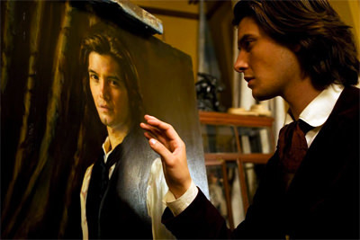
Is there a mirror for the soul?

Slide 3
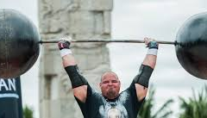
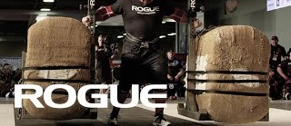
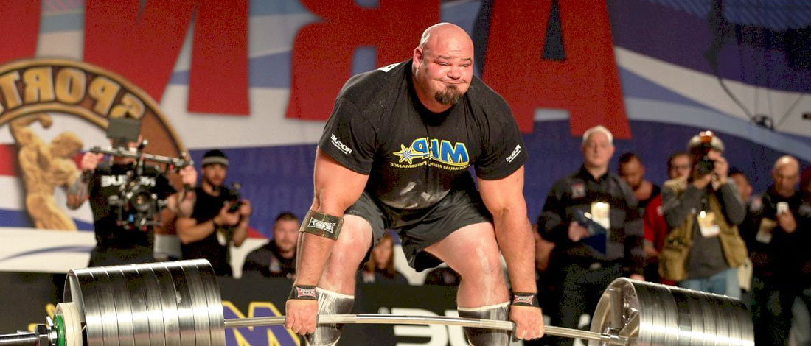

Slide 4
How do we live righteously among those who do not know God?
Noah
Abraham
Joseph
Esther
Paul
Timothy
Daniel
Hananiah
Mishael
Azariah

Slide 6
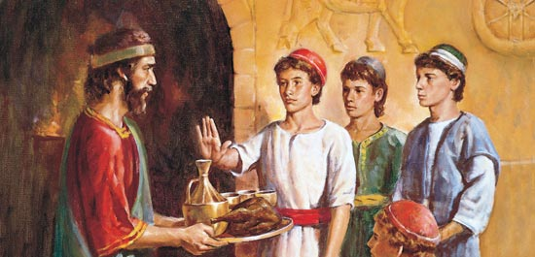
A Question of Values
A question of names

Slide 7
A question of values
Golden Vessels
Admiration and appreciation is not the same as worship.
What do people think of when they think of God?
Food Laws
Why did they have them?
-Leviticus 11:1-8
-Mark 7:14-23
-Galatians 3:21-29
Danger of keeping food laws
-Matthew 23:27-28
Something New
Galatians 5 19-26
Not a question of what city we live in but what city we live for.
Choose you this day
-1 Peter 3:13-17

Slide 8
Our Promise
A question of Names
Daniel- God is my Judge
Hananiah-Yahweh is gracious
Mishael- Who is like God
Azariah- helped by God
→Belteshazzar- May Marduk protect his life
→Shadrach- Command of Aku
→Meshach- Who is like Aku
→Abednego- Servant of Nabu
*No matter what we are called what will our values be shown to be?*
Jeremiah 29:10-14
Matthew 25:31-46

