Slide 1
Creationists Make Good Scientists
Memorable & Meaningful Facts About Creation & Science

Slide 2
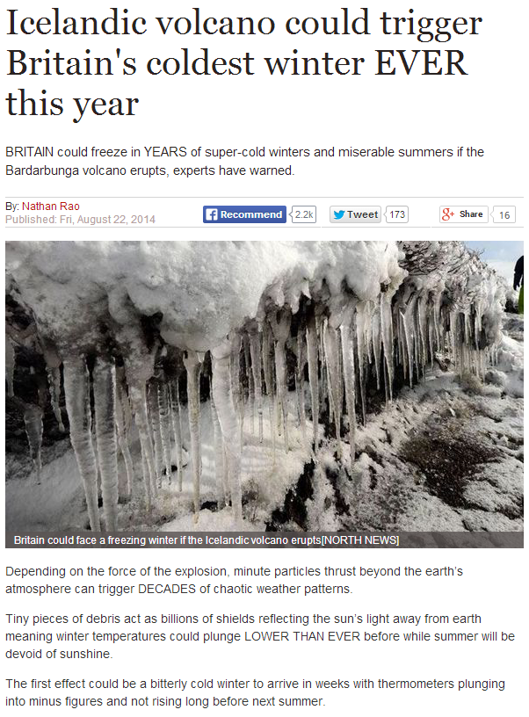
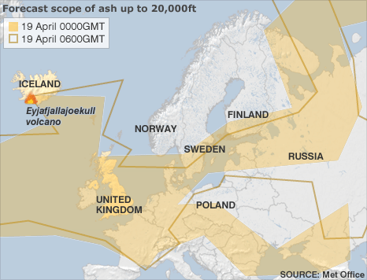
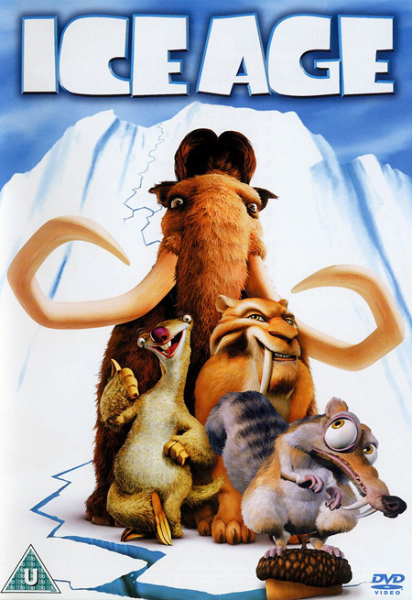
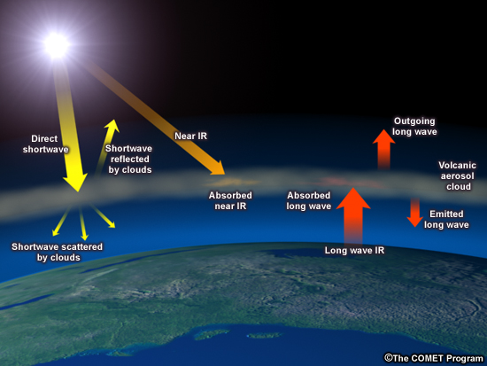
Creationists Make Good Scientists
Science: the process of discovering what is currently true.
Ideas & opinions are constantly changing, progressing.

Slide 3
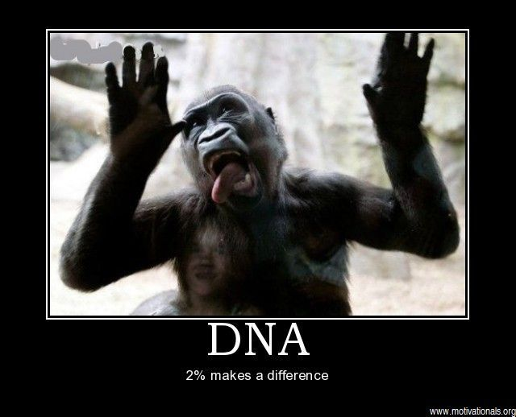
Creationists Make Good Scientists
Science: the process of discovering what is currently true.
Ideas & opinions are constantly changing, progressing.
The Gen 7 flood CAN explain The Ice Age.
Reality 70% similarity; 30% = 900,000,000 differences

Slide 4
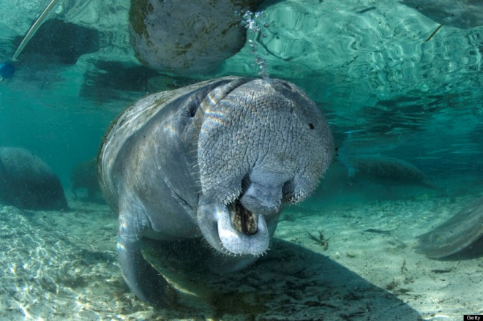
Creationists Make Good Scientists
Sea Cows aka
Manatees
Science: the process of discovering what is currently true.
Ideas & opinions are constantly changing, progressing.
The Gen 7 flood CAN explain The Ice Age.
DNA science is confirming the ‘kinds’ in Gen 1:24.
Evolution struggles to explain some vulnerable species.
A very unique kind that will blow your mind!

Slide 5
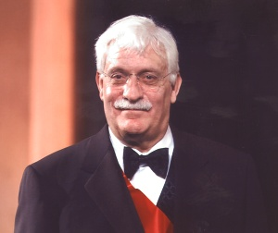
Creationists Make Good Scientists
Science: the process of discovering what is currently true.
Ideas & opinions are constantly changing, progressing.
The Gen 7 flood CAN explain The Ice Age.
DNA science is confirming the ‘kinds’ in Gen 1:24.
Evolution struggles to explain some vulnerable species.
Creation scientists allow the creation to inspire them.
Electrolocation has benefitted science & health.
Dr. R. Damadian (Harvard)
Invented the MRI (1977).
His life motto, [Col 2:2-4]
“The individual scientist has to continually remind himself that while he is experimenting on the natural world, it gives him no knowledge about the history of the world. There is a decided difference.” Dr. Damadian

Slide 6
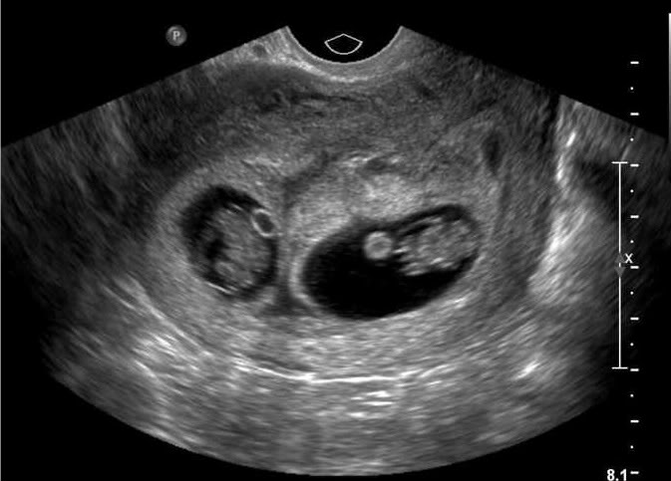
Creationists Make Good Scientists
Science: the process of discovering what is currently true.
Ideas & opinions are constantly changing, progressing.
The Gen 7 flood CAN explain The Ice Age.
DNA science is confirming the ‘kinds’ in Gen 1:24.
Evolution struggles to explain some vulnerable species.
Creation scientists allow the creation to inspire them.
Creationists have benefitted from scientific innovation.
“The medical truths were right there in front of me.
What we ‘didn’t get’ was my son.” -Cynthia Wenz

Slide 7
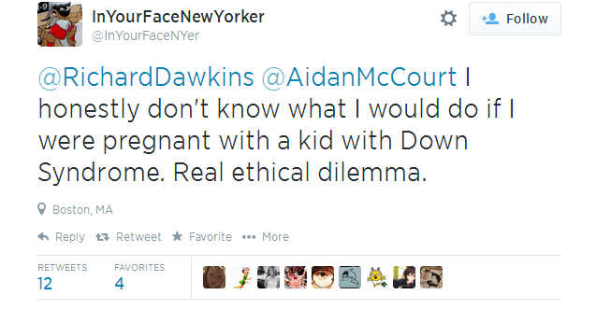
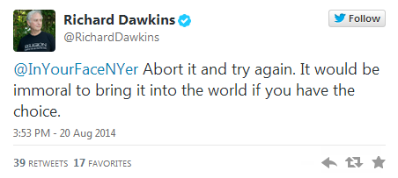
Creationists Make Good Scientists
Science: the process of discovering what is currently true.
Ideas & opinions are constantly changing, progressing.
The Gen 7 flood CAN explain The Ice Age.
DNA science is confirming the ‘kinds’ in Gen 1:24.
Evolution struggles to explain some vulnerable species.
Creation scientists allow the creation to inspire them.
Creationists have benefitted from scientific innovation.

Slide 8
Creationists Make Good Scientists
Science: the process of discovering what is currently true.
Ideas & opinions are constantly changing, progressing.
The Gen 7 flood CAN explain The Ice Age.
DNA science is confirming the ‘kinds’ in Gen 1:24.
Evolution struggles to explain some vulnerable species.
Creation scientists allow the creation to inspire them.
Creationists have benefitted from scientific innovation.
Embrace what science can do, recognize its limits.
“Destroy speculations raised against God” 2 Cor 10:3-6

