Slide 1
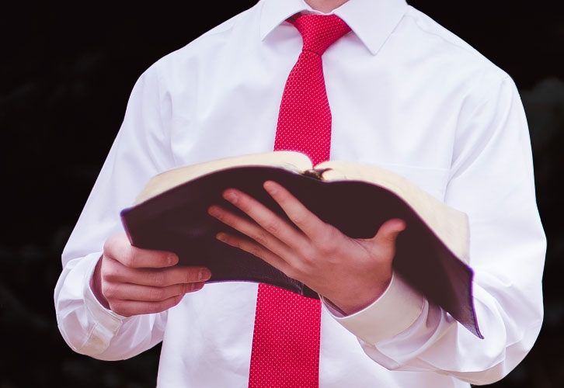
Seven Attitudes Needed to Understand God’s Word
Psalm 119:161

Slide 2
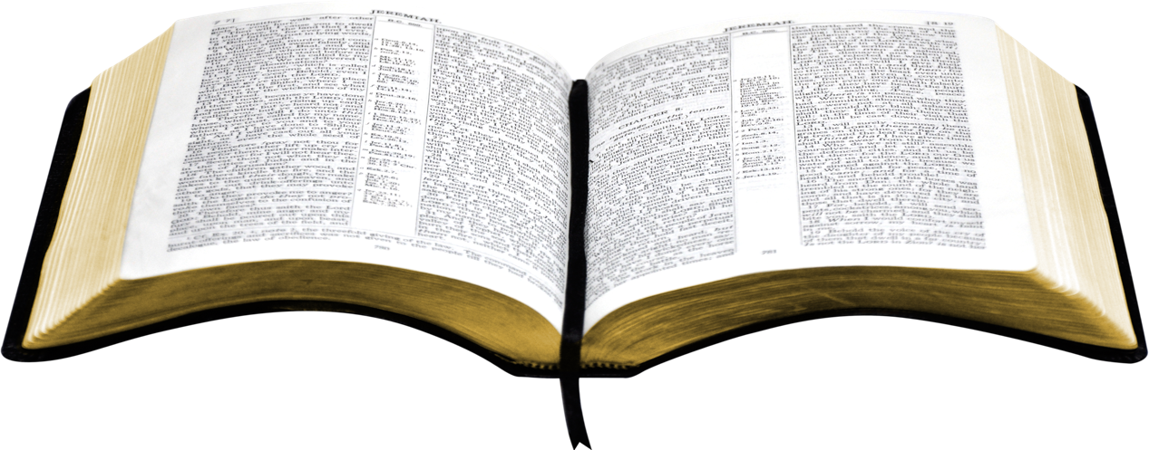
Introduction
“The Bible is just too difficult; nobody can understand it.”
“Too many different interpretations, none can see it alike.”
If one does not have the proper attitudes, they will never understand God’s word.
God demands that we approach the Scriptures with deep reverence and humility. (Isaiah 66:2)
Deep reverence for the Word important. Yet, notice these seven attitudes one must have to understand God’s word…

Slide 3
Introduction
#1. We Must Believe in Divine Inspiration.
“These things we also speak, not in words which man's wisdom teaches but which the Holy Spirit teaches, comparing spiritual things with spiritual.” (1 Corinthians 2:13)
“For this reason we also thank God without ceasing, because when you received the word of God which you heard from us, you welcomed it not as the word of men, but as it is in truth, the word of God, which also effectively works in you who believe.” (1 Thessalonians 2:13)

Slide 4
2 Peter 1:21
“For prophecy never came by the will of man, but holy men of God spoke as they were moved by the Holy Spirit.”

Slide 5
Introduction
#2. We Must Love the Word of God.
“Oh, how I love Your law! It is my meditation all the day.” (Psalm 119:97)
“And with all unrighteous deception among those who perish, because they did not receive the love of the truth, that they might be saved. And for this reason God will send them strong delusion, that they should believe the lie, that they all may be condemned who did not believe the truth but had pleasure in unrighteousness.” (2 Thessalonians 2:10-12)

Slide 6
Introduction
#3. We Must Realize the Bible is Understandable.
“So they read distinctly from the book, in the Law of God; and they gave the sense, and helped them to understand the reading.” (Nehemiah 8:8)
“By which, when you read, you may understand my knowledge in the mystery of Christ.” (Ephesians 3:4)

Slide 7
Ephesians 5:17
“Therefore do not be unwise, but understand what the will of the Lord is.”

Slide 8
Introduction
#4. We Must Understand the Bible was Written to Us.
“But blessed are your eyes for they see, and your ears for they hear.” (Matthew 13:16)
“It is written in the prophets, 'And they shall all be taught by God.' Therefore everyone who has heard and learned from the Father comes to Me.” (John 6:45)

Slide 9
Introduction
#5. We Must Believe the Bible is Relevant Today.
“And He said to them, Go into all the world and preach the gospel to every creature.” (Mark 16:15)
“And the things that you have heard from me among many witnesses, commit these to faithful men who will be able to teach others also.” (2 Timothy 2:2)

Slide 10
Introduction
#6. We Must Interpret the Bible Correctly to Understand its Teaching.
“And that from childhood you have known the Holy Scriptures, which are able to make you wise for salvation through faith which is in Christ Jesus. All Scripture is given by inspiration of God, and is profitable for doctrine, for reproof, for correction, for instruction in righteousness, that the man of God may be complete, thoroughly equipped for every good work.” (2 Timothy 3:15-17)

Slide 11
2 Peter 1:2,3
“Grace and peace be multiplied to you in the knowledge of God and of Jesus our Lord, as His divine power has given to us all things that pertain to life and godliness, through the knowledge of Him who called us by glory and virtue.”

Slide 12
2 Peter 1:4
“By which have been given to us exceedingly great and precious promises, that through these you may be partakers of the divine nature, having escaped the corruption that is in the world through lust.”

Slide 13
Introduction
#7. We Must Have the Proper Mental and Spiritual Qualities.
“Now thanks be to God who always leads us in triumph in Christ, and through us diffuses the fragrance of His knowledge in every place.” (1 Corinthians 2:14)

Slide 14
2 Timothy 3:1,2
“But know this, that in the last days perilous times will come:
For men will be lovers of themselves, lovers of money, boasters, proud, blasphemers, disobedient to parents, unthankful, unholy.”

Slide 15
2 Timothy 3:3,4
“Unloving, unforgiving, slanderers, without self-control, brutal, despisers of good, traitors, headstrong, haughty, lovers of pleasure rather than lovers of God.”

Slide 16
2 Timothy 3:5,6
“Having a form of godliness but denying its power. And from such people turn away! For of this sort are those who creep into households and make captives of gullible women loaded down with sins, led away by various lusts.”

Slide 17
2 Timothy 3:7
“Always learning and never able to come to the knowledge of the truth.”

Slide 18
Conclusion
Preacher once said, “One must have a burning desire to know the will of God, diligence to study, zeal to acquire knowledge of necessary related subjects and the willingness to do the will of God in all things.”
Students of God’s word must have the proper attitudes needed to grasp an understanding.
Approaching the word with reverence, humility, and these “seven attitudes” our studies will be fruitful and blessed!

