Slide 1
MARRIAGE ON THE CROSS

Slide 2
MARRIAGE ON THE CROSS
GIVE ME THE TRUTH! Bill Crews If you are my friend, if you’re concerned about my soul, give me the truth. Do not flatter me. Do not praise my virtues while remaining silent about my vices. Do not fear the truth will offend me. Do not treasure our friendship, our friendly relations, above my salvation. Do not think by ignoring my sins you can help me. Do not think that being blind to my sins will prove you charitable. However, I may react to it, whatever may be my attitude toward you after you have done it, GIVE ME THE TRUTH. For the Truth, and only the Truth, can make me free from the shackles of sin, strengthen me in the pathway of righteousness, and lead me to heaven's joy. If I am wavering, weak, lukewarm, indifferent, neglectful; if I have been overtaken in a trespass; if I have been drawn into the pleasure of the world; if I have left my first love; if I have been led astray by error; or if I have done none of these, but simply need to grow in knowledge and be edified, GIVE ME THE TRUTH

Slide 3
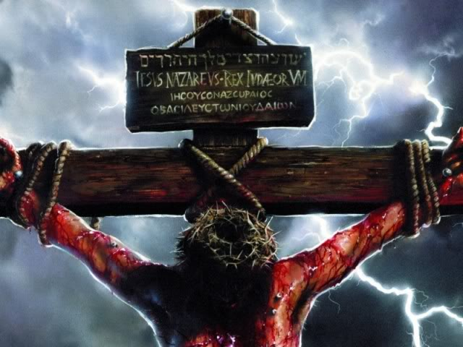
Someone
Hasn’t
Been A
“Christian
Indeed”
Someone
Has Failed
To Remember
The Cross
Luke 23:44-48; 1 Peter 2:21

Slide 4
MARRIAGE ON THE CROSS
The Cross
Defines Love
(1 John 4:10-11;
Romans 5:8)

Slide 5
MARRIAGE ON THE CROSS
The Cross Makes
An Unselfish
Person
(Luke 22:41-45;
Matthew 16:24-25;
Romans 6:6;
Galatians 2:20)

Slide 6
MARRIAGE ON THE CROSS
The Cross Teaches
Sacrifice
(Philippians
2:3-11)

Slide 7
MARRIAGE ON THE CROSS
The Cross
Teaches
Service
(Mark 10:35-45;
1 Peter 3:7;
1 Corinthians
7:33-34)

Slide 8
MARRIAGE ON THE CROSS
The Cross
Models
Mutual
Submission
(Ephesians
5:22-25;
5:21)

Slide 9
MARRIAGE ON THE CROSS
The Cross Shows
Patient Endurance,
Non-retaliation,
Forgiveness
(1 Peter 2:21-24;
Hebrews 12:2-3;
Luke 23:32-34;
Acts 2:36-37)

Slide 10
MARRIAGE ON THE CROSS
The Cross
Demonstrates
Faithfulness
(Hebrews 13:5;
2 Timothy 2:13;
Ephesians 5:25-29)

Slide 11
BRINGING THE CROSS INTO YOUR MARRIAGE
The Path To
An Exalted
Marriage If
Each Person
Is Like Jesus
(Revelation 19:7-9)

Slide 12
MARRIAGE ON THE CROSS
Christ/ Church
Husband/Wife
Ephesians 5:25-33
What
Does
Your
Marriage
Say?

