Slide 1
Seek the Welfare
Of The City
- JEREMIAH 29:7

Slide 2
Pray For All Men
The Solution For A Diverse World

Slide 3
Pray For ALL Men 1 Tim 2:1-7
Prayer is the first correction for problems.
All types of prayers for all types of people.
The prayer is for two phrases:
A peaceful & quiet life, an ideal scenario…
To live in godliness & dignity! Do good deeds!
Learn how God would act & then DO IT!
For Paul, prayer replaced OT sacrifices:
Acceptable prayer seeks God’s will, which…
Desires ALL be saved, thus, prayer for ALL men.
NOT limited by geography, but ALL nations!

Slide 4
Pray For ALL Men 1 Tim 2:1-7
Prayer is the first correction for problems.
Prayer for peace & quiet to live godly!
Good prayer prays for ALL nations.
God planned for one man as mediator.
The man, Christ Jesus, the voluntary ransom!
Only His example of selflessness gives peace.
ALL nations, all religions, must submit to Him.
How should we think of ‘world peace’?

Slide 5
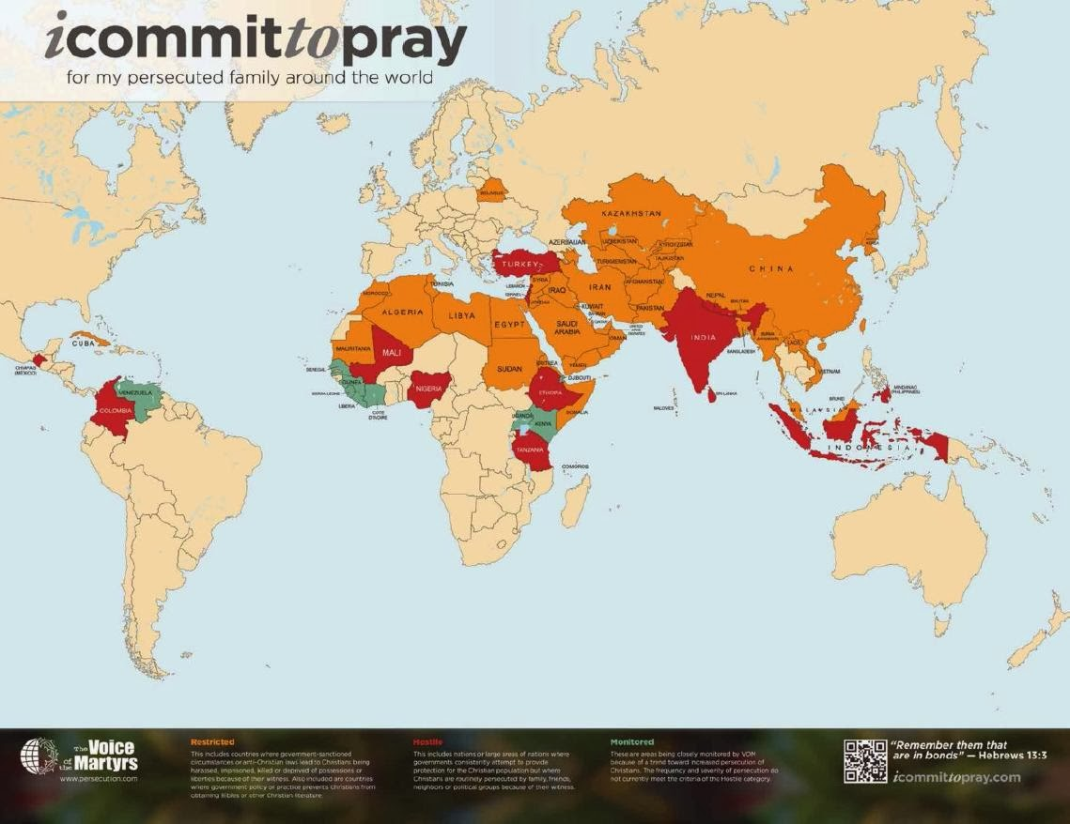
Pray For ALL Men 1 Tim 2:1-7
Prayer is the first correction for problems.
Prayer for peace & quiet to live godly!
Good prayer prays for ALL nations.
God planned for one man as mediator.
The man, Christ Jesus, the voluntary ransom!
Only His example of selflessness gives peace.
ALL nations, all religions, must submit to Him.
How should we think of ‘world peace’?
Remember Romans 5:
suffering should lead to hope.

