Slide 1
Spiritual Metamorphosis
[Psalm 148:7-12]
Spiritual Lessons From Butterfly Science

Slide 2
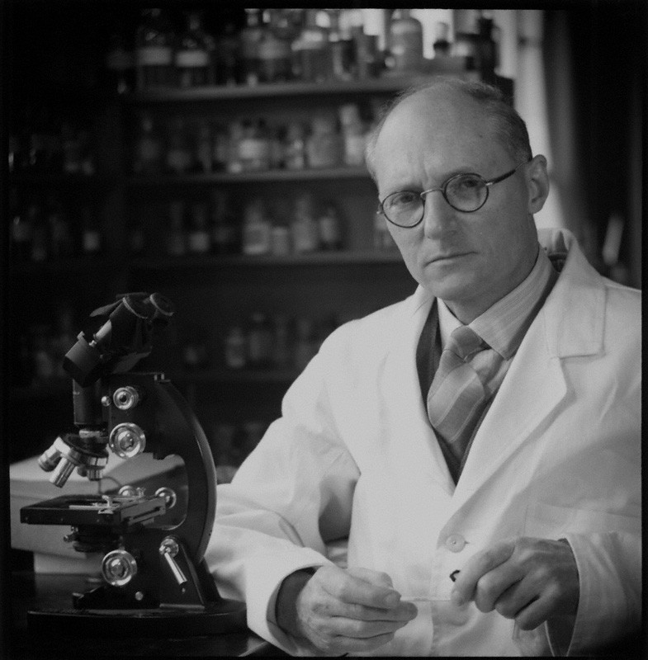
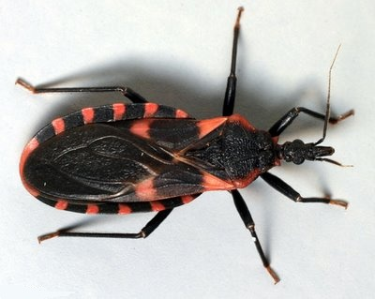
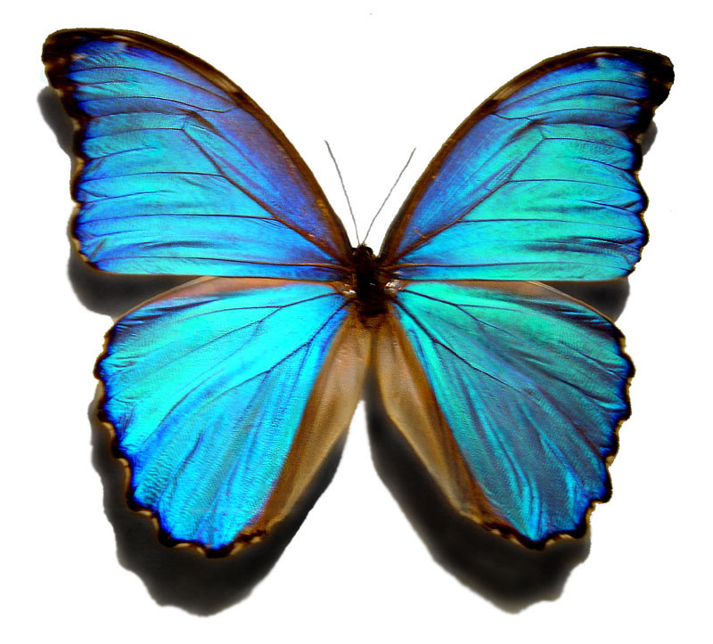
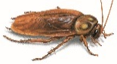
Spiritual Metamorphosis
What do we know about metamorphosis?
Sir Vincent
Wigglesworth

Slide 3
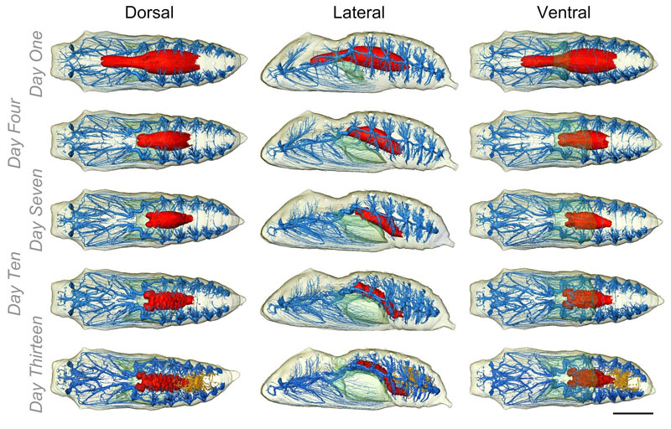
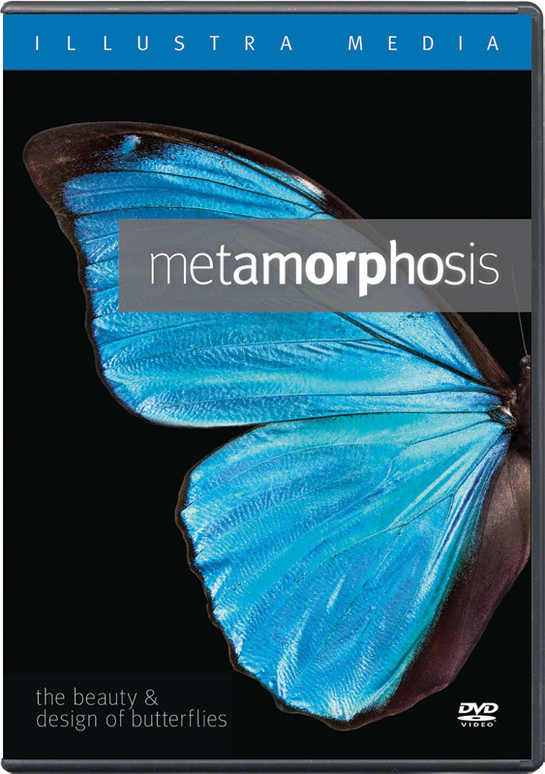
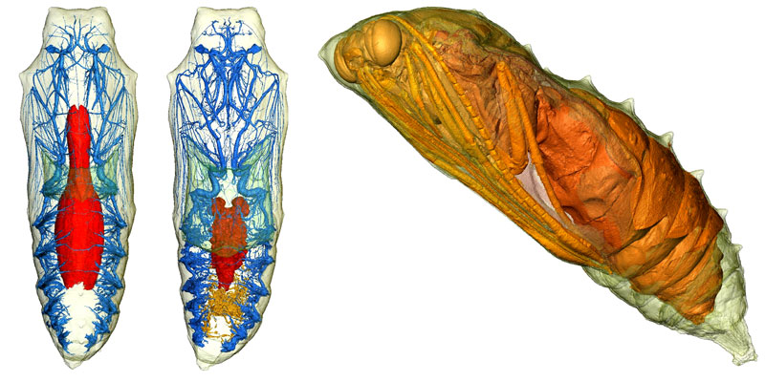
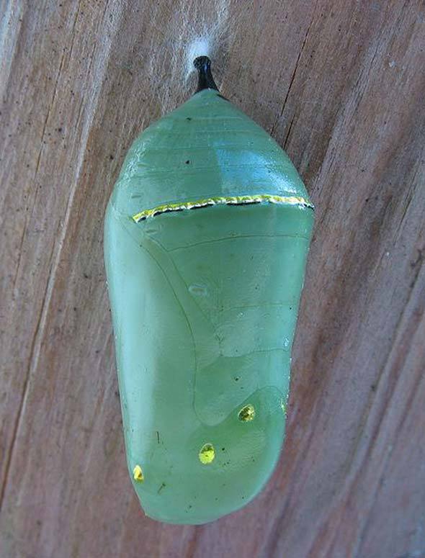
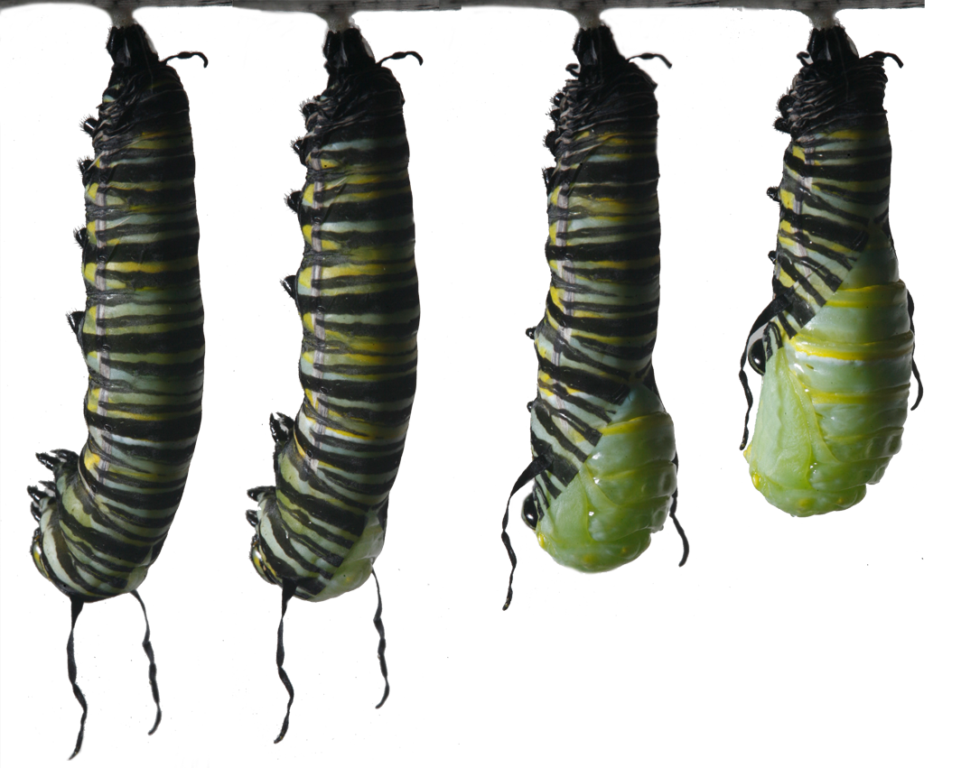
Spiritual Metamorphosis
(Top)
(Side)
(Bottom)
What do we know about metamorphosis?

Slide 4
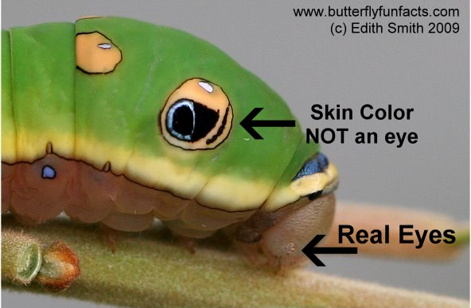
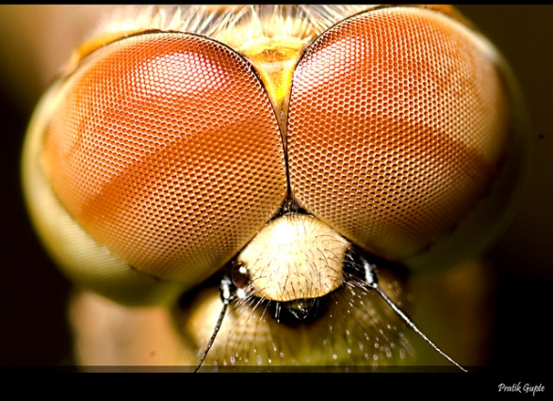
Spiritual Metamorphosis
Digestive Tract is completely altered.
¼ of original size! From jaws to straws!
Reproductive System is brand new.
Caterpillars don’t even have them.
Visual System gets a complete conversion of eyes.

Slide 5
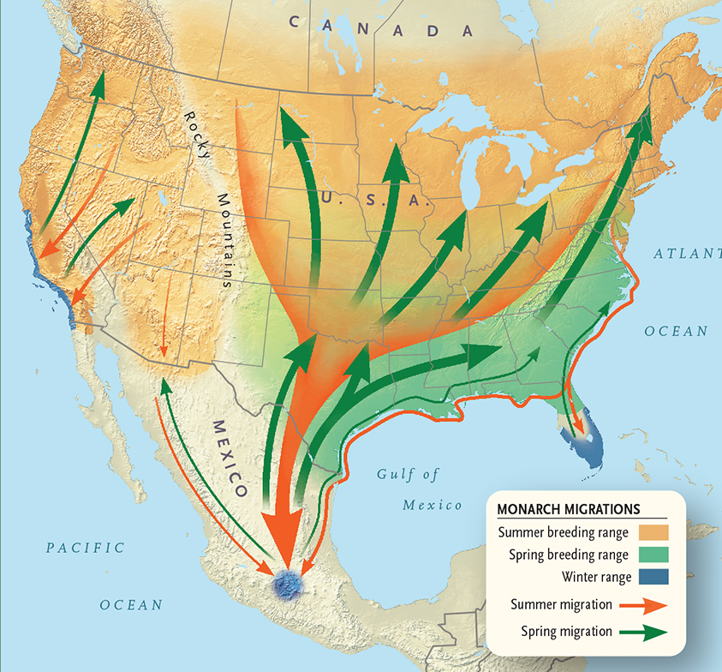
Spiritual Metamorphosis
Incredible Migration for the 4th generation.

Slide 6
Spiritual Metamorphosis
Digestive Tract; Reproductive System;
Visual System; Legs & Muscles; Respiratory…
“All of these organs have to make transitions. You’ve got an orchestra in there. You’ve got a Conductor that’s responsible for it all.” -Dr. Richard Stringer
I hope you can see the spiritual parallels… (Mt 6:28)
Consider the butterflies of the field.

Slide 7
Spiritual Metamorphosis
1) Parents, are we placing our children carefully?
Are we distorting their natural desire to grow?
2) Transform your natural desires to new cravings:
Be transformed, not conformed [Rom 12:1-2]
Feast on the words of eternal life Jn 6:52-58 Make progress & maturity your goal Heb 5:12-13 Don’t make your gut you god [Php 3:17-21]
3) Set your eyes on new heights: [Col 3:1-4]
Have vision & see our real location (Eph1:20; 2:1-7)
4) Control your urges [1 Th 4:2-5; 1 Cor 6:15-20]

