Slide 1
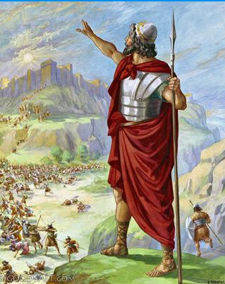
The Enemies Regroup Joshua 9-12

Slide 2
The Enemies Regroup Joshua 9-12
A) How did Israel end up with ALLIES?
The consequences of Ch 7 continue to the enemies in [9:1-2]. Hearts were no longer melted. [5:1] As Joshua had predicted. 7:9
Do we fully grasp the ripple effects of sin? Do we repel people? How many Rahab’s could have been saved? Rom 2:24
B) How did the Gibeonites become allies? They had lied but Joshua obeyed. Dt 20:15, 29:11 Israel’s leaders take an unpopular position [Josh 9:18-21].
God’s people should be known for honesty/reliability.
Notice the Gibeonites humble contentment:
begging for mercy & offering servitude. Jesus our King provides & protects His servants.

Slide 3
The Enemies Regroup Joshua 9-12
C) God honors the covenant! [10:6-11]
Helps Israel make a 20-25 mile uphill night time hike!
D) There was no day like it! [10:12-15] 1) Book of Jashar included patriotic war songs. E.g. 2 Sa 1:18
2) The grammar is tricky for WHO told the sun to be still.
3) How did God hear Joshua different than all other men? God had heard Israel in Num 21. He’ll do this in 1 Kings 17:22. The point is: YHWH does more than hear, He reacts!
E) What exactly did happen in the sky?

Slide 4
The Enemies Regroup Joshua 9-12
E) What exactly did happen in the sky? 10:12-15
Traditionally: The earth stopped rotating.
Note that it is morning. The sun is in the east. Furthermore, I’m not aware of credible NASA research on it.
Other believers: It’s poetic language as used elsewhere. Exodus 15 poetically describes the war of Exodus 14. Judges 5 poetically describes the war of Judges 4.
Poetry isn’t disbelief. Do rivers clap their hands? Ps 98:8
James 1:5-8, Let’s make sure
we believe when we pray!

Slide 5
The Enemies Regroup Joshua 9-12
F) Ch 10-12 God Fulfills the Promise of Deuteronomy
Deut 7:22 The nations will be removed little by little. Israel did not destroy them all at once. God handled it.
Our attention is drawn to the 5 Kings [10:22-28]
They’re locked in a burial by a large stone.
But our King rolled the stone away! He gives us victory! 1 Cor 15:25-26; 2 Tim 1:10 Death has lost its power!

