Slide 1
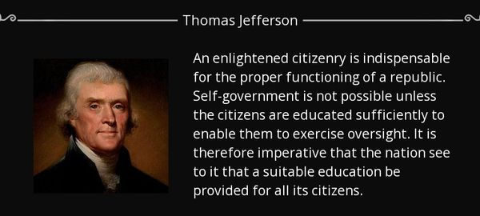
Salvation Creates An Enlightened Citizenry
Acts 26:12-23

Slide 2
An Enlightened Citizenry
Some of our trouble is blamed on Satan
Biblically, he is blamed for several types of earthly trouble. [1 Th 2:17-18; 2 Cor 2:5-11] Let scripture light the way.
Look beyond DNA to the Inner Man (Eph2)
But do look for some noticeable/observable differences.
Genuinely pledge allegiance to a better country [Heb 11:8-16]
Remember, Jesus’ country is different [Jn 18:33-37]

Slide 3
An Enlightened Citizenry
The Benefits of Heavenly Citizenship
The rewards are not all delayed, some exist NOW! [Lk18:28ff]
It also gives us focus for daily service. Col 1:13; Ac 26:12-23
Peter joins in connecting citizenry & LIGHT [1 Pet 2:9-12]
We’re Expected To Have Enlightened Thinking
The Light has been suppressed but we still know He triumphs!
Our minds were once darkened but He transforms our thoughts.

Slide 4
An Enlightened Citizenry
The Light Has Changed Zion’s Citizens
Our hearts & minds have been enlightened by our Creator.
Our dark behavior has been turned into Light! [Mt5:14-16]
Don’t allow the world’s citizens to rob us of…
His wisdom, peace, joy, hope… our Light.

