Slide 1
Thy Word Is A Lamp Unto My Feet
Psalm 119:105

Slide 2
Thy Word Is A Lamp… – Psm 119:105
God’s Word Gives Us Lighted Paths
Thankfully, we aren’t left in the dark [1Jn1:1-2:1]
God’s Word hasn’t trapped us on a path. Rom 7
Instead, He empowers us to walk right in His world. He doesn’t ask us to do the impossible.
Sadly, some LOVE the darkness [Rom 1:18-25]. Their foolish hearts were darkened.

Slide 3
Thy Word Is A Lamp… – Psm 119:105
God’s Word Gives Us Lighted Paths [1Jn1:1-2:1]
Man Has Long Loved Darkness [Job 24:13-17]
Don’t be alarmed, Jesus affirmed this [John 3:19-21]
He told us to be Lights on a Hill [Matt 5:14-16]
Recall v11 of our theme text: Eph 5:8-14 Take no part in the darkness, instead expose them!
This fits the context of the 2nd Greatest Command: Lev 19:17-18 Reason frankly with your neighbor.

Slide 4
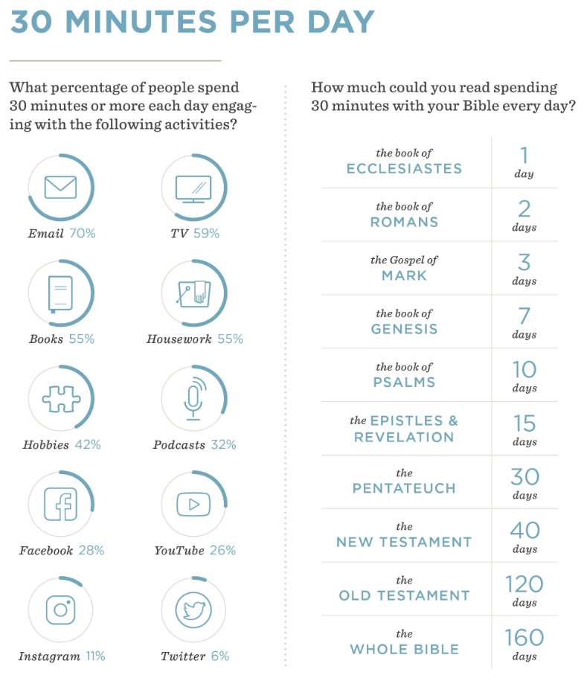
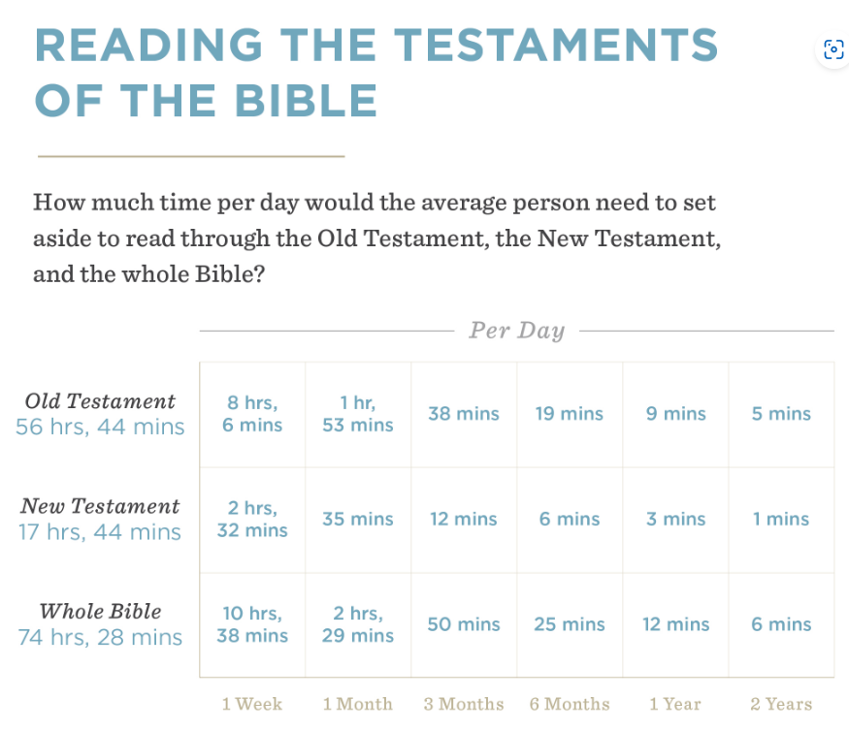
Thy Word Is A Lamp… – Psm 119:105
God’s Word Gives Us Lighted Paths [1Jn1:1-2:1]
Man Has Long Loved Darkness [Jn 3:19-21]
Using God’s Lamplight: [Lk 14:15-22]
Fight for Time. Why do we do this for hobbies?
Have A Plan. Who builds without one?
Challenge Yourself. Learning is never easy.
Ask for Accountability. Power in teams.

Slide 5
Thy Word Is A Lamp… – Psm 119:105
God’s Word Gives Us Lighted Paths [1Jn1:1-2:1]
Man Has Long Loved Darkness [Jn 3:19-21]
Using God’s Lamplight: [Lk 14:15-22]
Fight for Time. Why do we do this for hobbies?
Have A Plan. Who builds without one?
Challenge Yourself. Learning is never easy.
Ask for Accountability. Power in teams.
Be patient & gracious with yourself & others.

