Slide 1
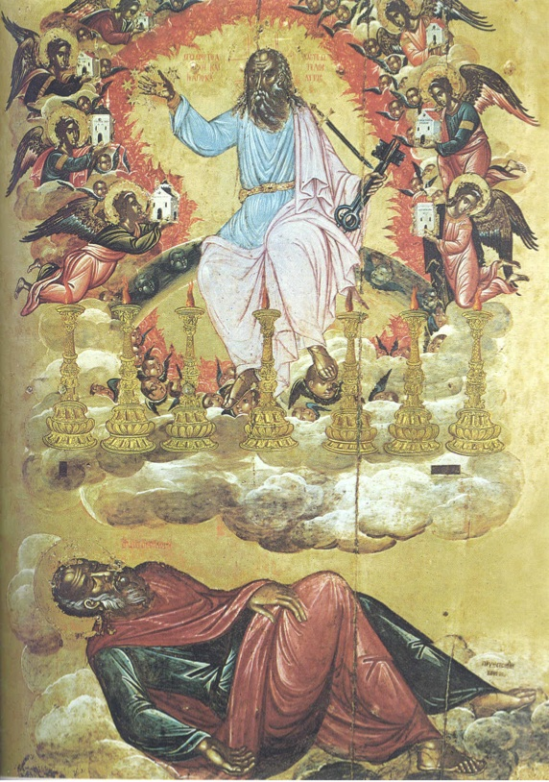
God’s Revelation to John
Revelation is meant to (1) be a BLESSING and (2) it should be KEPT (or obeyed).
…from Jesus Christ, which God gave him… …made known by sending an angel…

Slide 2
Returning to Revelation
1) The Revelation is a BLESSING [1:1-3] (7x!)
Blessed… are those who keep (or obey in NET/NLT).
…are those who die in the Lord, they may rest. (14:13)
Blessed is the one who stays awake. (16:15)
…are those invited to the marriage supper of The Lamb. (19:9)
…is the one who shares in the 1st Resurrection. (20:6)
Blessed is the one who obeys this prophecy. (22:7) (22:14)
…are those who wash their robes so they may enter heaven.
Keep the original audience in mind: No need to be dogmatic over debatable details. There are clear details from the 7 Churches of Asia. Let the prophecy edify as intended. 1 Cor 14:1-12

Slide 3
Returning to Revelation
2) The Revelation Should Be Obeyed
What does obeying Ch 1 look like? Be a holy priesthood! Remember Jesus’ example & patiently endure.
What does obeying Ch 2-3 look like? Overcome with Jesus. Churches can be good, bad, & often include both. We need to conquer our unique temptations.
What about obeying Ch 4-5? Worship with enthusiasm!
How excited are we about The Father & The Son?

Slide 4
Returning to Revelation
3) Why Does John Write This Way?
He’s using OT language to write about NT realities. +800 allusions in 404 verses. 28 of 39 OT books.
The Gospels are also known in NT books. John’s language sounds like Mt 24, Mk 13, Lk 21.
It’s an artistic depiction of [2 Tim 3:10-17].
Let this prophetic letter bless our view of the world. And may God help us to obey this victorious prophecy!

