Slide 1
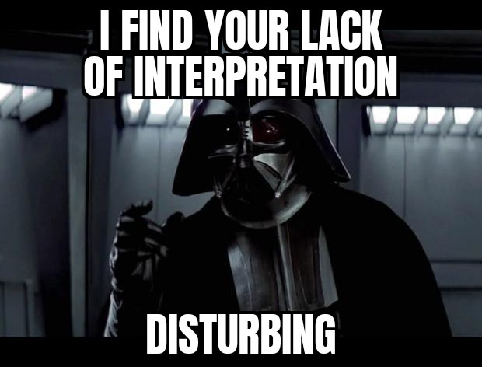
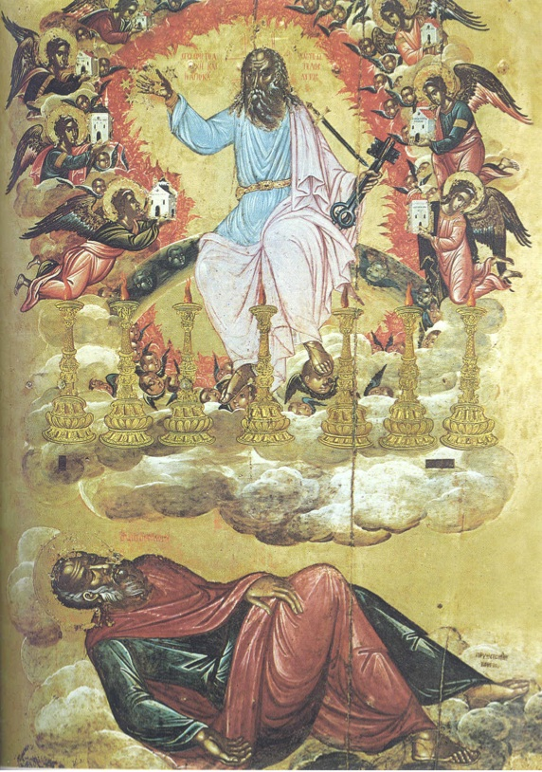
God’s Revelation to John
Comfortable saints may contemplate… but
Revelation is meant to (1) be a BLESSING and (2) it should be KEPT (or obeyed).
…from Jesus Christ, which God gave him… …made known by sending an angel…
It should UNITE us, not create factions.

Slide 2
Seven Seals Ch 6-7
1) What happens in The Seals [6:1-17]?
OT Language to describe New Covenant Spiritual Reality
(A) Four Horses & Zech 6 (Evil still exists)
(B) Martyrs Crying, & Psm 10x, Hab 1:2, Zech 1 (Prayer)
(C) De-Creation chaos & Joel 2, Isa 13:10, 34:1-12 [Jer 4:19-27].
Similar to Jesus in Mt 24, Mk 13, & Lk 21, 23:30.

Slide 3
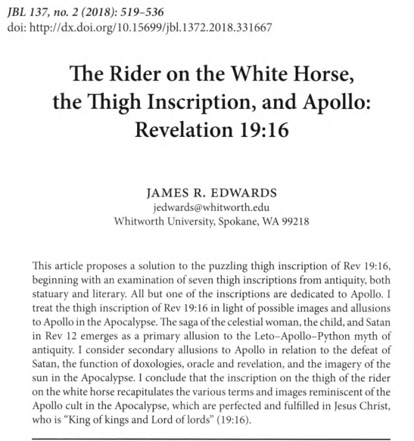
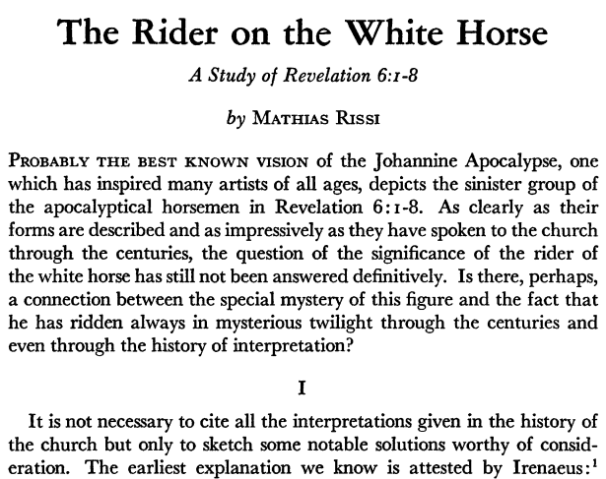
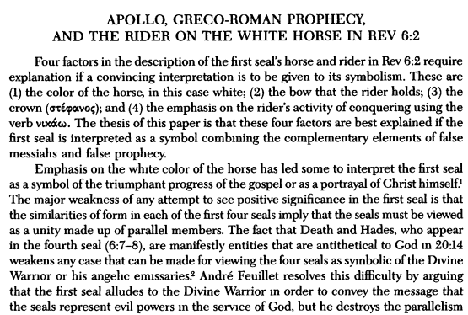
Seven Seals Ch 6-7
1) What happens in The Seals [6:1-17]?
Issues of Interpretation:
(A) White Horse: Several options, Christ, Parthians, etc.
(B) Martyrs Crying: Agreement despite intriguing questions!
(C) De-Creation chaos: Endless possibilities because… NEW interpretations arise from “earth-shattering” events.
USA, Iran, Iraq, Russia, new nations over 1000s of years.

Slide 4
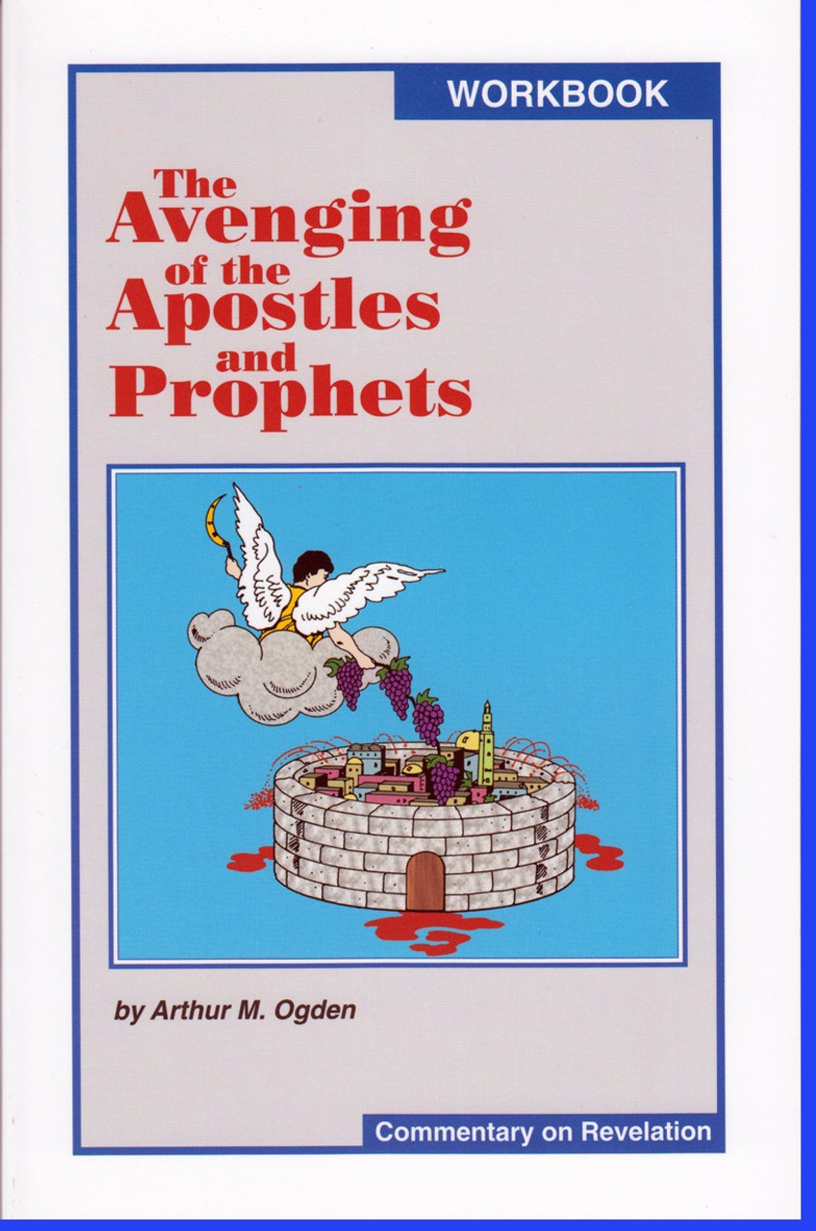
Seven Seals Ch 6-7
2) How Are The Seals A BLESSING?
It is GOOD to hear that God cares about justice. He will avenge His people. The Song of Moses [Dt 32:39-47]

Slide 5
Seven Seals Ch 6-7
2) How Are The Seals A BLESSING?
It is GOOD to hear that God cares about justice. He will avenge His people. The Song of Moses [Dt 32:39-47]
It is GOOD to know “Who can stand at His wrath?” 6:17 [7:9-10, 13-17] Those sealed & washed by His blood. More OT & Gospel ideas: Ezk 9, Passover, Lk 23/Hos 10 Recall Eph 1:13-14, 4:30, we’re sealed by His Spirit.

Slide 6
Seven Seals Ch 6-7
3) How Do We OBEY The Seals Message?
First, why wait to be washed by His blood?
Second, remember Jesus’ promise for His people:
As Living Water, we’ll never thirst. As Bread of Life, we’ll never hunger. His victory over death ensures a place with no tears. We must fully worship The Father & The Lamb!

Slide 7
Seven Seals Ch 6-7
3) How Do We OBEY The Seals Message?
Be washed by His blood & worship The Lamb!
Third, have realistic expectations for life on earth:
(1) Expect war, evil, poverty, disease, & death. (2) Expect persecution. (3) Expect prayer to be heard. (4) Expect a final judgment & (5) protection from Him. (6) Expect to enjoy His provision & presence. (2Pt 2:9)
The creature shouldn’t question The Creator’s world.

