Slide 1
Will Christianity Make Me Happy?
Is it mean to say Jesus is the ONLY way?
Can I Trust The Bible?
What about Hell?
How does God view time?

Slide 2
“There is probably no other practice of worship among churches of Christ that is more opposed to most denominations than singing only, as contrasted to the use of mechanical instruments of music.” - Tim Stevens, Congregational Singing, pg. 203
1st Principle: Take the Word of God seriously [1 Th 2:13-14].
That includes, don’t make assumptions [Num 15:30-36].
Therefore, we respect God’s silence [Heb 7:12-14].
The root leads to the fruit of “distinctive doctrines.”

Slide 3
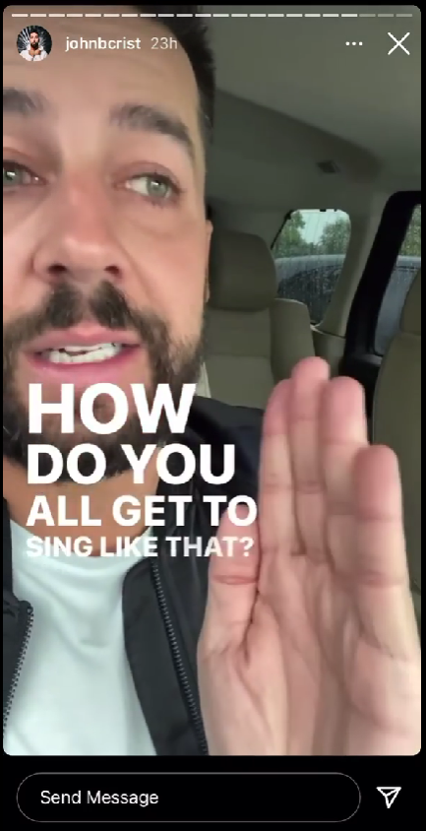
Why don’t you all have music?
1) How do you define music? Technically we do have music:
Music: The science or art of pleasing & intelligible combinations of vocal or instrumental tones having definite structure. (Webster’s)
In fact, many members are musically gifted.
2) Where are instruments prevalent in scripture? The OT
They occur early & often under divine command: 2 Chr 29 Notice the details [1 Ch 15:22, 25:6-8]. Gen 4:21, Psm 81
3) Is Psalms filled with instruments as is often assumed?
Explicit mention is only 17%. 17 Psalms, 8 Headings. The Jews originally didn’t use instruments in synagogues.

Slide 4
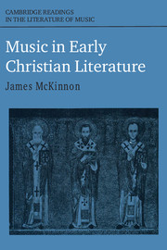
Why don’t you all have music?
1) How do you define music? Technically we do have music:
Music: Vocal or instrumental tones having definite structure. (Webster’s)
2) Where are instruments prevalent in scripture? The OT
Early & often by divine command: [1 Ch 15:22, 25:6-8] 2 Chr 29 3) Is Psalms filled with instruments as is often assumed?
Explicit mention only 17%. Jews partially limited instruments to the Temple.
4) Are the commands of Eph 5 & Col 3 conclusive?
“The antagonism which the fathers of the early church displayed toward instruments has two outstanding characteristics: vehemence & uniformity.” Careful examination of the ancient writings demonstrates “two distinct yet related conclusions: There is the fact that early Christian music was vocal & there is the patristic polemic against instruments.”
-J. McKinnon Music in Early Christian Literature (Citation in Wolfgang essay)
“The original meaning of psallō was “pluck”, “play”, (a stringed instrument); this persisted to the time of Lucian (cp. Par 17). In the LXX psallō frequently means “sing”, whether to the accompaniment of an instrument (Ps. 32.2; 97.5 et al.) or not, as is usually the case (Ps. 7.18; 9.12; 107.4 et al.). This focus on singing continued until psallō in Modern Greek means “sing” exclusively; cp psaltēs = singer, chanter with no reference to instrumental accompaniment.”
Arndt, Danker, Bauer, & Gingrich, A Greek-English Lexicon of the New Testament & other Early Christian Literature.

Slide 5
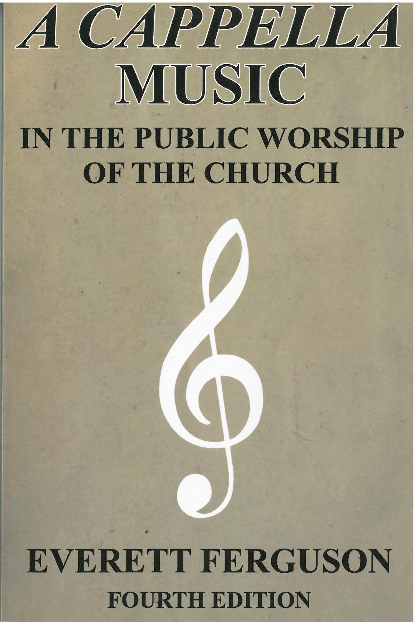
Why don’t you all have music?
1) How do you define music? Technically we do have music:
Music: Vocal or instrumental tones having definite structure. (Webster’s)
2) Where are instruments prevalent in scripture? The OT
Early & often by divine command: [1 Ch 15:22, 25:6-8] 2 Chr 29 3) Is Psalms filled with instruments as is often assumed?
Explicit mention only 17%. Jews partially limited instruments to the Temple.
4) Are the commands of Eph 5 & Col 3 conclusive?
“Historical evidence makes it most unlikely that an instrument can be found in psallo & psalmos in the NT & shows that the absence of any clear reference to instrumental music in the church’s worship in early days was not accidental. It was not mentioned because it was not there. There is no time when one can point to an original use of instruments in the church being abandoned.” -E. Ferguson, A Capella Music, 96
“The original meaning of psallō was “pluck”, “play”, (a stringed instrument); this persisted to the time of Lucian (cp. Par 17). In the LXX psallō frequently means “sing”, whether to the accompaniment of an instrument (Ps. 32.2; 97.5 et al.) or not, as is usually the case (Ps. 7.18; 9.12; 107.4 et al.). This focus on singing continued until psallō in Modern Greek means “sing” exclusively; cp psaltēs = singer, chanter with no reference to instrumental accompaniment.”
Arndt, Danker, Bauer, & Gingrich, A Greek-English Lexicon of the New Testament & other Early Christian Literature.

Slide 6
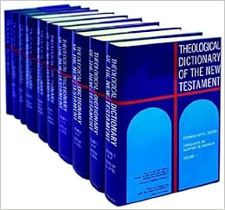
Why don’t you all have music?
1) How do you define music? Technically we do have music:
Music: Vocal or instrumental tones having definite structure. (Webster’s)
2) Where are instruments prevalent in scripture? The OT
Early & often by divine command: [1 Ch 15:22, 25:6-8] 2 Chr 29 3) Is Psalms filled with instruments as is often assumed?
Explicit mention only 17%. Jews partially limited instruments to the Temple. 4) Are the commands of Eph 5 & Col 3 conclusive?
“Jesus & His disciples sang a hymn (hymnos)… The reference to stringed instruments in heavenly worship at Rev 5:8, 15:2… need not mean that such instruments might sometimes accompany the singing at primitive Christian worship.”
G. Delling, “Hymnos” in the Theological Dict. Of the NT Vol 8.
“The original meaning of psallō was “pluck”, “play”, (a stringed instrument); this persisted to the time of Lucian (cp. Par 17). In the LXX psallō frequently means “sing”, whether to the accompaniment of an instrument (Ps. 32.2; 97.5 et al.) or not, as is usually the case (Ps. 7.18; 9.12; 107.4 et al.). This focus on singing continued until psallō in Modern Greek means “sing” exclusively; cp psaltēs = singer, chanter with no reference to instrumental accompaniment.”
Arndt, Danker, Bauer, & Gingrich, A Greek-English Lexicon of the New Testament & other Early Christian Literature.

Slide 7
Why don’t you all have music?
1) How do you define music? Technically we do have music:
Music: Vocal or instrumental tones having definite structure. (Webster’s)
2) Where are instruments prevalent in scripture? The OT
Early & often by divine command: [1 Ch 15:22, 25:6-8] 2 Chr 29 3) Is Psalms filled with instruments as is often assumed?
Explicit mention only 17%. Jews partially limited instruments to the Temple.
4) Are the commands of Eph 5 & Col 3 conclusive?
Depends on which Psalm is being sung & how to define that word.
5) What about instruments in Revelation? [14:1-4, 15:2-4]
If we take everything in the book literally, we’re all lacking in many ways.
6) Why do both sides tend to neglect other verses?
Mt 26 & Mk 14; [1 Cor 14:6-17, 26]; Heb 3:15; Eph/Col “to one another.”

Slide 8
Why don’t you all have music?
1) How do you define music? Technically we do have music:
2) Instruments are from God, early, & prevalent in the OT.
3) Direct mention in Psalms, 17%. Jewish use at the Temple.
4) Commands of Eph 5 & Col 3 are not conclusive.
5) The Revelation uses impossible figurative speech.
6) Both sides can tend to neglect other verses.
7) Why have so many resisted through the years?
The Catholics, Lutherans, & Anglicans all had them.
But Eastern Orthodoxy, Baptists, Calvinists, Puritans, & more did not.
“Precisely when instruments began to be used in Christian worship remains unclear… the organ was the first instrument to appear. It was introduced about 1000 to 1300 and only gradually became universal.”
-Paul Westermeyer Te Deum: The Church & Music

