Slide 1
Will Christianity Make Me Happy?
Is it mean to say Jesus is the ONLY way?
Can I Trust The Bible?
How does God view time?
Psalm 90 God is Eternal

Slide 2
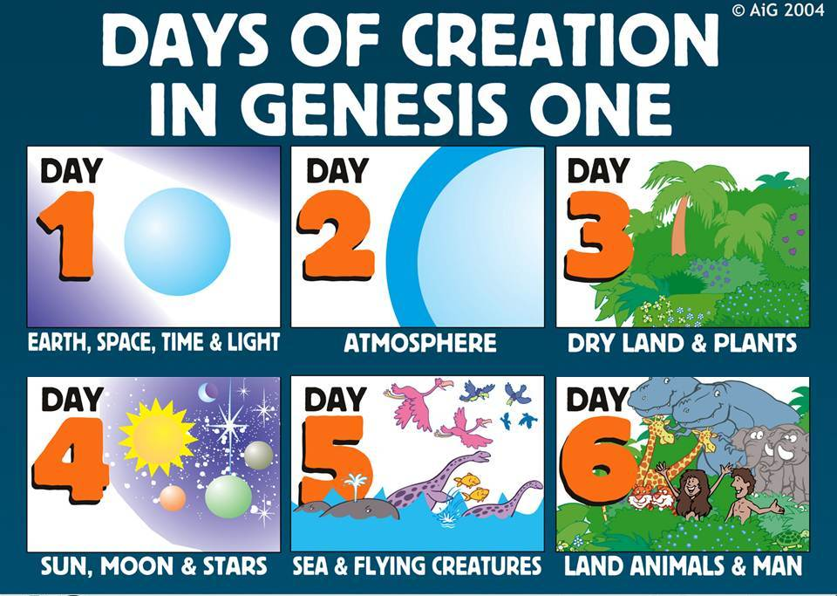
God & TIME
TAKE TIME TO BE HOLY

Slide 3
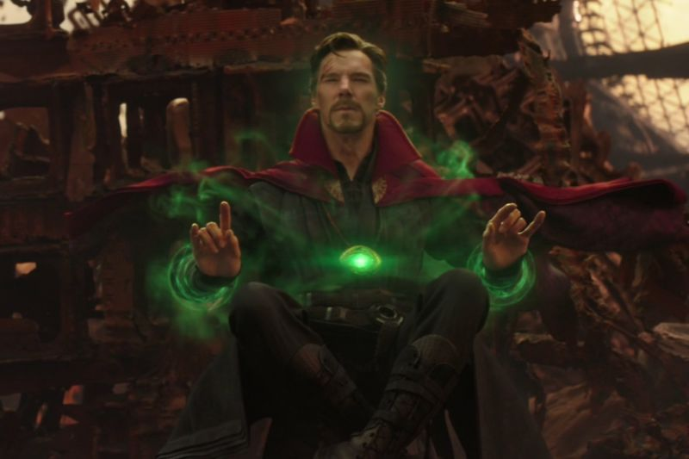
How does God view time?
Remember Jesus’ Teaching Techniques:
1) Ask good questions: Define terms? What is the deeper concern? Is there an actual contradiction?
2) Utilize a relatable story (a parable)
God is ABOVE & OVER time… He can see ALL possible outcomes.
1 Sam 23:6-14 What Saul would have done.

Slide 4
How does God view time?
Remember Jesus’ Teaching Techniques:
1) Ask good questions. 2) Tell a story (a parable)
Three other biblical tips:
1) Stay humble [Col 4:2-6] Mercy for doubters. Jude 22
2) Don’t overstate your case. Cf. Jesus’ trial. Be gentle & concise. [2 Tim 2:24-26]

Slide 5
How does God view time?
Remember Jesus’ Teaching Techniques:
1) Ask good questions. 2) Tell a story (a parable)
Three other biblical tips:
1) Humble & merciful [Col 4:2-6; Jude 22].
2) Don’t overstate your case. [2Tim 2:24-26]
3) FOCUS on the 1st Importance (1Cor 15:3). The fullness of time [Gal 3:23-4:7].
Therefore, humble yourselves under the mighty hand of God, that He may exalt you at the proper time. 1 Peter 5:6

