Slide 1
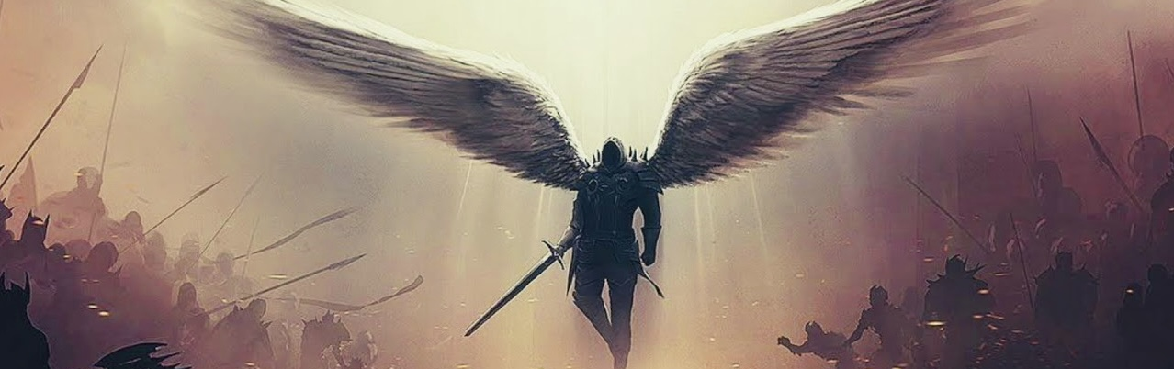
Psalm 18 A Psalm of David A Royal Song of Thanksgiving Thanksgiving for Deliverance by YHWH
Lament Psalms
Wisdom Psalms
Confidence Psalms
Enthronement Psalms
Praise Psalms
Historical Psalms
Thanksgiving Psalms
Songs of Zion Psalms
Psalms of Ascents
Messianic Psalms
Acrostic Psalms
Imprecatory Psalms

Slide 2
Close Encounters of the Lord's kind
tHEOPHANy

Slide 3
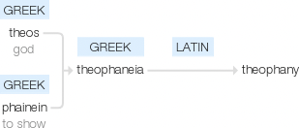
Theophany

Slide 4
Theophany
An appearance of YHWH
An appearance of YHWH (the invisible) in a form that allowed man to know YHWH (visible or audible manifestation).
A temporary appearance of YHWH revealed to a specific person(s) for a specific purpose.
A physical appearance of YHWH to a human being with a distinct commonality, ‘no one’ can see Him.
(FULL Glory of YHWH)

Slide 5
Non-human form
NATURE
ANIMALS
The Burning Bush (Exodus 3)
Pillar of Cloud and Fire (Exodus 13:20-22)
Mt. Sinai (Exodus 19)
Whirlwind or Tornado (Job 38:1)
A donkey speaks to Balaam - The Angel of YHWH Confronts Balaam. (Numbers 22:22-35)
A Great Fish (Jonah 1 & 2)

Slide 6
Visible manifestations
MEN
ANGELS
Appearing to Abraham & Sarah (Genesis 18)
Wrestling Jacob (Genesis 32)
The Fourth Man in the Fire (Daniel 3:16-28)
Hagar (Genesis 16 – El Roi, lit. God Who Sees)
Appearing to Abraham (Genesis 19)
Commander of the Lord’s Army Appears to Joshua (Joshua 5:13-15)
Gideon (Judges 6)
The Angel of the Lord Visits Manoah and His Wife (Judges 13)

Slide 7
Auditory manifestations
DIRECT VERBAL PROPHESY
INDIRECT PROPHESY
“Thus saith the LORD” | Number of times
Exodus | 10
Joshua | 2
Judges | 1
1 Samuel | 3
2 Samuel | 5
1 Kings | 13
2 Kings | 20
1 Chronicles | 4
2 Chronicles | 8
Isaiah | 35
Jeremiah | 148
Ezekiel | 126
Amos | 13
Obadiah | 1
Micah | 2
Nahum | 1
Haggai | 4
Zachariah | 18
Malachi | 1
Urim & Thummin (Exodus 28:30)

Slide 8
Visions & dreams
AWAKE
ASLEEP
“I saw all Israel scattered upon the hills” (1Kings 22:13-28)
“And the LORD said to Samuel” (1Samuel 3)
“In thoughts from the visions of the night” (Job 4)
“I saw also the LORD sitting upon a throne” (Isaiah 6)
“Four living creatures” (Ezekial 1)
“Daniel had a dream and visions…” (Daniel 7)
“Tell the vision to no man…” (Matt. 17:1-13)
“and to him said the LORD in a vision, Ananias…” (Acts 9)
“A great sheet knit at the four corners” (Acts 10:9-23)
“A great voice, as of a trumpet” (Rev 1)
Abimelech (Gen. 20)
Jacob (Gen. 28:12; 31:10, 11)
Laban (Gen. 31:24)
Joseph (Gen. 37:1-10; Gen. 40)
Pharoah (Gen. 41)
Unnamed Man (Judges 7:13)
Solomon (1Kings 3:5-15)
Nebuchadnezzar (Daniel 4)
Daniel (Daniel 7)
Joseph (Matt. 1 & 2)
Pontius Pilate’s wife (Matt. 27:19)

Slide 9
TYPOLOGY
Abraham & Isaac
The Ark of Noah (Flood)
Moses (Servant of YHWH, Prophet & Law-giver)
Melchizedek (King of Peace, High Priest)
Passover Lamb
Manna (Bread from Heaven)
Joshua (Servant of YHWH, Promised Land)
David (Servant of YHWH, Kingship)
Jonah (3 days & 3 nights)
Heavenly Father & His Beloved Son
The Church of Christ (Baptism)
The Word (Servant of YHWH, Prophet & Law-giver)
The Messiah (Prince of Peace, High Priest)
The Lamb of God
Savior (Bread of Life)
Yeshua (Servant of YHWH, Heaven)
The Son of David (Servant of YHWH, Kingship)
Immanuel (3 days & 3 nights)

Slide 10
The Messiah & Miracles
37 | Miracles of The Messiah
# | Miracle | Matthew | Mark | Luke | John
1 | The Messiah turns water into wine at the wedding in Cana |  |  |  | 2:1-11
2 | The Messiah heals an official's son at Capernaum in Galilee |  |  |  | 4:43-54
3 | The Messiah drives out an evil spirit from a man in Capernaum |  | 1:21-27 | 4:31-36
4 | The Messiah heals Peter's mother-in-law sick with fever | 8:14-15 | 1:29-31 | 4:38-39
5 | The Messiah heals many sick and oppressed at evening | 8:16-17 | 1:32-34 | 4:40-41
6 | The Messiah miraculous catch of fish on the Lake of Gennesaret |  |  | 5:1-11
7 | The Messiah cleanses a man with leprosy | 8:1-4 | 1:40-45 | 5:12-14
8 | The Messiah heals a centurion’s paralyzed servant in Capernaum | 8:5-13 |  | 7:1-10
9 | The Messiah heals a paralytic who was let down from the roof | 9:1-8 | 2:1-12 | 5:17-26
10 | The Messiah heals a man's withered hand on the Sabbath | 12:9-14 | 3:1-6 | 6:6-11

Slide 11
The Messiah & Miracles
37 | Miracles of The Messiah
# | Miracle | Matthew | Mark | Luke | John
11 | The Messiah raises a widow's son from the dead in Nain |  |  | 7:11-17
12 | The Messiah calms a storm on the sea | 8:23-27 | 4:35-41 | 8:22-25
13 | The Messiah casts demons into a herd of pigs | 8:28-33 | 5:1-20 | 8:26-39
14 | The Messiah heals a woman in the crowd with an issue of blood | 9:20-22 | 5:25-34 | 8:42-48
15 | The Messiah raises Jairus' daughter back to life | 9:18, 23-26 | 5:21-24, 35-43 | 8:40-42, 49-56
16 | The Messiah heals two blind men | 9:27-31
17 | The Messiah heals a man who was unable to speak | 9:32-34
18 | The Messiah heals an invalid at Bethesda |  |  |  | 5:1-15
19 | The Messiah feeds 5,000 plus women and children | 14:13-21 | 6:30-44 | 9:10-17 | 6:1-15
20 | The Messiah walks on water | 14:22-33 | 6:45-52 |  | 6:16-21

Slide 12
The Messiah & Miracles
37 | Miracles of The Messiah
# | Miracle | Matthew | Mark | Luke | John
21 | The Messiah heals many sick in Gennesaret as they touch his garment | 14:34-36 | 6:53-56
22 | The Messiah heals a gentile woman's demon-possessed daughter | 15:21-28 | 7:24-30
23 | The Messiah heals a deaf and dumb man |  | 7:31-37
24 | The Messiah feeds 4,000 plus women and children | 15:32-39 | 8:1-13
25 | The Messiah heals a blind man at Bethsaida |  | 8:22-26
26 | The Messiah heals a man born blind by spitting in his eyes |  |  |  | 9:1-12
27 | The Messiah heals a boy with an unclean spirit | 17:14-20 | 9:14-29 | 9:37-43
28 | The Messiah temple tax in a fish's mouth | 17:24-27
29 | The Messiah heals a blind, mute demoniac | 12:22-23 |  | 11:14-23
30 | The Messiah heals a woman who had been crippled for 18 years |  |  | 13:10-17

Slide 13
The Messiah & Miracles
37 | Miracles of The Messiah
# | Miracle | Matthew | Mark | Luke | John
31 | The Messiah heals a man with dropsy on the sabbath |  |  | 14:1-6
32 | The Messiah cleanses ten lepers on the way to Jerusalem |  |  | 17:11-19
33 | The Messiah raises Lazarus from the dead in Bethany |  |  |  | 11:1-45
34 | The Messiah restores sight to Bartimaeus in Jericho | 20:29-34 | 10:46-52 | 18:35-43
35 | The Messiah withers the fig tree on the road from Bethany | 21:18:22 | 11:12-14
36 | The Messiah heals a servant's severed ear while he is being arrested |  |  | 22:50-51
37 | The Messiah second miraculous catch of fish at the Sea of Tiberias |  |  |  | 21:4-11

Slide 14
Five similar characteristics of theophanies
A God-initiated encounter
An introductory description
Declarations of deity
Divine self-asseveration
Miraculous actions and knowledge
Divine speech
Comforting statements
Quelling of human fear
Worship of God ensued because of the encounter
Dedications

