Slide 2
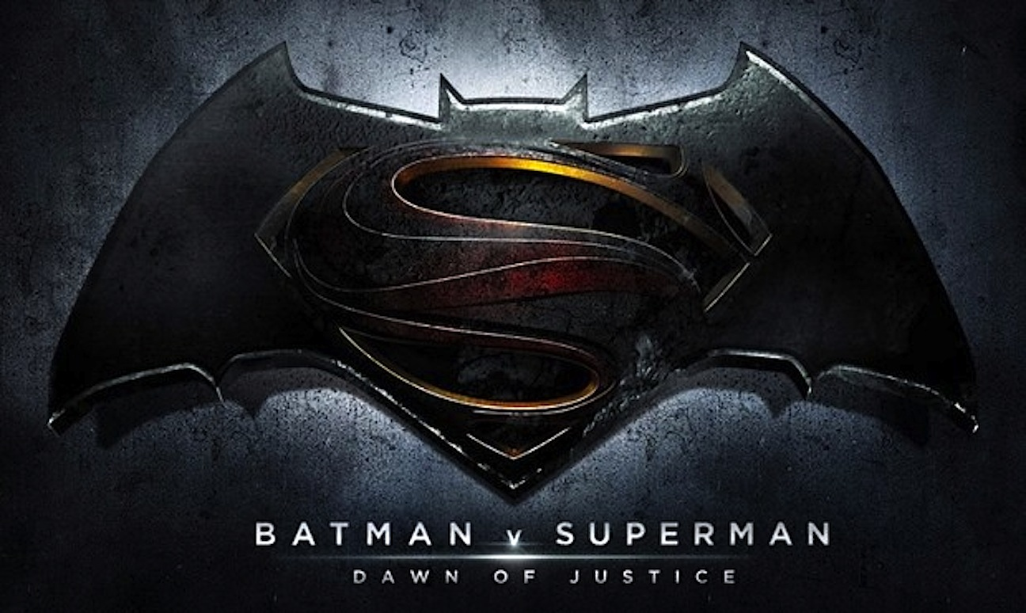
That’s Not Fair

Slide 3
Why does man long for justice?
Despite great efforts, will we ever achieve justice?
Sadly, Christians also regularly fall short [Rom 7:14-24]
Yet, most men keep seeking their definition of justice.
This emotion is an open door for Jesus.

Slide 4
Why does man long for justice?
This emotion is an open door for Jesus.
Jehovah from the start desires justice. Gen 18:19
The Law warns of perverting justice. Eg Dt 16:19
A key trait throughout key OT stories. [1 Ki 3:28]
Job cries out for it & Elihu responds [Job 35:1-9]

Slide 5
Why does man long for justice?
This emotion is an open door for Jesus.
Every part of the OT emphasizes justice.
But the prophets, especially Isaiah, say the most:
Jehovah loves justice! [61:8] Looks for it [5:7] Knows it well [40:14] Promises a Just King [9:6-7]
Thankfully, the King serves w/ justice [41:25-42:4]
So, it’s no surprise Jesus blesses peacemakers Mt 5:9
And we are to work for Peace/Reconciliation 2Cor5:20

Slide 6
Why does man long for justice?
This emotion is an open door for Jesus.
Every part of the OT emphasizes justice.
The prophets, Jesus, & Paul see justice & peace.
So, are we made in the image of a Just God?
Does He offer forgiveness b/c He is just?
Are we ready to face an impartial God? Does He see a passion for justice in us?

