Slide 1
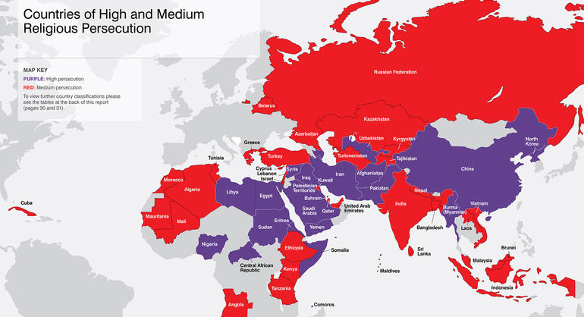
What Else Did Jesus Promise? PERSECUTION
Acts 2:42 Jesus’ first followers were
Devoted to The Apostles’ teaching…
[Mt 10:16-39] They were promised
The Holy Spirit & Persecution
persecution.com
christianfreedom.org

Slide 2
What Did Jesus Promise? Persecution
The Apostles Expected Persecution [Mt 10:16-39] Jesus permitted running. 10:23 [Ac 9:23-25]
He didn’t permit “just warfare” [Lk 22:35-53]
God avenged Paul’s crimes [Ac9:13-15;2Co11:23ff]
Peter Also Warned His Flock [1Pet 4:12-19]
Jesus is our example [1Pet 2:18-25]
Paul warns of it at the start [Ac 14:19-22]
And in his “last words” to Timothy [2Ti 3:10-14]

Slide 3
What Did Jesus Promise? Persecution
The Apostles Expected Persecution [Mt 10:16-39] Peter Also Warned His Flock [1Pet 4:12-19]
Tacitus, a Roman historian, records Nero’s efforts.
The Martyrdom of Polycarp ca. 150AD
Swear by the fortune of Caesar; repent, and say, “Away with the (Christians)." But Polycarp, gazing with a stern countenance on all the multitude of the wicked heathen then in the stadium, and waving his hand towards them, while with groans he looked up to heaven, said, "Away with the Atheists." Then, the proconsul urging him, and saying, "Swear, and I will set thee at liberty, reproach Christ;" Polycarp declared, "Eighty and six years have I served Him, and He never did me any injury: how then can I blaspheme my King and my Savior?"

Slide 4
What Did Jesus Promise? Persecution
Persecution Records Outside of Scripture
Pliny’s Letters to Emperor Trajan ca. 100AD
It is my practice, my lord, to refer to you all matters concerning which I am in doubt. For who can better give guidance to my hesitation or inform my ignorance? I have never participated in trials of Christians…
…I have observed the following procedure: I interrogated these as to whether they were Christians; those who confessed I interrogated a second and a third time, threatening them with punishment; those who persisted I ordered executed. For I had no doubt that, whatever the nature of their creed, stubbornness and inflexible obstinacy surely deserve to be punished…

Slide 5
What Did Jesus Promise? Persecution
Persecution Records Outside of Scripture
Tacitus, Roman historian, records Nero’s fires. Martyrdom of Polycarp describes his flight & plight. Pliny’s Letters to Trajan records early Christian trials.
Most early persecutions were from local laws & rulers.
There was fear Christianity upset their ordered society.
Christians appeared to be rebels. [Ac 16:19-21 & 17:6-8]
So, the NT urges good citizenship (Rom13; 1Tim2; 1Pet2)

Slide 6
What Did Jesus Promise? Persecution
“The most significant aspect of the dispute between Arius & Alexander in 322 is that there was so little about it that was new. At least at the outset, it is arguable that the controversy between the two men had more to do with local autonomy & the structure of the church in Alexandria than with doctrine.”
-Constantine The Emperor by David Potter
The Apostles Expected Persecution [Mt 10:16-39 Historical Records Confirm It Happened Pliny The NT urges good citizenship (Rom 13; 1Tim 2; 1Pet 2) There Were A Variety of Appropriate Responses
But Then There Was An Enormous Transition
In the 300s Emperor Constantine has a “conversion.” He invites bishops to Nicaea & pays for their travel.
Finally, Augustine becomes exhausted with false teachers. In the 400s he justifies using force with [Lk 14:16-24]
Priscillian of Spain in 383AD.
A bishop for a “house church.”
Maximus, ruler in The West condemned him & six followers. Three other bishops lamented this secular interjection & subsequently excommunicated all the bishops involved.

